Slide 1

Interpreting Group and Individual Change: Minimally Important Difference Versus Responder
Ron D. Hays, Ph.D.
Guest Lecture in PEP 8561
March 31, 2022 (9:30 am -12:20 pm ET)

Slide 2

SF-36 in HIV versus other chronic conditions
(Hays et al. (2000). American Journal of Medicine, 2000)
Worse Health
Better health
Jacob Cohen’s rules of thumb
0.2 SD = small; 0.5 SD = medium; 0.8 SD = large
T-score (mean = 50, SD = 10)
MS = multiple sclerosis; ESRD = end-stage renal disease; GERD = gastroesophageal reflux disease.

Slide 3
SF-36 in HIV versus other chronic conditions
and U.S. General Population
Worse Health
Better Health
T-score metric
MS = multiple sclerosis; ESRD = end-stage renal disease; GERD = gastroesophageal reflux disease.

Slide 4
SF-36 in HIV versus other chronic conditions
and U.S. General Population
Worse Health
Better Health
T-score metric
MS = multiple sclerosis; ESRD = end-stage renal disease; GERD = gastroesophageal reflux disease.

Slide 5
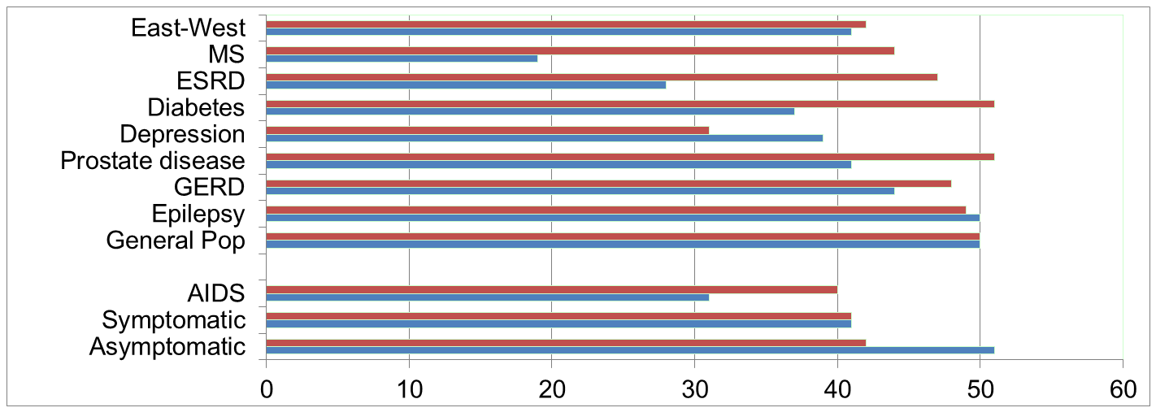
SF-36 Physical Functioning and Emotional Well-Being at Baseline for 54 UCLA Center for East West Medicine Patients
EWB
Physical
Hays, R. D., Brodsky, M., Johnston, M. F., Spritzer, K. L., & Hui, K. (2005). Evaluating the statistical significance of health-related quality of life change in individual patients. Evaluation and the Health Professions, 28, 160-171.
MS = multiple sclerosis; ESRD = end-stage renal disease; GERD = gastroesophageal reflux disease.
5

Slide 6
Patients seen at UCLA Center for East-West Medicine
Have a variety of illnesses:
  Chronic pain conditions such as neck and back pain, headaches, fibromyalgia, sports and occupational-related injuries, and cancer-related symptoms.
Therapeutic techniques include:
  Patient education, medication adjustments, trigger point injections, acupuncture, acupressure, therapeutic massage, dietary and herbal counseling, and mind-body exercises

Slide 7
SF-36 Physical Functioning and Emotional Well-Being at Baseline for 54 UCLA Center for East West Medicine Patients
EWB
Physical
Hays, R. D., Brodsky, M., Johnston, M. F., Spritzer, K. L., & Hui, K. (2005). Evaluating the statistical significance of health-related quality of life change in individual patients. Evaluation and the Health Professions, 28, 160-171.
MS = multiple sclerosis; ESRD = end-stage renal disease; GERD = gastroesophageal reflux disease.
7

Slide 8
Significant Improvement in all but 1 of SF-36 Scales (3-month change in T-scores)
Change
t-test
prob.
PF-10
1.7
2.38
.0208
RP-4
4.1
3.81
.0004
BP-2
3.6
2.59
.0125
GH-5
2.4
2.86
.0061
EN-4
5.1
4.33
.0001
SF-2
4.7
3.51
.0009
RE-3
1.5
0.96
.3400
EWB-5
4.3
3.20
.0023
PCS
2.8
3.23
.0021
MCS
3.9
2.82
.0067

Slide 9
Effect Size
(Follow-up – Baseline)/ SD_{baseline}
_{Cohen’s Rule of Thumb:}
_{ES = 0.20 Small}
_{ES = 0.50 Medium}
_{ES = 0.80 Large}

Slide 10
Effect Sizes for Changes in SF-36 Scores
Effect Size
0.13
0.35
0.35
0.21
0.53
0.36
0.11
0.41
0.24
0.30
PFI = Physical Functioning; Role-P = Role-Physical; Pain = Bodily Pain; Gen H=General Health; Energy = Energy/Fatigue; Social = Social Functioning; Role-E = Role-Emotional; EWB = Emotional Well-being; PCS = Physical Component Summary; MCS =Mental Component Summary.

Slide 11

Minimally Important Difference (MID)
“Smallest difference in a score that is considered to be worthwhile or important”
  Hays & Wooley, 2000, Pharmacoeconomics
Cohen’s effect size rule of thumb
  0.2 SD = small; 0.5 SD = medium; 0.8 SD = large
This Photo by Unknown Author is licensed under CC BY-NC

Slide 12


Slide 13
Change in SF-36 Physical Functioning for one Adult Male
Baseline = 100 (U.S. males mean = 87, SD = 20)
Hit by a motorcycle causes me to be
limited a lot in vigorous activities
limited a lot in climbing several flights of stairs.
limited a little in moderate activities,
Physical functioning drops to 75 (- 1.25 SD, large)
Hit by a bicycle causes me to be
limited a little in vigorous activities
Physical functioning drops to 95 (- 0.25 SD, small)
Note: 0-100 possible range of scoring used for this example.

Slide 14
Minimally Important Difference (MID) Retrospective Rating of Change Anchor Item
We would like know about any changes in how you are doing now compared to 6 months ago.
Has your ability to carry out your everyday physical activities such as walking, climbing stairs, carrying groceries, or moving a chair …
  Got a lot better?
  Got a little better?
  Stayed the same?
  Got a little worse?
  Got a lot worse?

Slide 15
Raw Score Change (12 months) on PROMIS Physical Function (T-score) by Change on Retrospective Change Anchor
 | Lot Better | Little Better | Same | Little Worse | Lot Worse
 | (n = 21) | (n = 35) | (n = 252) | (n = 113) | (n = 30)
Change | 1.94ª | 1.63^{a,b} | 0.27^{b} | -1.68^{c} | -3.20^{d}
Hays, R.D., Spritzer, K. L., Fries, J. F., & Krishnan, E. (2015). Responsiveness and minimally important
difference for the Patient-Reported Outcomes Measurement and Information System (PROMIS) 20-Item
Physical Functioning Short-Form in a Prospective Observational study of Rheumatoid Arthritis. Annals of
the Rheumatic Diseases. 74(1):104-7.

Slide 16
Distribution-based MID “estimates”
Norman et al. (2003). Remarkable universally of ½ SD.
- MID estimates were often close to ½ SD (Cohen’s medium effect size)
- 1 SEM is approximately 0.5 SD when the reliability is 0.75.
The so-called “distribution-based” methods of estimating the MID provide no direct information. These indices express observed change in a standardized metric (i.e. SD). Expressing scores that use a different raw score metric in terms of how much of a SD they represent facilitates comparisons but a half of the SD is not an estimate of the minimally important change in a measure.
Why should 1 SEM have anything to do with the MID? The SEM is the product of the standard deviation and the square root of 1- reliability of the measure. It is used to set the confidence interval (CI) around an individual score:
Observed (or estimate true) score plus or minus 1.96 SEMs is the 95% CI.
(1 SEM is ~ 68% CI)
Anchor-based methods are the only way to estimate the MID.

Slide 17
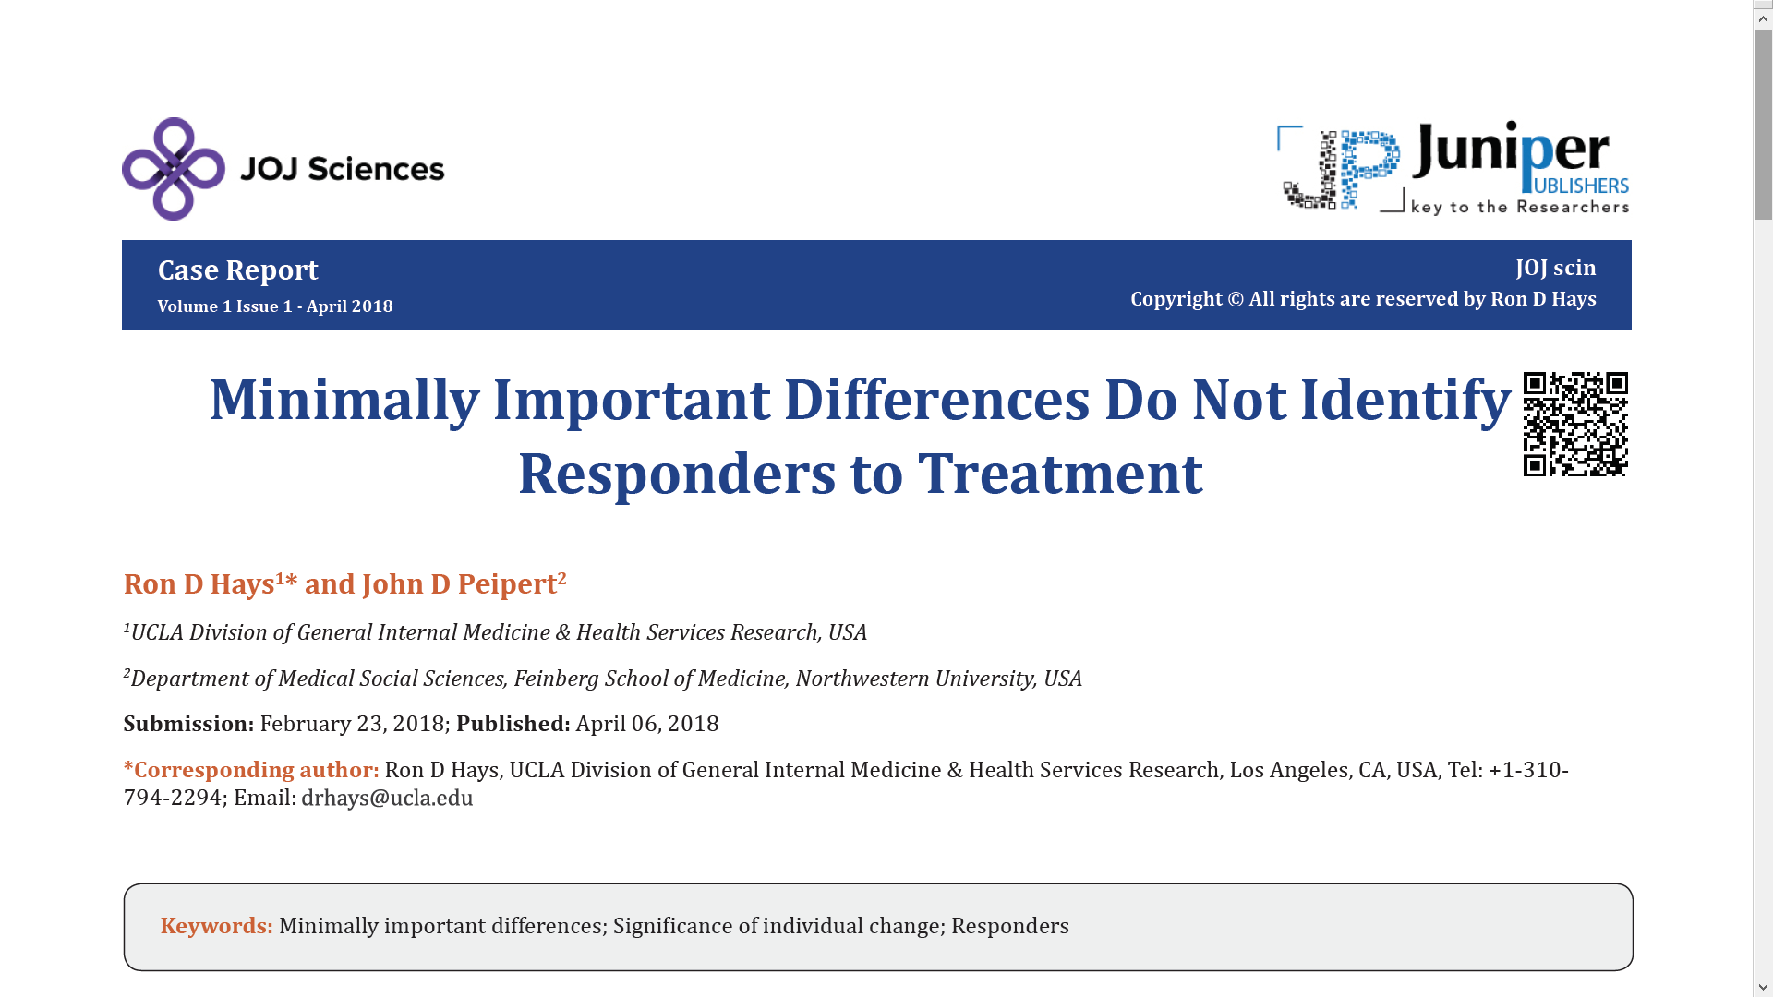

Slide 18
How do you identify the individuals in a study that are “responders”?
Time series data is ideal, but requires 10 or more assessments per person
  10+ per subject (Borckardt et al. 2008)
  15 per subject (Moinpour et al. 2017)
Notes:
Collecting multiple observations for each participant is required to estimate individual variation, but the number of data points needed is prohibitive for almost all patient-reported outcome studies: at least 10 and up to 15 observations per subject. Therefore, I will focus on two time points,

Slide 19
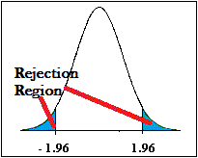
Identifying “Responders”: Reliable Change Index (RCI)
>= 1.96
SEM = standard error of measurement
SD_{bl} = standard deviation at baseline
r_{xx} = reliability
Jacobson and Truax (1991)
Notes:
Jacobson first proposed the reliable change index in 1984 when he was 35 years old. The original formula did not have the square root of 2 term. Christensen and Mendoza pointed out this omission in a letter to the editor in 1986.
This slide provides the revised reliable change index formula described by Jacobson and Truax 31 years ago.

Slide 20
Identifying “Responders”: Reliable Change Index (RCI)
>= 1.96
SEM = standard error of measurement
SD_{bl} = standard deviation at baseline
r_{xx} = reliability
Jacobson and Truax (1991)
Notes:
Jacobson was a psychology professor at the University of Washington whose research included studies of depression, domestic violence and the efficacy of marital therapy. Unfortunately, he died of a heart attack on June 1, 1999 at age 50 in Las Vegas before a workshop where he was going to speak about domestic violence.

Slide 21
Amount of Change in Observed Score Needed To be Statistically Significant
= 2.77 *
SD
∗
1
−
r
= 2.77 * SEM
xx
“Coefficient of repeatability” (aka “minimally detectable change,” “smallest real difference,” and “smallest detectable change”).
Note: SD = standard deviation and r_{xx} = reliability
Notes:
The coefficient of repeatability is a re-expression of the RCI that indicates the change needed for statistical significance. Shown here is the coefficient of repeatability formula for probability of 0.05—that is, 2.77 times the SEM.
This coefficient is also known as the minimally detectable change, smallest detectable change, and smallest real difference.

Slide 22
Amount of Change in Observed Score
Needed for Significant Individual Change
Scale
Coefficient of Repeatability
Effect size
Cronbach’s alpha
PF-10
8.4
0.67
0.94
RP-4
8.4
0.72
0.93
BP-2
10.4
1.01
0.87
GH-5
13.0
1.13
0.83
EN-4
12.8
1.33
0.77
SF-2
13.8
1.07
0.85
RE-3
9.7
0.71
0.94
EWB-5
13.4
1.26
0.79
PCS
7.1
0.62
0.94*
MCS
9.7
0.73
0.93*
*Mosier’s formula (not coefficient alpha).
See: https://labs.dgsom.ucla.edu/hays/pages/programs_utilities

Slide 23
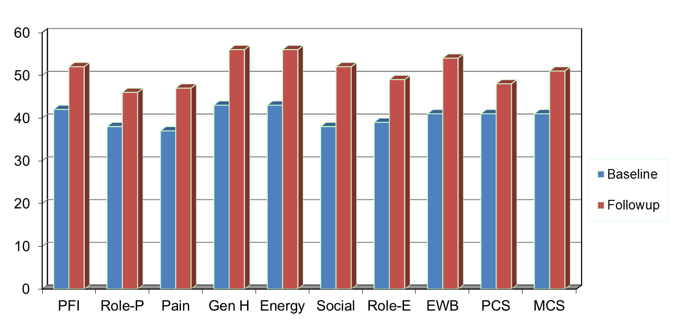
Amount of Change Needed for Significant Individual Change
Effect Size
0.67
0.72
1.01
1.13
1.33
1.07
0.71
1.26
0.62
0.73
PFI = Physical Functioning; Role-P = Role-Physical; Pain = Bodily Pain; Gen H=General Health; Energy = Energy/Fatigue; Social = Social Functioning;
Role-E = Role-Emotional; EWB = Emotional Well-being; PCS = Physical Component Summary; MCS =Mental Component Summary.

Slide 24
Appropriate coefficients of repeatability are two-to-three times larger than the 5-point change threshold.
Notes:
Abu et al used MID thresholds to identify whether patients improved or declined on the Atrial Fibrillation Effect QualiTy-of-Life Questionnaire. A five-point threshold was used for “clinically meaningful change.”
This threshold was based on group-level MID estimates from a prior study that used physician assessment of functional status.
The authors concluded that 22% declined and 40% improved from baseline to 1 year later in a sample of 1097 older adults with atrial fibrillation.

Slide 25
7-31% of People in Sample Improve Significantly
% Improving
% Declining
Improving - Declining
PF-10
13%
2%
+ 11%
RP-4
31%
2%
+ 29%
BP-2
22%
7%
+ 15%
GH-5
7%
0%
+ 7%
EN-4
9%
2%
+ 7%
SF-2
17%
4%
+ 13%
RE-3
15%
15%
0%
EWB-5
19%
4%
+ 15%
PCS
24%
7%
+ 17%
MCS
22%
11%
+ 11%

Slide 26
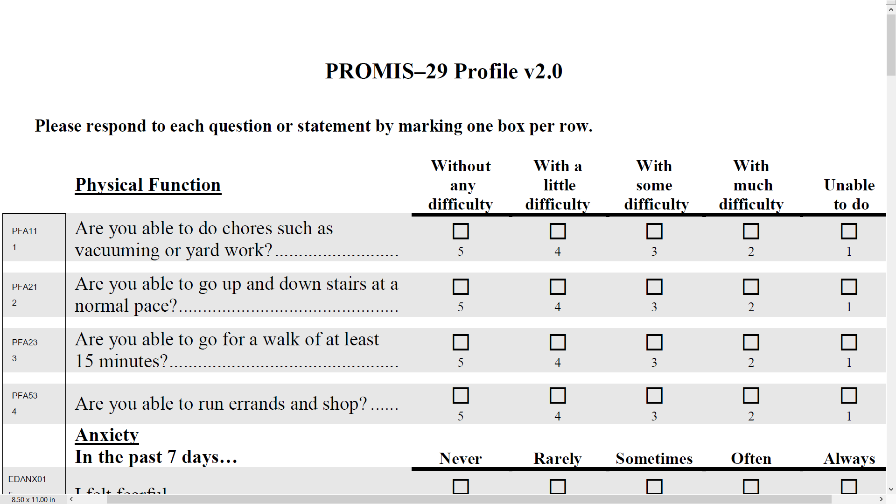

Slide 27
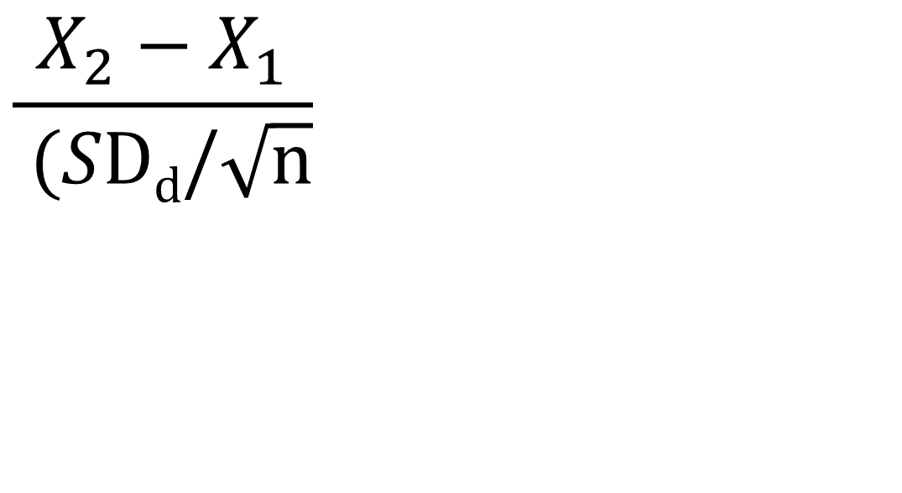
Group-Level Change in Physical Function in 2024 chiropractic patients:
Baseline (46) to 3 months Later (47)
--
--
>= 1.96
)
Within group t-test = 4.15
Effect size = Numerator/SD_{b} = 0.08

Slide 28
Reliable Change Index (RCI)
>= 1.96
13% Got Better (Responders)
9% Got Worse
78% Stayed the Same

Slide 29

Break

Slide 30
Notes:
This slide provides the denominators for 4 indices used to estimate significant individual change that include the SD and reliability. The numerator for all indices is individual change from baseline to follow-up. You should recognize the last one from what we talked about before the break, the reliable change index. The reliable change index is the one most often used for estimating significant individual change. When the absolute value of an index is 1.96 or larger, the individual is deemed to have changed significantly at p <.05.

Slide 31
Notes:
When reliability is high (around 0.90 or higher), the SEM and the standard error of estimation yield similar estimates of significant individual change.

Slide 32
Notes:
And the standard error of prediction and the reliable change index produce similar estimates

Slide 33
3 & 4 > 1 & 2
Notes:
In addition, bigger change is needed to reach significance for the standard error of prediction and the reliable change index than for the SEM and standard error of estimation.

Slide 34
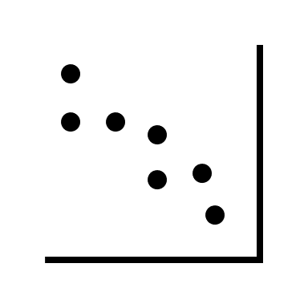
An editor’s comments
Methods based on between individual variance estimates are not admissible to classify within-individual changes.
Needs to be supported by an appropriate ontological/ epistemological justification for the use of this method for that level of analysis. As the indices are all based on between-individual variances and between-individual test-retest correlations, claiming these can be used to classify individuals needs a robust justification.
Use SD_{change} or within subject SD?
Notes:
The standard deviation between respondents is often used in these individual change formulas. An editor suggested that estimating significant individual change using this standard deviation is inappropriate without justification.
- It is possible to use the SD of change or within subject SD instead of SD at baseline in the denominators of the individual change indices.

Slide 35
Analogous to Responsiveness Indices
Effect size (ES) = D/SD_{b}
(2) Standardized Response Mean (SRM) = D/SD†
(3) Guyatt responsiveness statistic (RS) = D/SD‡
D = raw score change in “changed” group
SD_{b} = baseline SD
SD† = SD of D
SD‡ = SD of D among “unchanged”
Notes:
Doing so is analogous to using the standardized response mean or Guyatt’s responsiveness statistic to estimate a measure’s responsiveness to change.
Each of these three indices have group mean change in the numerator and SD in the denominator. The effect size has the SD at baseline while the standardized response mean has the SD of change.
The Guyatt index is desirable because it uses a pure measure of noise, the SD of change among those deemed not to have changed based on other information.

Slide 36
Reeve et al. (2013, p. 1895)
“ISOQOL respondents … did not support as a minimum standard that a multi-item PRO measure should be required to have evidence of test–retest reliability…. They noted practical concerns regarding test–retest reliability; primarily that some populations studied in PCOR are not stable and that their HRQOL can fluctuate. This phenomenon would reduce estimates of test–retest reliability, making the PRO measure look unreliable when it may be accurately detecting changes over time. In addition, memory effects will positively influence the test–retest reliability when the two survey points are scheduled close to each other.”
Notes:
Limitations in using test-retest reliability were noted by an International Society of Quality of Life Research advisory task force lead by Bryce Reeve that surveyed 120 ISOQOL members.
In the article published in Quality of Life Research, the authors noted practical concerns estimating test-retest reliability such as the difficulty ensuring people have not changed.

Slide 37
Change needed to be statistically significant (p <.05) in 316 low back pain patients over 6 weeks
1 2 3 4 5 6
PROMIS-29 Scale | SD_{baseline} _{n = 316} | SD_{change} _{n = 316} | SD_{change}* n = 119 | MS_{within}+ n = 119 | TE& n = 119
Physical function | 6 | 11 ↑ | 8 ↑ | 11 ↑ | 11 ↑
Pain interference | 5 | 16 ↑ | 11 ↑ | 13 ↑ | 12 ↑
Pain intensity | 12 | 15 ↑ | 10 ↓ | 13 ↑ | 13 ↑
Fatigue | 7 | 16 ↑ | 15 ↑ | 17 ↑ | 17 ↑
Sleep disturbance | 9 | 11 ↑ | 9 | 12 ↑ | 12 ↑
Depression | 6 | 10 ↑ | 9 ↑ | 11 ↑ | 11 ↑
Anxiety | 8 | 14 ↑ | 13 ↑ | 15 ↑ | 15 ↑
Ability to participate | 5 | 18 ↑ | 15 ↑ | 15 ↑ | 16 ↑
* Among 119 who reported they did not change. ⁺ Bland & Altman (1996). & Swinton et al. (2018)
Notes:
This slide shows an example of coefficient of repeatability estimates obtained based on the reliable change index in a sample of low back pain patients who completed the PROMIS-29 at baseline and 6 weeks later. Five different estimates are shown in columns 2-6. The second column is for the SD at baseline, the third column is for the SD of change, the fourth is for the SD of change among those retrospectively reporting that they had not changed, the fifth column uses the within subject SD suggested by Bland and Altman, and column six is based on a typical error method popular in sports medicine.

Slide 38
Change needed to be statistically significant (p <.05) in 316 low back pain patients over 6 weeks
1 2 3 4 5 6
PROMIS-29 Scale | SD_{baseline} _{n = 316} | SD_{change} _{n = 316} | SD_{change}* n = 119 | MS_{within}+ n = 119 | TE& n = 119
Physical function | 6 | 11 ↑ | 8 ↑ | 11 ↑ | 11 ↑
Pain interference | 5 | 16 ↑ | 11 ↑ | 13 ↑ | 12 ↑
Pain intensity | 12 | 15 ↑ | 10 ↓ | 13 ↑ | 13 ↑
Fatigue | 7 | 16 ↑ | 15 ↑ | 17 ↑ | 17 ↑
Sleep disturbance | 9 | 11 ↑ | 9 | 12 ↑ | 12 ↑
Depression | 6 | 10 ↑ | 9 ↑ | 11 ↑ | 11 ↑
Anxiety | 8 | 14 ↑ | 13 ↑ | 15 ↑ | 15 ↑
Ability to participate | 5 | 18 ↑ | 15 ↑ | 15 ↑ | 16 ↑
* Among 119 who reported they did not change. ⁺ Bland & Altman (1996). & Swinton et al. (2018)
Notes:
The standard deviation at baseline, as shown in Column 2, consistently yielded the smallest coefficients of repeatability, meaning it would indicate more people have changed. Estimates in columns 3-6 were larger and relatively similar to one another.

Slide 39
Change needed to be statistically significant (p <.05) in 316 low back pain patients over 6 weeks
1 2 3 4 5 6
PROMIS-29 Scale | SD_{baseline} _{n = 316} | SD_{change} _{n = 316} | SD_{change}* n = 119 | MS_{within}+ n = 119 | TE& n = 119
Physical function | 6 | 7 ↑ | 5 ↓ | 11 ↑ | 11 ↑
Pain interference | 5 | 6 ↑ | 4 ↓ | 13 ↑ | 12 ↑
Pain intensity | 12 | 15 ↑ | 10 ↓ | 13 ↑ | 13 ↑
Fatigue | 7 | 6 ↓ | 6 ↓ | 17 ↑ | 17 ↑
Sleep disturbance | 9 | 8 ↓ | 7 ↓ | 12 ↑ | 12 ↑
Depression | 6 | 5 ↓ | 5 ↓ | 11 ↑ | 11 ↑
Anxiety | 8 | 8 | 7 ↓ | 15 ↑ | 15 ↑
Ability to participate | 5 | 5 | 4 ↓ | 15 ↑ | 16 ↑
* Among 119 who reported they did not change. ⁺ Bland & Altman (1996). & Swinton et al. (2018)
Notes:
If coefficient alpha is used instead of test-retest reliability in the coefficient of repeatability formulas for the SD of change columns, their estimates are similar to those based on the SD at baseline.

Slide 40
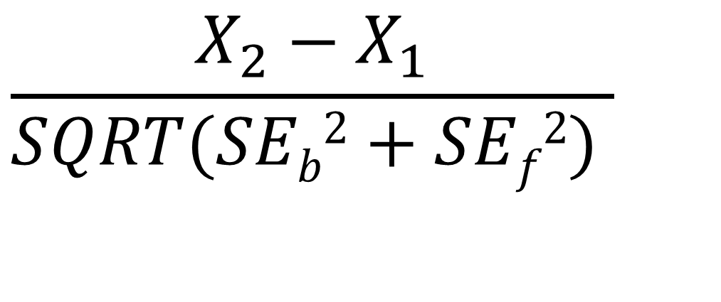
Reliable Change Index (IRT)
$$\frac{X_{2}−X_{1}}{SQRT(SEb2+SEf2) }$$
SE_{b}² = Variance at baseline, SE_{f}² = Variance at follow-up
Jabrayilov et al. (2016). Comparison of classical test theory
and item response theory in individual change assessment.
Appled Psychological Measurement, 40(8), 559-572.
Notes:
Here is the reliable change index that has been used to assess measures calibrated using item response theory
Note that the denominator uses the SEs at baseline and follow-up.
(Standard errors are obtained using the information function. Expected A Posterior (EAP) estimates of physical function scores were estimated.)

Slide 41
PROMIS-29 Physical Function and Emotional Distress Measures
PROMIS-29 Measure | Baseline Mean | 3-month later Mean | t | Effect Size
Physical function | 46 | 47 | 4.15 | .08
Emotional Distress | 50 | 50 | 0.04 | .01
Emotional distress = mean of 4-item depression and 4-item anxiety scales
Notes:
Individual change was examined previously in two waves of PROMIS-29 data collected from a sample of 1834 chiropractic patients with chronic low back or neck pain receiving care from 125 clinics throughout the U.S. This prior publication was limited to the classical test theory reliable change index.

Slide 42
PROMIS-29 Physical Function and Emotional Distress Measures
PROMIS-29 Measure | Baseline Mean | 3-month later Mean | t | Effect Size
Physical function | 46 | 47 | 4.15 | .08
Emotional Distress | 50 | 50 | 0.04 | .01
Emotional distress = mean of 4-item depression and 4-item anxiety scales
Notes:
Shown here are mean scores at baseline and 3 months later for the 4-item PROMIS-29 physical function scale and the 8-item emotional distress composite. The change in physical function of 1 T-score point was statistically significant because of the large sample size while emotional distress stayed the same.
Next, I show comparisons of classical test theory and IRT for change in physical function. Conclusions based on emotional distress were similar and are not shown.

Slide 43
78%
91%
Spearman rank-order correlation = 0.54
Notes:
This shows the number of people in the sample of 1834 classified as becoming significantly worse, staying the same, or significantly better on physical function from baseline to 3 months later.
IRT is shown in the columns and classical test theory is shown in the rows. Bold entries indicate agreement in classification.
A lot more of the sample was classified as staying the same from IRT than classical test theory (91% versus 78%). The Spearman rank-order correlation between the two ways of estimating significant individual change was only 0.54.

Slide 44
99%
Notes:
Of the 1425 individuals that were classified as the same according to CTT, 99% were also classified as the same by IRT.

Slide 45
27%
Notes:
But only 27% of the 173 people that were worse according to CTT were classified as such by IRT.

Slide 46
38%
Notes:
Similarly, only 38% of the 236 people classified as better by CTT were deemed better by IRT.

Slide 47
*Δ = -13.7
SEM = 2.6, RCI_{CTT} = 3.7 versus SE = 7.1, RCI_{IRT} = 1.93
Notes:
This shows an example of a case that was classified as getting significantly worse by classical test theory but staying the same by IRT. The decrease in physical function of 14 points and fixed standard error of measurement of 2.6 yielded a reliable change index of 3.7 which easily exceeded the 1.96 threshold.
But IRT indicated a much greater standard error and the reliable change index of 1.93 was not quite significant.

Slide 48
Physical Function Simulation
Simulated change in physical function ranging from 1 to 6 SDs in true thetas (z-scores)
-3 to -2, -3 to -1, -3 to 0, -3 to 1, -3 to 2, -3 to 2, -3 to 3
-2 to -1, -2 to 0, -2 to 1, -2 to 2, -2 to 3
-1 to 0, -1 to 1, -1 to 2, -1 to 3
0 to 1, 0 to 2, 0 to 3
1 to 2, 1 to 3
2 to 3
For true theta change from -3 to -2, 67% of the time when CTT indicated improvement, IRT classified as same.
Notes:
Change in physical function of different thetas was simulated. Results were consistent with the observed data reported earlier. For example, for a change from a z-score of -3 to -2, when classical test theory classified someone as improved, 67% of the time IRT indicated they stayed the same.

Slide 49
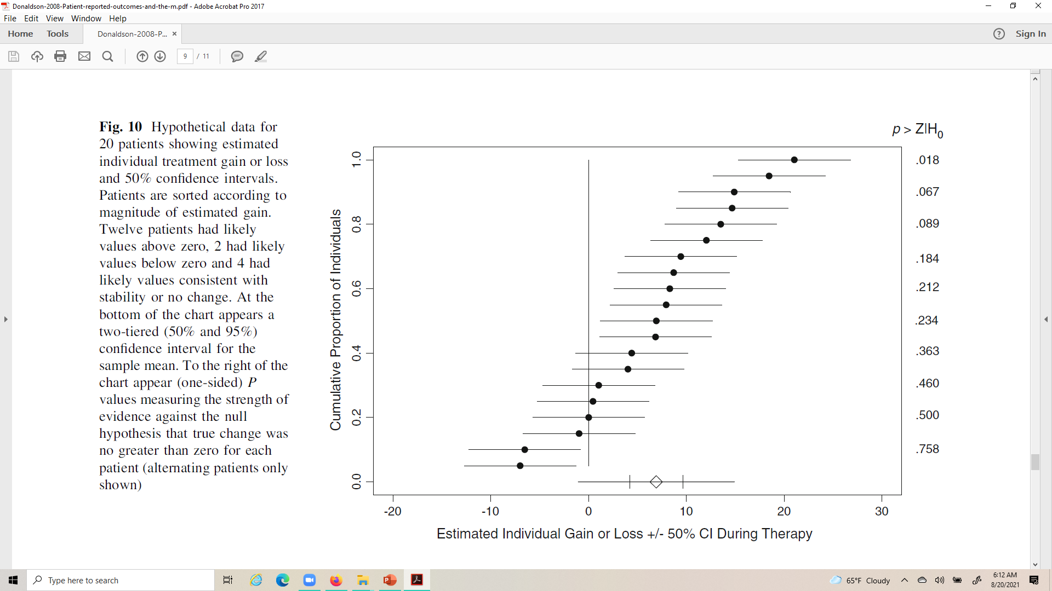
Likely Change (Donaldson, 2008)
Notes:
Gary Donaldson published a paper in Quality of Life Research providing arguments for examining likely individual change. In this figure from the article, he showed change and 50% confidence intervals for 20 hypothetical patients.
The likely values suggest

Slide 50




Likely Change (Donaldson, 2008)
Notes:
positive change for 12 of the patients,

Slide 51

Likely Change (Donaldson, 2008)
Notes:
No change for 6 patients, and

Slide 52

Likely Change (Donaldson, 2008)
Notes:
negative change for 2 patients.

Slide 53

Likely Change (Donaldson, 2008)
Notes:
One-sided probabilities that the individual’s change was greater than zero appear on the far right. The first two patients at the top are the only ones that changed significantly at p < .05. At the bottom are 95% and 50% confidence intervals for group mean change.
The 95% confidence interval for group mean change overlaps with zero but the 50% confidence interval does not.

Slide 54
Peer Reviewer’s Comment
If a person's change surpasses the RCI-50% threshold it means that, if the person were unchanged, probability of observing that change is 50%.
What does this tell us about the how likely it is that the person has really changed?
The scores observed are likely even if the person has not changed.
Notes:
In contrast to Donaldson, a peer reviewer argued that use of the 50% threshold to assess likely change is problematic because the
* observed change is likely even if the person has not actually changed.

Slide 55
CR (two-tailed): 2.77*SEM
CR (one-tailed): 2.33*SEM
Notes:
This table presents classification of people on physical function that represents a compromise between Donaldson and the peer review. Data is from the U.S. chiropractic sample reported earlier.

Slide 56


Notes:
Those who significantly changed at p < .05 based on a two-tailed test are labeled “Definitely” worse or better while

Slide 57


Notes:
Those significantly changed based on a one-tailed but not two-tailed test are labeled “probably” worse or better.

Slide 58
Journal editor not in favor of estimating significance of individual change
"Surely we're not trying to conduct a statistical test for each person as to whether or not they changed? This would lead to a major multiple testing issue. It also doesn't make sense because the point of a statistical test is to make inferences to a population, whereas in this case we want to know whether a specific person experienced meaningful change. Statistical tests are not an appropriate way to do that.”
Notes:
One journal editor was opposed to statistical tests for individual change because they don’t indicate meaningful change.

Slide 59
Peer Reviewer’s Comment
As no clinical or patient-reported anchors were included in the study, the authors are unable to classify people into change groups and subsequently compute individual-level change thresholds. This is contrary to the FDA's PRO Guidance, including their most recent updates, on use of anchor-based methods to compute within-patient meaningful change. To call the approaches used in this manuscript individual-level statistics is simply incorrect and cannot be published this way. This is a fatal flaw of this study.
See citation below for appropriate meaningful change methodology.
Wywrich, K.W., Norquist, J.M, Lenderking. W.R. (2013). Methods for interpreting change over time in patient-reported outcome measures. Quality of Life Research.
Notes:
Similarly, a peer reviewer claimed that it is incorrect to classify people into change groups using significance tests and suggested that this can only be done using anchor-based methods following FDA guidance.

Slide 60

Meaningful individual change
Incorporating Clinical Outcome Assessments into Endpoints for Regulatory Decision-Making (December 6, 2019, patient-focused drug development guidance public workshop)
  “Distribution-based methods (e.g., effect sizes, certain proportions of the standard deviation and/or standard error of measurement) do not directly take into account the patient voice and as such cannot be the primary evidence for within-patient clinical meaningfulness.”
Guidance focuses on average change for patients who improved or got worse.
Notes:
The FDA discourages use of distribution-based methods for estimating within-patient meaningful change. Their recommendation is to use average change among patients who report improvement on anchor items such as retrospective ratings of change.

Slide 61
Distribution-based “estimates”
“Distribution-based” methods are simply a way of expressing the observed change in a standardized metric.
This makes it possible to compare change observed for measures that have a different raw metric but does not provide new information about the size of change in a measure that is minimally important.
Anchor-based methods are the only way to estimate minimally important change.
Notes:
As noted earlier, I agree with the FDA’s position on not using distribution-based methods for identifying responders.

Slide 62
But minimally important change should not be used to identify responders to treatment
Underestimate the amount of change needed to be significant at the individual level due to large measurement error around individual change scores.

Slide 63
Statistically Significant and
Meaningful Individual Change
Jacobson and Truax (1991)
  Recovered
    Statistically significant and clinically significant improvement
  Improved
    Statistically significant but not clinically significant
  Unchanged
    Not statistically significant
  Deteriorated
    Statistically significantly worse
Notes:
A more appropriate perspective about meaningful individual change was suggested by Jacobson and Truax. They recommended reporting individual statistical significance along with individual meaningful change.
The most desirable group is those who improve statistically and clinically. The least desirable group is defined by those that are significantly worse.

Slide 64

Impact Stratification Score
37% statistically significant improvement (using RCI) over 6 weeks in sample of 750 active-duty U.S. military personnel with low back pain.
59% reported they were a little better, moderately better, much better or their pain was completely gone post-baseline.
Most desirable: 33% improved significantly and reported being better
Intermediate:
  4% improved significantly but reported not being better
  26% did not improve significantly but reported being better
Least desirable: 37% did not improve significantly or report being better
Notes:
The gist of the Jacobson and Truax recommendation is shown using the Impact Stratifications Score, a simple sum of the PROMIS-29 physical function, pain interference, and pain intensity scales, in a sample of 750 active-duty U.S. military personnel with low back pain participating in a clinical trial.
Significant change was based on the reliable change index and meaningful change using a retrospective self-rating of low back pain at 6 months compared to baseline.

Slide 65
Impact Stratification Score
37% statistically significant improvement (using RCI) over 6 weeks in sample of 750 active-duty U.S. military personnel with low back pain.
59% reported they were a little better, moderately better, much better or their pain was completely gone post-baseline.
Most desirable: 33% improved significantly and reported being better
Intermediate:
  4% improved significantly but reported not being better
  26% did not improve significantly but reported being better
Least desirable: 37% did not improve significantly or report being better
Notes:
A third of the sample had the most positive outcome in that they improved significantly and reported that they were a little better, moderately better, much better, or their back pain was completely gone.
Four percent improved significantly but did not report that their back pain was better while 26% reported that their back pain was better even though they did not improve significantly.
Thirty-seven percent did not improve significantly and felt they had not improved over the 6 months.

Slide 66

Further
Further comparison of the SD of change and SD within subject versus the SD between subjects is needed.
Use
Use item response theory for more accurate standard error estimates.
Consider
Consider classifying change using less stringent cutoffs than p < 0.05
Report
Report statistically significant AND meaningful individual change.
Notes:
These are four take-aways.

Slide 67
Bibliography
Bland, J. M., & Altman, D. G. (1996). Measurement error. BMJ, 313: 744-753.
Brouwer, D., Meijer R. R., & Zevalkink, J. (2013). Measuring individual significant change on the Beck Depression Inventory-II through IRT-based statistics. Psychotherapy Research, 23(5):489-501.
De Vries, R., Meijer, R. R., Van Bruggen V., & Morey, R. D. (2016). Improving the analysis of routine outcome measurement data: What a Bayesian approach can do for you. Int J Methods Psychiatr Res, 25(3), 155-167.
Donaldson, G. (2008). Patient-reported outcomes and the mandate of measurement. Qual Life Res, 17(10), 1303-13.
Hays, R. D., & Peipert, J. (2021). Between-group minimally important change versus individual treatment responders. Qual Life Res. 30, 2765-2772
Hays, R. D., Spritzer, K. L., & Reise, S. P. (2021). Using item response theory to identify responders to treatment: Examples with the Patient-Reported Outcomes Measurement Information System (PROMIS®) physical functioning and emotional distress scales. Psychometrika, 86(3): 781-792.
Hurst, H., & Bolton, J. (2004). Assessing the clinical significance of change scores recorded on subjective outcome measures. Journal of Manipulative and Physiological Therapeutics, 27:26-35.
Jabrayilov, R., Emons, W. H. M., & Sijtsma, K. (2016). Comparison of classical test theory and item response theory in individual change assessment. Applied Psychological Measurement, 40(8):559-572.
Jacobson, N. S., & Truax, P. (1991). Clinical significance: A statistical approach to defining meaningful change in psychotherapy research. Journal of Consulting and Clinical Psychology, 59(1):12-19.
Reeve, B. B., Wyrwich, K. W., et al. (2013). ISOQOL recommends minimum standards for patient-reported outcome measures used in patient-centered outcomes and comparative effectiveness research. Quality of Life Research, 22: 1889-1905.
Swinton, P. A., Hemingway, B. S., et al. (2018). A statistical framework to interpret individual response to intervention: Paving the way for personalized nutrition and exercise prescription. Frontiers in Nutrition, 5: 41.
Terwee, C. B., Peipert, J. D., et al. (2021). Minimal important change (MIC): A conceptual clarification and systematic review of MIC estimates of PROMIS measures. Qual Life Res. doi: 10.1007/s11136-021-02925-y
Notes:
Here are 12 articles I mentioned today.

