Slide 1

Health-Related Quality of Life as an Indicator of Quality of Care
May 4, 2014 (8:30 – 11:30 PDT)
HPM216: Quality Assessment/
Making the Business Case for Quality
10940 Wilshire Blvd. Suite 700
Los Angeles, CA
Ron D.Hays, Ph.D. drhays@ucla.edu

Slide 2
Examples of Health-Related
Quality of Life in Pubmed
Int J Public Health, 2014, in 8,743 coronary patients
J Cancer Surviv, 2014, SF-36 in cancer survivors
JAMA Otolaryngol Head Neck Surg, 2013, laryngopharyngeal reflux-HRQOL laryngopharyngeal reflux patients
JAMA, 2011, “sexual HRQOL” in men with prostate cancer

Slide 3

Health-Related Quality of Life (HRQOL)
How the person FEELs (well-being)
  Emotional well-being
  Pain
  Energy
What the person can DO (functioning)
  Self-care
  Role
  Social

Slide 4
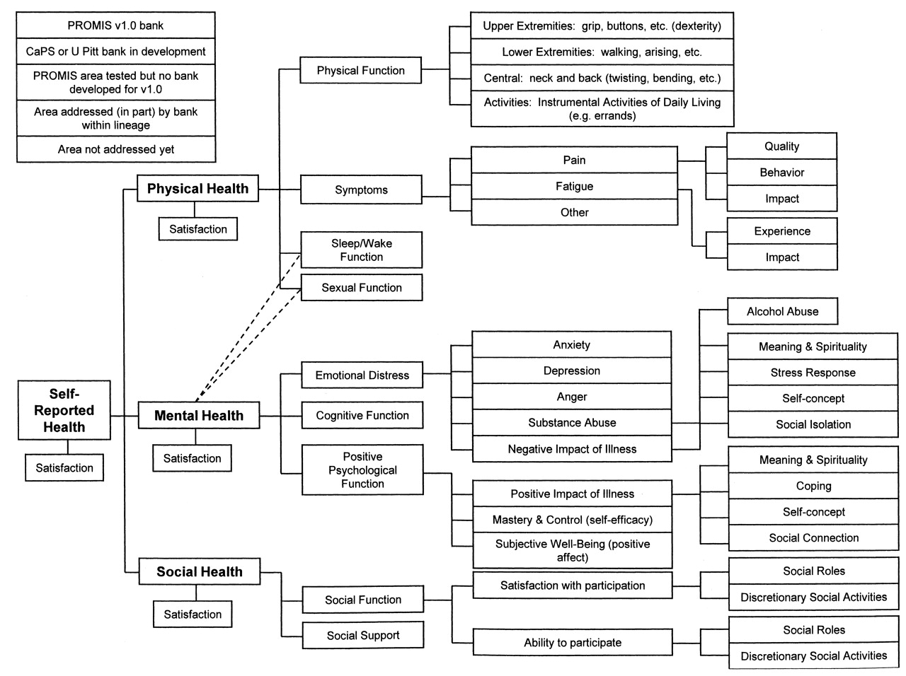

Slide 5
In the past 7 days …
I was grouchy [1st question]
  Never [39]
  Rarely [48]
  Sometimes [56]
  Often [64]
  Always [72]
Estimated Anger = 56.1
SE = 5.7 (rel. = 0.68)
Notes:
Never: 39
Rarely: 48
Sometimes = 56
Often = 64
Always = 72

Slide 6
In the past 7 days …
I felt like I was ready to explode
[2nd question]
  Never
  Rarely
  Sometimes
  Often
  Always
Estimated Anger = 51.9
SE = 4.8 (rel. = 0.77)

Slide 7
In the past 7 days …
I felt angry [3rd question]
  Never
  Rarely
  Sometimes
  Often
  Always
Estimated Anger = 50.5
SE = 3.9 (rel. = 0.85)

Slide 8
In the past 7 days …
I felt angrier than I thought I should [4th question]
- Never
  Rarely
  Sometimes
  Often
  Always
Estimated Anger = 48.8
SE = 3.6 (rel. = 0.87)

Slide 9
In the past 7 days …
I felt annoyed [5th question]
  Never
  Rarely
  Sometimes
  Often
  Always
Estimated Anger = 50.1
SE = 3.2 (rel. = 0.90)

Slide 10
In the past 7 days …
I made myself angry about something just by thinking about it. [6th question]
  Never
  Rarely
  Sometimes
  Often
  Always
Estimated Anger = 50.2
SE = 2.8 (rel = 0.92)

Slide 11




Computer Adaptive Testing (CAT)
Notes:
Early research on CAT was funded by the U.S. military to enhance mental measurement.
NASD = National Association of Security Dealers. In 1978 they began developing CAT for regulatory exam to assess knowledge of securities and securities future products among licensed brokers.
The National Council of State Boards of Nursing starting using CAT in 1994.

Slide 12
Item Responses and
Trait Levels
Person 1
Person 2
Person 3
Trait
Continuum
Item 1
Item 2
Item 3
www.nihpromis.org

Slide 13
Reliability Target for Use of Measures with Individuals
Reliability ranges from 0-1
  0.90 or above is goal
  SEM = SD (1- reliability)^{1/2}
  95% CI = true score +/- 1.96 x SEM
    if true z-score = 0, then CI: -.62 to +.62
      Width of CI is 1.24 z-score units
Reliability = 0.90 when SE = 3.2
  T-scores (mean = 50, SD = 10)
  Reliability = 1 – (SE/10)²
T = 50 + (z * 10)
Notes:
T = z*10 + 50

Slide 14
PROMIS Physical Functioning vs. “Legacy” Measures
10 20 30 40 50 60 70

Slide 15
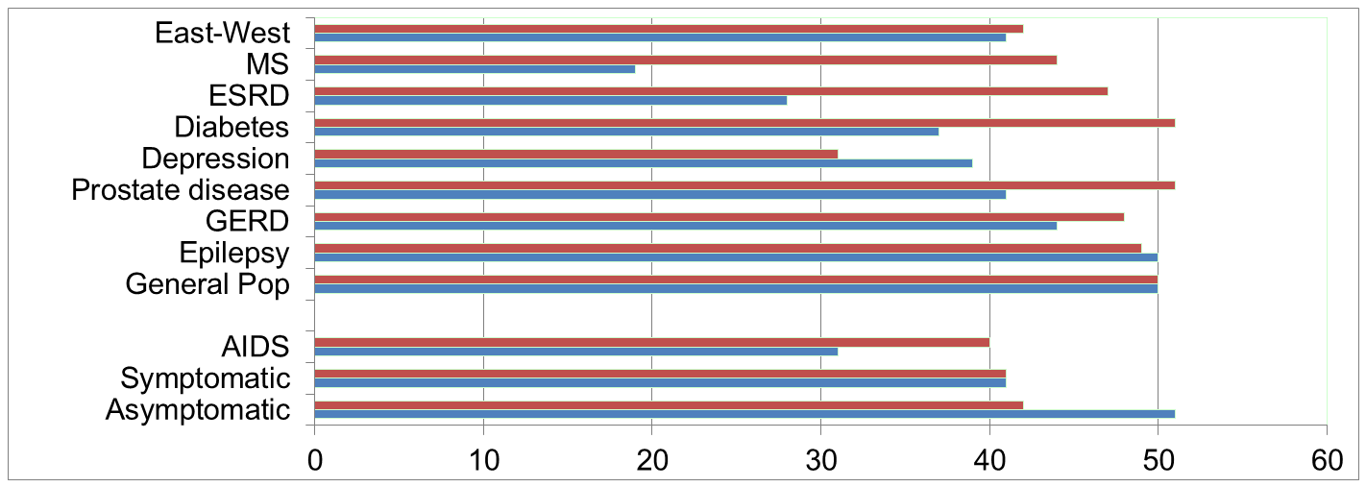
Physical Functioning and Emotional Well-Being at Baseline for 54 Patients at UCLA-Center for East West Medicine
EWB
Physical
MS = multiple sclerois; ESRD = end-stage renal disease; GERD = gastroesophageal reflux disease.
15

Slide 16
Significant Improvement in all but 1 of SF-36 Scales (Change is in T-score metric)
Change
t-test
prob.
PF-10
1.7
2.38
.0208
RP-4
4.1
3.81
.0004
BP-2
3.6
2.59
.0125
GH-5
2.4
2.86
.0061
EN-4
5.1
4.33
.0001
SF-2
4.7
3.51
.0009
RE-3
1.5
0.96
.3400
EWB-5
4.3
3.20
.0023
PCS
2.8
3.23
.0021
MCS
3.9
2.82
.0067

Slide 17
Effect Sizes for Changes in SF-36 Scores
Effect Size
0.13
0.35
0.35
0.21
0.53
0.36
0.11
0.41
0.24
0.30
PFI = Physical Functioning; Role-P = Role-Physical; Pain = Bodily Pain; Gen H=General Health; Energy = Energy/Fatigue; Social = Social Functioning; Role-E = Role-Emotional; EWB = Emotional Well-being; PCS = Physical Component Summary; MCS =Mental Component Summary.

Slide 18
Effect Size
(Follow-up – Baseline)/ SD_{baseline}
_{Cohen’s Rule of Thumb:}
_{ES = 0.20 Small}
_{ES = 0.50 Medium}
_{ES = 0.80 Large}

Slide 19
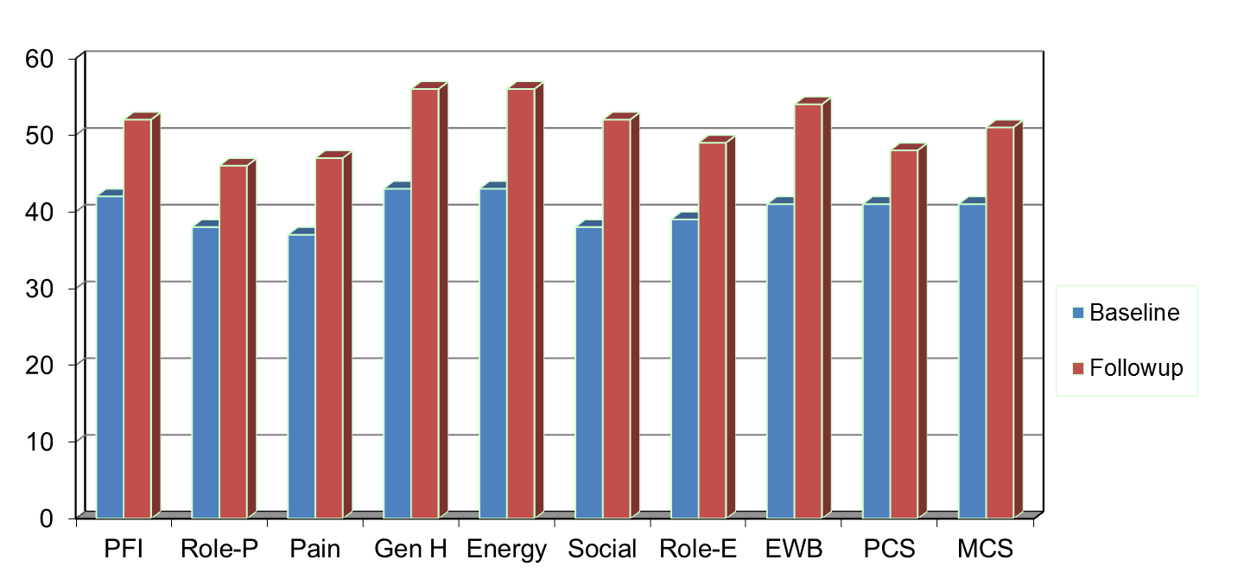
Amount of Change Needed for Significant Individual Change
Effect Size
0.67
0.72
1.01
1.13
1.33
1.07
0.71
1.26
0.62
0.73
PFI = Physical Functioning; Role-P = Role-Physical; Pain = Bodily Pain; Gen H=General Health; Energy = Energy/Fatigue; Social = Social Functioning;
Role-E = Role-Emotional; EWB = Emotional Well-being; PCS = Physical Component Summary; MCS =Mental Component Summary.

Slide 20
7-31% of People in Sample Improve Significantly
% Improving
% Declining
Difference
PF-10
13%
2%
+ 11%
RP-4
31%
2%
+ 29%
BP-2
22%
7%
+ 15%
GH-5
7%
0%
+ 7%
EN-4
9%
2%
+ 7%
SF-2
17%
4%
+ 13%
RE-3
15%
15%
0%
EWB-5
19%
4%
+ 15%
PCS
24%
7%
+ 17%
MCS
22%
11%
+ 11%

Slide 21
Defining a Responder: Reliable Change Index (RCI)
Note: SD_{bl} = standard deviation at baseline
r_{xx} = reliability

Slide 22
Amount of Change in Observed Score Needed To be Statistically Significant
Note: SD_{bl} = standard deviation at baseline and r_{xx} = reliability

Slide 23
“Implementing patient-reported outcomes assessment in clinical practice: a review of the options and considerations”
Snyder, C.F., Aaronson, N. K., et al. Quality of Life Research, 21, 1305-1314, 2012.
  HRQOL has rarely been collected in a standardized fashion in routine clinical practice.
  Increased interest in using PROs for individual patient management.
  Research shows that use of PROs:
    Improves patient-clinician communication
    May improve outcomes

Slide 24
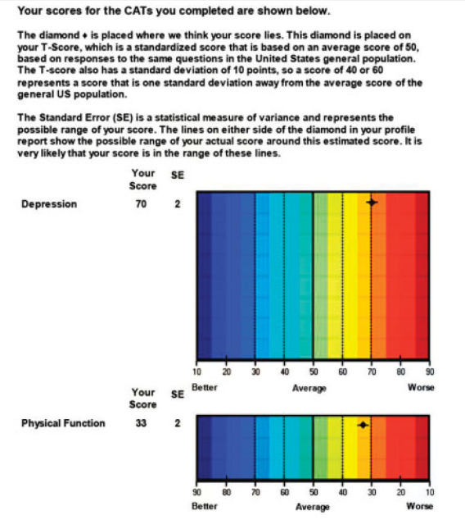

Slide 25
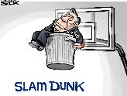
Break

Slide 26

U.S. Health Care Issues
Access to care
  ~ 50 million people without health insurance
Costs of care
  Expenditures ~ $ 2.7 Trillion
Effectiveness (quality) of care

Slide 27
How Do We Know If Care Is Effective?
Effective care maximizes probability of desired health outcomes
  Health outcome measures indicate whether care is effective
Cost ↓
Effectiveness ↑

Slide 28
Health Outcomes Measures
Traditional clinical endpoints
  Survival
  Clinical/biological indicators
    Rheumatoid factor
    Blood pressure
    Hematocrit
Patient-Reported Outcomes

Slide 29
Types of HRQOL Measures
- Generic vs. Targeted
- Profile vs. Preference-based

Slide 30
Generic Item
In general, how would you rate your health?
Excellent
Very Good
Good
Fair
Poor

Slide 31
Targeted Items Assessing
“Burden of Kidney Disease”
My kidney disease interferes too much with my life.
Too much of my time is spent dealing with my kidney disease.
I feel frustrated with my kidney disease.
I feel like a burden on my family.

Slide 32
Is CAM Better than
Standard Care (SC)?
CAM
SC
CAM
SC
Physical
Health
CAM > SC
Mental
Health
SC > CAM

Slide 33
Is Acupuncture Related to Worse HRQOL?
Subject Acupuncture HRQOL (0-100)
1 No dead
2 No dead
3 No 50
4 No 75
5 No 100
6 Yes 0
7 Yes 25
8 Yes 50
9 Yes 75
10 Yes 100
  Group n HRQOL
  No Acupuncture 3 75
  Yes Acupuncture 5 50

Slide 34
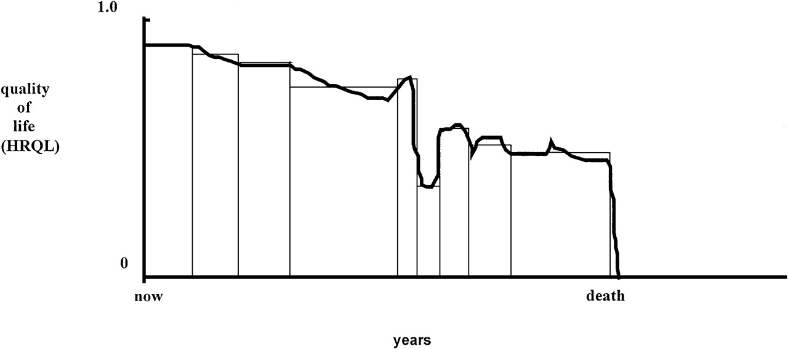
Quality of Life for Individual Over Time

Slide 35
Goal is Access to
Cost-Effective Care
Cost ↓
Effectiveness (“Utility”) ↑

Slide 36
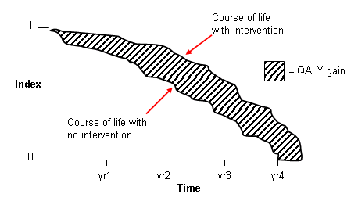
http://www.ukmi.nhs.uk/Research/pharma_res.asp

Slide 37
“QALYs: The Basics”
Milton Weinstein, George Torrance, Alistair McGuire
(Value in Health, 2009, vol. 12 Supplement 1)
What is value?
  Preference or desirability of health states
How are QALYs used?
  Societal resource allocation
  Personal decisions such as decision about whether to have a treatment
  Societal or program audit
    Evaluate programs in terms of health of the population.

Slide 38
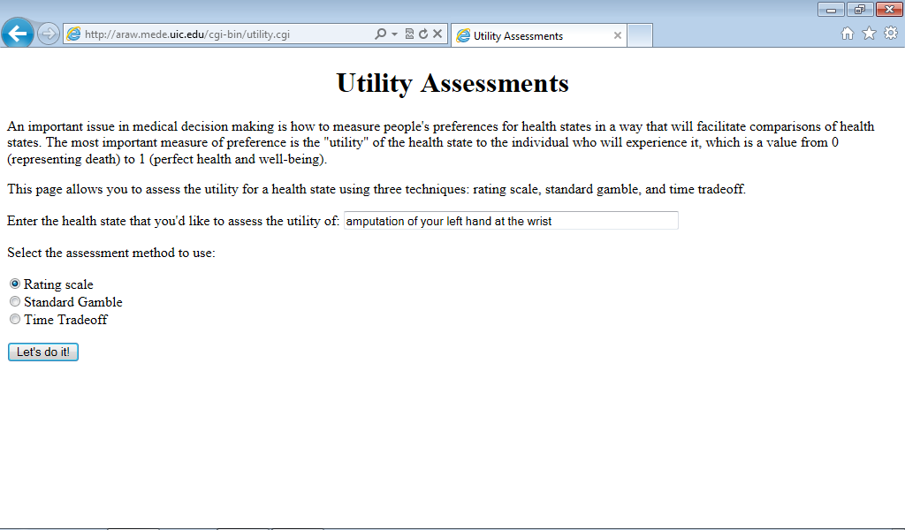
http://araw.mede.uic.edu/cgi-bin/utility.cgi
http://araw.mede.uic.edu/cgi-bin/utility.cgi

Slide 39
SG>TTO>RS
SG = TTOª
SG = RS^{b}
^{Where a and b are less than 1}

Slide 40
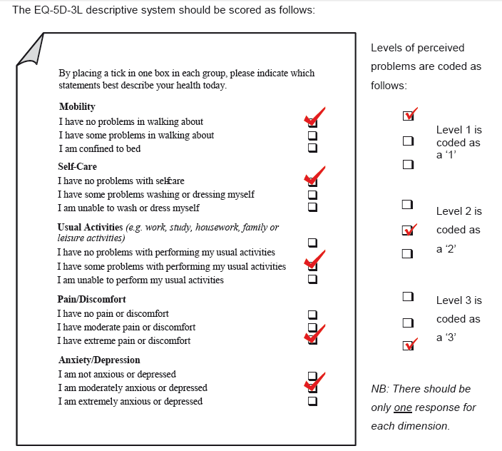
0.435

Slide 41
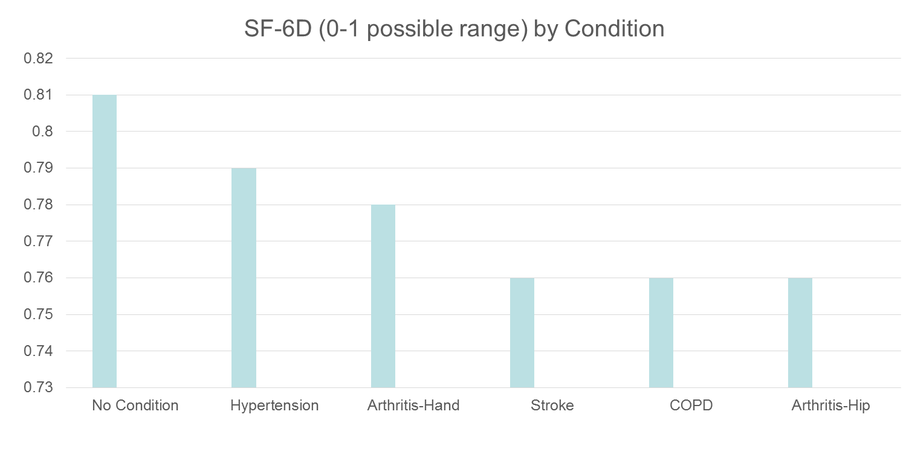
HRQOL in SEER-Medicare Health Outcomes Study (n = 126,366)
Controlling for age, gender, race/ethnicity, education, income, and marital status.

Slide 42
Distant stage of cancer associated with 0.05-0.10 lower SF-6D Score

Slide 43
Questions?
drhays@ucla.edu
Powerpoint file at: http://gim.med.ucla.edu/FacultyPages/Hays/
Notes:
43

