Slide 1

Online survey data quality among those who have “Syndomitis” or “Chekalism”
Ron D. Hays, Ph.D.
2023 (12:00-12:59 pm)
GIM HSR Friday Noon Seminar Series 2022-2023 focuses on:
"Health Services Delivery for Individuals and Populations”
https://labs.dgsom.ucla.edu/hays/pages/presentations
I have no conflicts of interest.

Slide 2

Acknowledgements
Nabeel Qureshi
Patricia Herman
Anthony Rodriguez
Arie Kapteyn
Maria Edelen Orlando
National Center for Complementary and Integrative Health (NCCIH). Grant No. 1R01AT010402-01A1, “Measuring Chronic Pain Impact: Measurement Enhancement for Chronic Pain.”
https://clinicaltrials.gov/ct2/show/NCT04426812

Slide 3
“Define online research panel”
“An online research panel is a group of people who have agreed to participate in market research studies online. This can include online surveys, focus groups, and interviews. Online research panels are a quick and cost-effective way to collect data from a large number of people.”
  LaMDA (2023). Bard (May 1 version). [Language Model for Dialogue Applications]. https://bard.google.com/

Slide 4
Online Research “Panels”
Quick data collection
Large samples
Cost-effective
Probability/Opt-in Panels
Growth of panels for data collection is: “one of the most compelling stories of the last decade” Baker et al. (2013, p. 715).
Summary report of the AAPOR Task Force on Non-probability Sampling. Journal of Survey Statistics and Methodology, 1, 90–143.

Slide 5
“The main difference between a probability research panel and an opt-in research panel is how participants are selected.”
Probability research panels
  Selected using random sampling.
    More representative of the general population.
Non-probability-based (Opt-in) research panels
  Consist of people who elect to join.
    Less representative of the general population.

Slide 6
Telepanel (1985-86)
Started by professor of sociology at University of Amsterdam
  Recruited 1000 Dutch adults and gave them computers and modems.
  Panel asked to download a survey every weekend, answer and upload it to the central modem pool.
Sold Telepanel to Dutch Gallup organization.
http://en.wikipedia.org/wiki/Willem_Saris

Slide 7
CentERpanel (1991)
Started by University of Amsterdam
  Supported by Dutch Science Foundation
  Oldest academic internet probability panel in the world.
  Panel size = 2-3k
CentERpanel taken over by Tilburg University Center for Economic Research 5 years later

Slide 8
Other probability-based panels
1999: Knowledge Networks (now Ipsos KnowledgePanel).
  Address-based sampling
  Approximate recruiting response rate = 14%
  Panel size = 55k
2007: Longitudinal Internet Studies for the Social Sciences (LISS), Netherlands
  Population registry-based sampling
  Recruited face-to-face and telephone
  Approximate recruiting response rate = 45%
  Panel size = 7.5k

Slide 9


Local probability-based panels
2006: American Life Panel, U.S.
  Recruited by random digit dialing, face-to-face, and address-based
  Approximate recruiting response rate = 15%
  Panel size = 6k
2014: Understanding America Study, U.S.
  Address-based sampling
  Approximate recruiting response rate = 20%
  Panel size = 2k

Slide 10
Violato et al. (2023, PLoS Medicine)
The COVID-19 pandemic and health-related quality of life across 12 high- and low-middle-income countries: A cross-sectional analysis
“We asked 15,536 participants from a diverse group of 13 countries (approx. 1,200 per
country) to answer an online survey in which we asked questions about sociodemographic
characteristics, health, and perceived HRQoL prior to and during the
pandemic.
The Oxford COVID-19 Vaccine Preference and Opinion Survey (CANDOUR) Project conducted online surveys of adults over 18 years of age from 13 countries.
In all but Chile and Uganda, respondents were sampled by the sampling firm, Respondi…Respondi primarily rely on online channels with some supplementation from computer-assisted telephone interviews. After completing a profiling questionnaire covering basic sociodemographic information panelists are invited to participate in a few surveys.”
https://www.respondi.com/EN/

Slide 11
Patient-Reported Outcomes Measurement Information System (PROMIS®)
Polimetrix (now YouGov)
Non-probability recruitment of panel
> 1 million members who regularly participate in online surveys
Liu et al. (2010). Representativeness of the Patient-Reported Outcomes Measurement Information System internet panel. J Clinical Epidemiology, 63, 1169-1178.

Slide 12
Quota Sampling (n = 11,796)
Data collected July 2006- March 2007
PROMIS targets (“Quota sampling”)
  50% female
  20% 18-29, 30-44, 45-59, 60-74 and 75+
  12.5% Black, 12.5% Hispanic
  10% < high school graduate

Slide 13


PROMIS Internet Sample versus Census
 | PROMIS Sample | 2000 Census
% Female | 55% | 52%
% Hispanic | 13% | 11%
% Black | 10% | 11%
% < High school | 3% | 20%
% High school/GED | 19% | 29%
% > High school | 78% | 51%
Mean age | 50 | 45

Slide 14
PROMIS Internet Sample (Weighted*) versus Census
 | PROMIS (Weighted) Sample | 2000 Census
% Female | 52% | 52%
% Hispanic | 11% | 11%
% Black | 11% | 11%
% < High school | 20% | 20%
% High school/GED | 29% | 29%
% > High school | 51% | 51%
Mean age | 45 | 45
*Census gender, age, race/ethnicity, education, marital status, and income.

Slide 15
Non-probability Panels
Crowdsourced
  Website where “employers” can hire remotely located “workers” to perform discrete tasks (e.g., transcription, image coding)
Opt-in
  Sample draw from a panel with a pool of potential survey respondents

Slide 16
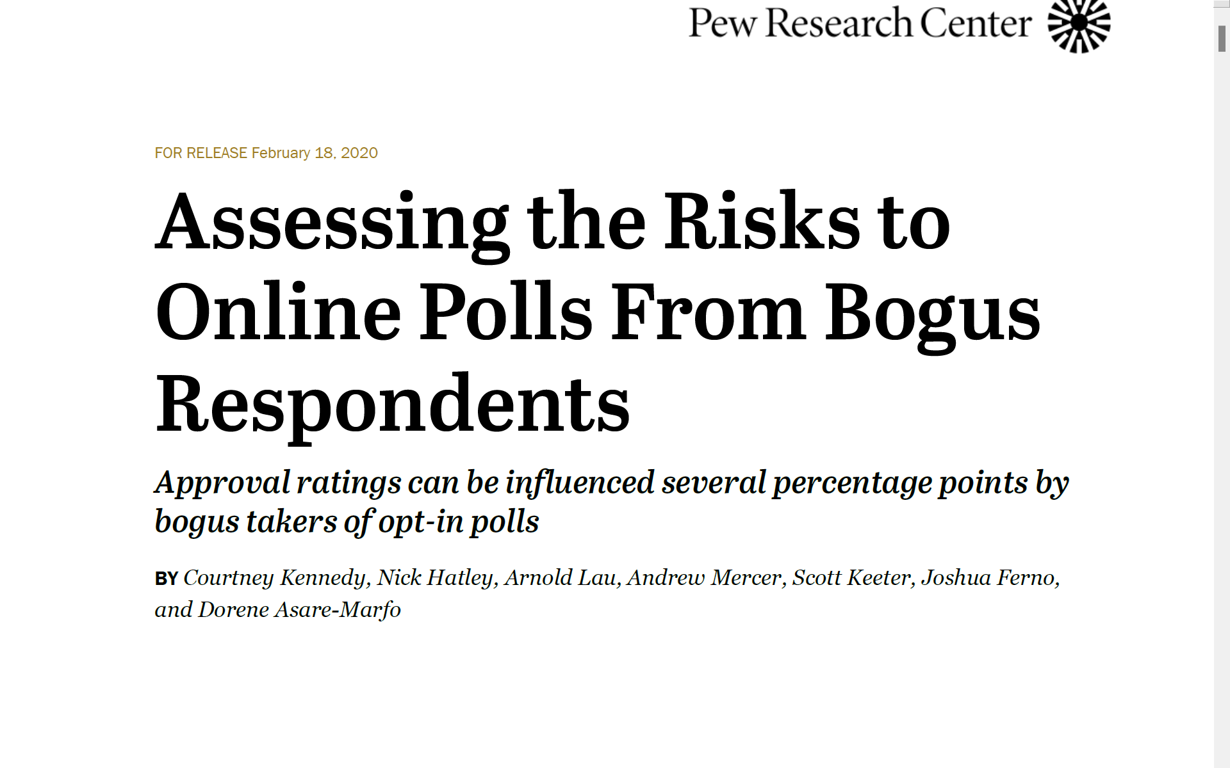
Online samples fielded with widely-used opt-in sources contain small but measurable shares of bogus respondents (about 4% to 7%). In the study bogus respondents were those who reported any of living outside the U.S., gave multiple non sequitur answers, took survey multiple times, or always said they approve/favor regardless of what was asked. Rates were: 7% in crowdsourced, 5% for opt-in panel, and 1% for address-recruited.

Slide 17
Amazon Mechanical Turk (MTurk) Data Collection (2021)
Opt-in (crowdsourcing) platform hosted by Amazon.
Jobs or tasks are referred to as human intelligence tasks and include:
  Completing surveys
  Coding
  Identifying content in images or videos
  Writing product descriptions
MTurk workers compared to U.S. general population
  Younger age
  More educated
  Less likely to be have household income of $100k or higher
  Worse self-reported health

Slide 18
MTurk Questionnaire (~190 items)
61 PROMIS® items (including PROMIS-29)
9 demographic items, 24 health conditions
Back pain-targeted measures
  7 chronicity items, 13 pain management
  PEG (Pain intensity, interference with Enjoyment of life, interference with General activity),
  Oswestry Disability Index (ODI)
  Roland-Morris Disability Questionnaire (RMDQ)
  Orebro Musculoskeletal Pain Questionnaire (OMPQ)
  Subgroups for Targeted Treatment (STarT) Back Tool
  Graded Chronic Pain Scale (GCPS) disability score.

Slide 19

Data Quality Steps
Quality workers - >95% approval rating; 500+ HITs
Deployed in small batches (9 surveys per hour) – reduce selection bias
Screened for back pain without revealing this was our target to minimize reporting it just to get paid
Eliminated those <1 second per item
Checked MTurker forums (e.g., www.mturkcrowd.com)

Slide 20
Data Quality Steps
Quality workers - >95% approval rating; 500+ HITs
Deployed in small batches (9 surveys per hour) – reduce selection bias
Screened for back pain without revealing this was our target to minimize reporting it just to get paid
Eliminated those <1 second per item
Checked MTurker forums for chatter on survey
Pilot study showed that 20% of respondents endorsed all health conditions
  Added fake conditions (Syndomitis, Chekalism)

Slide 21
Have you EVER been told by a doctor or other health professional that you had
1) hypertension
2) high cholesterol
3) heart disease
4) angina
5) heart attack
6) stroke
7) asthma
8) cancer
9) diabetes
10) chronic obstructive pulmonary disease
11) arthritis
12) anxiety disorder
13) depression
14) Syndomitis

Slide 22
Do you currently have
1) allergies or sinus trouble
2) back pain
3) sciatica
4) neck pain
5) trouble seeing
6) dermatitis
7) stomach trouble
8) trouble hearing
9) trouble sleeping
10) Chekalism

Slide 23
* 15% reported having 1 or both fake conditions, and were more likely to be male, non-White, younger, and report more health conditions.

Slide 25
T-scores: U.S. mean = 50, SD = 10 for all measures except PROPr: U.S. mean = 0.52, SD = 0.24, possible range: -0.022 to 1.00

Slide 26
6% of the 3-month survey respondents endorsed a fake condition.

Slide 28

Summary
Based on the 15% faker rate at baseline and 6% at 3-months, we estimate a 25%* faker rate in the MTurk sample.
Excluding those who endorsed a fake condition improved
  reliability of measurement
  Estimated mean health
    PROMIS-29+2 v2.1 T-scores by 1-2 points
    PROPr preference-based score by 0.04 (~0.16 effect size).
* f = % of fakers; p = probability of getting caught using the fake conditions
p(f)=0.146 and p(f)(1-p) = 0.061… then 0.146(1-p) = 0.061 -> p =0.58, f=0.061/(p(1-p))

Slide 29

Suggested researchers anticipate removing 35-50% of non-probability completes due to poor data quality.

Slide 30

Implications
Asking about fake health conditions can help screen out respondents who misrepresent themselves.
Its usefulness could fade over time if information about it spreads among survey respondents.
  e.g., urban dictionary warns readers not to select “Bindro” on surveys of drug use because doing so “voids the whole test.”
  https://www.urbandictionary.com/define.php?term=Bindro

Slide 31

Questions?
Bibliography
Baker, R. et al. (2013). Summary report of the AAPOR Task Force on non-probability sampling. Journal of Survey Statistics and Methodology, 1, 90–143.
Craig, B. M., Hays, R. D., Pickard A. S., Cella, D., Revicki, D. A., & Reeve, B. B (2013). Comparison of US panel vendors for online surveys. Journal of the Medical Internet Research, 15 (11), e260.
Hays, R. D., Liu, H., & Kapteyn, A. (2015). Use of internet panels to conduct surveys. Behavior Research Methods., 47 (3), 685-690.
Qureshi, N., Edelen, M., Hilton, L., Rodriguez, A., Hays, R. D., & Herman, P. M. (2022). Comparing data collected using Amazon’s Mechanical Turk to national surveys. American Journal of Health Behavior, 46(5), 497-502. doi: 10.5993/AJHB.46.5.1
Rivers, D. (2013). Comment. Journal of Survey Statistics and Methodology, 1, 111-117.
Tourangeau, R., Conrad, F. G., & Cooper, M. P. (2013). The science of Web surveys. Oxford: Oxford University Press.
Violato, M., et al. (2023). The COVID-19 pandemic and health-related quality of life across 13 high- and low-middle-income countries: A cross-sectional analysis. PLoS Med, 20(4), e1004146. https://doi.org/10.1371/journal.pmed.1004146

