Slide 1

Patient-Reported Outcome Measures in Nephrology
November 28, 2011 (Parlow Auditorium, Torrance, CA)
Ron D. Hays, Ph.D. (drhays@ucla.edu)
- UCLA Department of Medicine: Division of General Internal Medicine and Health Services Research
- UCLA School of Public Health: Department of Health Services
- RAND, Santa Monica
http://gim.med.ucla.edu/FacultyPages/Hays/

Slide 2
Outline of Presentation
Patient-reported measures figure
Consumer Assessment of Healthcare Providers and Systems (CAHPS®)
Kidney Disease Quality of Life measure
  KDQOLTM-36

Slide 3
Patient-Reported Measures
Demo-graphics
Technical
Reports
Quality of Care
Behavior
Health
Clinical
Reports

Slide 4
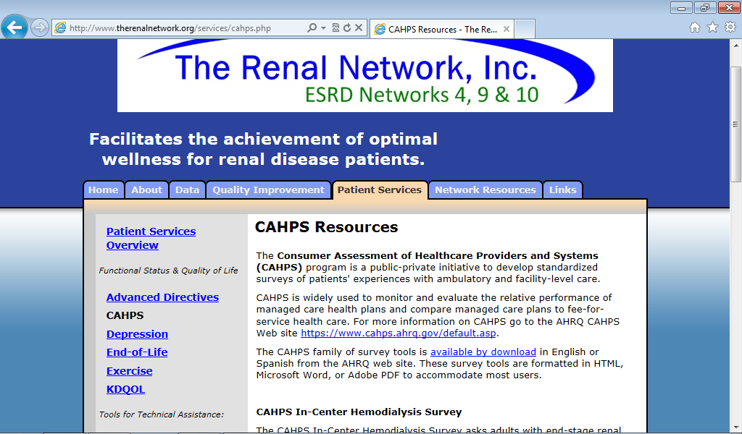

Slide 5
Consumer Assessment of Healthcare Providers and Systems
(CAHPS®) Surveys
Ambulatory Care Surveys
  CAHPS Health Plan Survey
  CAHPS Clinician & Group Survey
  CAHPS Surgical Care Survey
  ECHO® Survey
  CAHPS Dental Plan Survey
  CAHPS American Indian Survey
  CAHPS Home Health Care Survey
Facility Surveys
  CAHPS Hospital Survey
  CAHPS Nursing Home Survey
  CAHPS In-Center Hemodialysis Survey

Slide 6
CAHPS Design Principles
Emphasis on patients
  What patients value with respect to the setting of care
  Aspects of care for which patients are the best or only source of information
Dominated by reports rather than ratings of care
Standardization
  Surveys, data collection, analysis, reporting, benchmarking
Many CAHPS surveys are NQF endorsed
All CAHPS surveys and products are in the public domain

Slide 7
Development process
Literature review
Technical Expert Panels
Focus group feedback
Cognitive interviews (English and Spanish)
Field testing and psychometric analyses
Public release

Slide 8
CAHPS In-Center Hemodialysis Survey (In the last 3 months …)
How often did
  your kidney doctors listen carefully to you?
  your kidney doctors explain things in a way that was easy to understand?
  your kidney doctors show respect for what you had to say?
  your kidney doctors spend enough time with you?
  you feel your kidney doctors really cared about you as a person?
Reporting Measures for the CAHPS® In-Center Hemodialysis Survey. Agency for Healthcare Research and Quality, Rockville, MD. Updated Dec 2007. https://www.cahps.ahrq.gov/cahpskit/files/509_ICH_Reporting_Measures.htm

Slide 9
Health-Related Quality of Life is …
What you can do.
Functioning
  Self-care
  Role
  Social
How you feel about your life.
Well-being
  Emotional well-being
  Pain
  Energy

Slide 10
HRQOL Framework
Physical Health
Physical Functioning
Self-Reported Health
Mental Health
Depressive Symptoms
Social Health
Ability to Participate in Social Roles
Social Support
Patient Satisfaction

Slide 11
SF-36® Generic Profile Measure
Functioning
  Physical functioning (10 items)
  Role limitations/physical (4 items)
  Role limitations/emotional (3 items)
  Social functioning (2 items)
Well-Being
  Emotional well-being (5 items)
  Energy/fatigue (4 items)
  Pain (2 items)
  General health perceptions (5 items)

Slide 12
Generic vs. Disease-Targeted
In general, would you say your health is:
Excellent/ Very good/ Good/ Fair/ Poor?
How much does kidney disease bother you in your ability to work around the house?
Not at all bothered/Somewhat bothered/
Moderately bothered/Very much bothered/ Extremely bothered

Slide 13
Reliability of measures
0.0 (lowest) – 1.0 (highest possible)
̃ 0.80 for blood pressure and other clinical measures
- 0.70-0.90 for multi-item self-report measures
Hahn, E. A., Cella, D., et al. (2007). Precision of health-related
quality-of-life data compared with other clinical measures.
Mayo Clin Proceedings, 82 (10), 1244-1254.

Slide 14
SF-36 Physical Health Component
Summary Score Predicts Mortality
% dead
5 yrs.
later
(n=676)
(n=754)
(n=1181)
(n=609)
SF-36 Physical Health Component Score (PCS)—T score
Ware et al. (1994). SF-36 Physical and Mental Health Summary Scales: A User’s Manual.

Slide 15
HRQOL Predicts Mortality and Hospitalizations
Kalantar-Zadeh et al. (2001, J Am Soc Nephrol)
  “Total score and MCS”
Lowrie et al. (2003, Am J Kidney Dis)
  PCS and MCS
Mapes et al. (2003, Kidney International)
  PCS, MCS, and Kidney Disease Component Score (KDCS)
Molnar-Varga et al. (2011, Am J Kidney Dis)
  PCS predictive of mortality
  MCS and Kidney Disease Quality of Life (KDQOLTM) Symptom/problems predictive of transplant loss

Slide 16
Kidney Disease Quality of Life (KDQOLTM) Instrument
Focus groups with patients and staff
Pretests on small samples
Field test with 165 persons with kidney disease at 9 dialysis centers
Thousands of administrations since
Notes:
16

Slide 17
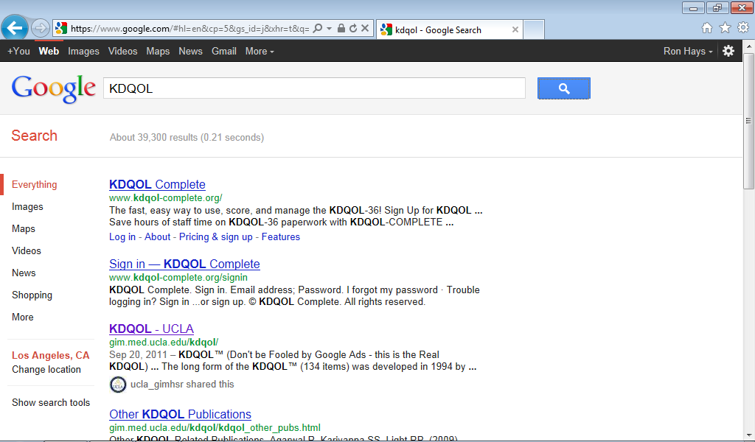

Slide 18
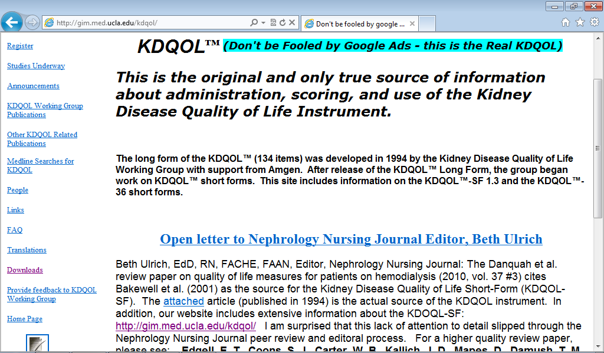

Slide 19
Kidney Disease Quality of Life (KDQOL) Publications
Hays, R. D., Kallich, J. D., Mapes, D. L., Coons, S. J., & Carter, W. B. (1994). Development of the Kidney Disease Quality of Life (KDQOLTM) Instrument. Quality of Life Research, 3, 329-338.
Edgell, E. T., Coons, S. J., Carter, W. B., Kallich, J. D., Mapes, D., Damush, T. M., & Hays, R. D. (1996). A review of health-related quality of life assessment in end-stage renal disease. Clinical Therapeutics, 18(5), 887-938.
Rao, S., Carter, W. B., Mapes, D. L., Kallich, J. D., Kamberg, C. J., Spritzer, K. L., & Hays, R. D. (2000). Development of subscales from the symptom/problems and effects of kidney-disease items in the Kidney Disease Quality of Life (KDQOLTM) instrument. Clinical Therapeutics, 22, 1099-1111.

Slide 20
KDQOL Targeted Domains
(97 items and 43 items)
Symptoms/problems 34 12
Effects of kidney disease 20 8
Burden of kidney disease 4 4
Work status 4 2
Cognitive function 6 3
Quality of social interaction 4 3
Sexual function 4 2
Sleep 9 4
Social support 4 2
Dialysis staff encouragement 6 2
Patient satisfaction 2 1
Notes:
20

Slide 21
KDQOL-36
Items 1-12: SF-12
Items 13-16: Burden of Kidney Disease (4)
Items 17-28: Symptoms/Problems (12)
Items 29-36: Effects of Kidney Disease (8)
Glover, C. et al. (2011). Understanding and assessing the impact of end-stage renal disease on quality of life: A systematic review of the content validity of self-administered instruments used to assess health-related quality of life in end-stage renal disease. Patient, 4(1), 19-30.

Slide 22
Burden of Kidney Disease
My kidney disease interferes too much with my life.
Too much of my time is spent deading with my kidney disease.
I feel frustrated with my kidney disease
I feel like a burden on my family.

Slide 23
Symptom/Problems--
To what extent were you bothered by ...
Soreness in your muscles?
Chest pain?
Cramps?
Itchy skin?
Dry skin?
Shortness of breath?
Faintness or dizziness?
Lack of appetite?
Washed our or drained?
Numbness in hands or feet?
Nausea or upset stomach?
Problems with access (catheter) site?

Slide 24
Effects of Kidney Disease—
How much does kidney disease bother you in …
Fluid restrictions?
Dietary restriction?
Your ability to work around the house?
Your ability to travel?
Being dependent on doctors and other medical staff?
Stress or worries caused by kidney disease?
Your sex life?
Your personal appearance?

Slide 25
Scoring
Higher score = better health
Transform linearly to 0-100 range
Average items in each scale together
Notes:
25

Slide 26
KDQOL-36 Translations
Chinese
Czech
Danish
Dutch
English
French
German
Greek
Hebrew
Hungarian
Italian
Malay
Polish
Portuguese
Russian
Spanish
Swedish
Turkish
http://gim.med.ucla.edu/kdqol (register for downloads)

Slide 27
Dialysis Outcomes and Practice Patterns Study (DOPPS)
Longitudinal study of hemodialysis patients and unit practices
  Goal is to identify practice patterns associated with improved patient outcomes
Uniform international data collection
  Mortality
  Health-related quality of life
  Hospitalization
  Vascular access
Coordinated by Arbor Research Collaborative for Health

Slide 28
DOPPS Data
308 dialysis facilities in DOPPS I
  12,465 patients from 7 countries
  France, Germany, Italy, Japan, Spain, UK, US
320 dialysis facilities in DOPPS II
  10,551 patients from 12 countries
  Same 7 above plus Australia, New Zealand, Belgium, Canada and Sweden
297 facilities in DOPPS III
  9,316 patients from the same 12 countries

Slide 29
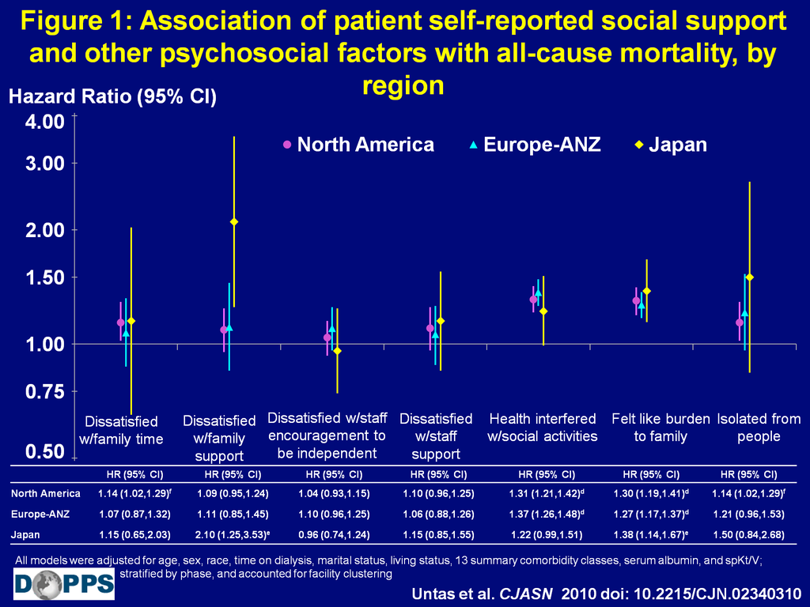
Figure 1: Association of patient self-reported social support and other psychosocial factors with all-cause mortality, by region
Notes:
The association of all-cause mortality with being dissatisfied with family support appeared to be substantially stronger in Japan than in North America or in the Europe-Australia/New Zealand study region. For all the other factors, the relationship of each social support and psychosocial factor with all cause mortality were consistent and similar across regions, and were consistent with the overall results stratified by country.

Slide 30
KDQOLTM Scores Compared to National Sample of Patients
Baseline
Follow-up
Dialysis Outcomes and Practice Patterns Study (DOPPS) 55-64 year old age group
Notes:
DOPPS 55-64 year old group
30

Slide 32
Hemo. vs. Peritoneal Dialysis
Fructuoso et al. Quality of Life in chronic kidney disease. Nefrologia, 2011, 31, 91-96.

Slide 33
Future Directions http://www.nihpromis.org/
Item banks to assess HRQOL and allow for computer-adaptive testing (CAT)
Reliability = 1 – SE² = 0.90
SE = 3.2 for T-score (mean= 50 & SD = 10)
.

Slide 34
Anger CAT¹ (In the past 7 days )
I was grouchy
  Never
  Rarely
  Sometimes
  Often
  Always
Theta = 56.1 SE = 5.7

Slide 35
²In the past 7 days …
I felt like I was read to explode
  Never
  Rarely
  Sometimes
  Often
  Always
Theta = 51.9 SE = 4.8

Slide 36
³In the past 7 days …
I felt angry
  Never
  Rarely
  Sometimes
  Often
  Always
Theta = 50.5 SE = 3.9

Slide 37
⁴In the past 7 days …
I felt angrier than I thought I should
  Never
  Rarely
  Sometimes
  Often
  Always
Theta = 48.8 SE = 3.6

Slide 38
⁵In the past 7 days …
I felt annoyed
  Never
  Rarely
  Sometimes
  Often
  Always
Theta = 50.1 SE = 3.2

Slide 39
⁶In the past 7 days …
I made myself angry about something just by thinking about it.
  Never
  Rarely
  Sometimes
  Often
  Always
Theta = 50.2 SE = 2.8

Slide 40
Theta and SE estimates
Item 1: 56 and 6
Item 2: 52 and 5
Item 3: 50 and 4
Item 4: 49 and 4
Item 5: 50 and 3
Item 6: 50 and <3

Slide 41
http://jwrginc.com/projects/current-projects
Functional Health Computer Adaptive Test (CAT) in Chronic Kidney Disease
NIH Agency: The National Institute of Diabetes and Digestive and Kidney Diseases (NIDDK)
Summary: This study completes a 4-year NIH-funded project designed to evaluate improvements in CKD-specific impact measures used to estimate health related quality of life outcomes among adult non-dialysis and non-transplant patients at Stages 3-5, dialysis patients, and transplant patients. Previous phases (I and II) analyzed Internet-based survey data to conduct psychometric tests of a new CKD-specific impact bank. Data from this new clinic-based study are being analyzed to replicate prior psychometric tests using Item Response Theory (IRT) as well as extend the research to include clinical tests of discriminant validity and responsiveness for new and legacy tools. JWRG and Tufts Medical Center are supporting project completion out of their own research funds. Investigators: JE Ware and K Meyer (Co-Investigators).

Slide 42

Thank you. http://gim.med.ucla.edu/kdqol/
Notes:
42

