Slide 1

Assessing Change in Individuals From Baseline to a Single Follow-up
Ron D. Hays
PROMIS Health Organization (PHO)
Virtual Plenary
https://labs.dgsom.ucla.edu/hays/pages/presentations
October 18, 2021
11:30 am-12:30 pm PT

Slide 2
Time series data ideal for estimating individual variation
But requires 10 or more observations
  10+ per subject (Borckardt et al. 2008)
  15 per subject (Moinpour et al. 2017)
Today’s presentation is about two time points
  Follow-up – baseline

Slide 3
Outline
Significant individual change
  Individual change indices
  Different standard deviation estimates
  Classical test theory versus item response theory
  Significance level and likely change
Meaningful individual change
Q&A

Slide 7
3 & 4 > 1 & 2

Slide 8
Amount of Change in Observed Score Needed To be Statistically Significant (p < .05)
= 2.77 *
SD
∗
1
−
r
= 2.77 * SEM
xx
“Coefficient of repeatability” (aka “minimally detectable change,” “smallest detectable change,” and “smallest real difference”
Note: SD = standard deviation and r_{xx} = reliability

Slide 9
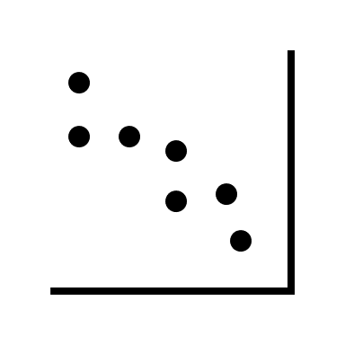
An editor’s comments
Methods based on between individual variance estimates are not admissible to classify within-individual changes.
Needs to be supported by an appropriate ontological/ epistemological justification for the use of this method for that level of analysis. As the indices are all based on between-individual variances and between-individual test-retest correlations, claiming these can be used to classify individuals need a robust justification.
Use SD_{change} or within subject SD?

Slide 10
Analogous to Responsiveness Indices
Effect size (ES) = D/SD_{b}
(2) Standardized Response Mean (SRM) = D/SD†
(3) Guyatt responsiveness statistic (RS) = D/SD‡
D = raw score change in “changed” group
SD_{b} = baseline SD
SD† = SD of D
SD‡ = SD of D among “unchanged”

Slide 11
Reeve et al. (2013, p. 1895)
“ISOQOL respondents … did not support as a minimum standard that a multi-item PRO measure should be required to have evidence of test–retest reliability…. They noted practical concerns regarding test–retest reliability; primarily that some populations studied in PCOR are not stable and that their HRQOL can fluctuate. This phenomenon would reduce estimates of test–retest reliability, making the PRO measure look unreliable when it may be accurately detecting changes over time. In addition, memory effects will positively influence the test–retest reliability when the two survey points are scheduled close to each other.”

Slide 12
Change needed to be statistically significant (p <.05) in 316 low back pain patients over 6 weeks
1 2 3 4 5 6
PROMIS-29 Scale | SD_{baseline} _{n = 316} | SD_{change} _{n = 316} | SD_{change}* n = 119 | MS_{within}+ n = 119 | TE& n = 119
Physical function | 6 | 11 ↑ | 8 ↑ | 11 ↑ | 11 ↑
Pain interference | 5 | 16 ↑ | 11 ↑ | 13 ↑ | 12 ↑
Pain intensity | 12 | 15 ↑ | 10 ↓ | 13 ↑ | 13 ↑
Fatigue | 7 | 16 ↑ | 15 ↑ | 17 ↑ | 17 ↑
Sleep disturbance | 9 | 11 ↑ | 9 | 12 ↑ | 12 ↑
Depression | 6 | 10 ↑ | 9 ↑ | 11 ↑ | 11 ↑
Anxiety | 8 | 14 ↑ | 13 ↑ | 15 ↑ | 15 ↑
Ability to participate | 5 | 18 ↑ | 15 ↑ | 15 ↑ | 16 ↑
* Among 119 who reported they did not change. ⁺ Bland & Altman (1996). & Swinton et al. (2018)
Notes:
2: alpha; 3: random effects ICC; 4: random effects ICC; 5: 2.77*SQRT(MSwithin); 6: 1.96 * SDchange

Slide 13
Coefficient of Repeatability Formula
2.77 times:
  SD_{baseline} * SQRT (1- alpha) Column 2
  SD_{change} * SQRT (1- ICC) Column 3
  SD_{change*} * SQRT (1- ICC) Column 4
  SQRT (MS_{residual}) Column 5
1.96 * SD_{change} Column 6

Slide 14
Change needed to be statistically significant (p <.05) in 316 low back pain patients over 6 weeks
1 2 3 4 5 6
PROMIS-29 Scale | SD_{baseline} _{n = 316} | SD_{change} _{n = 316} | SD_{change}* n = 119 | MS_{within}+ n = 119 | TE& n = 119
Physical function | 6 | 7 ↑ | 5 ↓ | 11 ↑ | 11 ↑
Pain interference | 5 | 6 ↑ | 4 ↓ | 13 ↑ | 12 ↑
Pain intensity | 12 | 15 ↑ | 10 ↓ | 13 ↑ | 13 ↑
Fatigue | 7 | 6 ↓ | 6 ↓ | 17 ↑ | 17 ↑
Sleep disturbance | 9 | 8 ↓ | 7 ↓ | 12 ↑ | 12 ↑
Depression | 6 | 5 ↓ | 5 ↓ | 11 ↑ | 11 ↑
Anxiety | 8 | 8 | 7 ↓ | 15 ↑ | 15 ↑
Ability to participate | 5 | 5 | 4 ↓ | 15 ↑ | 16 ↑
* Among 119 who reported they did not change. ⁺ Bland & Altman (1996). & Swinton et al. (2018)

Slide 15
Reliable Change Index
(Classical Test Theory)
>= 1.96
SEM = standard error of measurement
SD_{bl} = standard deviation at baseline
r_{xx} = reliability
Jacobson and Truax (1991)

Slide 16



Colleagues No Longer With Us
Steve Wallace Dennis Revicki Bill Rogers

Slide 17
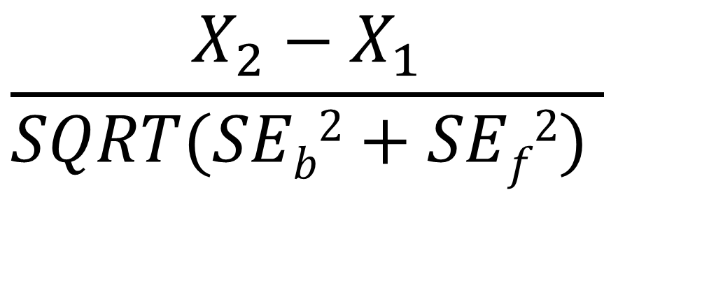
Reliable Change Index (IRT)
$$\frac{X_{2}−X_{1}}{SQRT(SEb2+SEf2) }$$
SE_{b}² = Variance at baseline, SE_{f}² = Variance at follow-up
Jabrayilov et al. (2016). Comparison of classical test theory
and item response theory in individual change assessment.
Appled Psychological Measurement, 40(8), 559-572.
Notes:
Standard errors are obtained using the information function. We use Expected A Posterior (EAP) estimates of physical function and associated standard errors.

Slide 18

Hays, R. D., Spritzer, K. L., Sherbourne, C. D., Ryan, G. W., & Coulter, I. D. (2019). Group and individual-level change on health-related quality of life in chiropractic patients with chronic low back or neck pain. Spine, 44(9), 647-651. for CERC National Study
125 clinics, 2024 (72% of eligible) at baseline; 1834 (91%) at follow-up.
Notes:
72% of those eligible for the study (n = 2024 out of 2829) participated.
n = 1834 (65%) of the 2829; 91% of 2024.

Slide 19
PROMIS-29 Physical and Mental Health Summary Scores
  1. Physical functioning (4 items)
  2. Pain intensity (1 item) and interference (4 items)
  3. Fatigue (4 items)
  4. Sleep disturbance (4 items)
  5. Social health/participation in roles and activities (4 items)
  6. Emotional distress--anxiety (4 items) and depression (4 items)
  7. Physical health summary score
  8. Mental health summary score
T-score metric (mean = 50, SD = 10)
  Hays, R. D., Spritzer, K. L., Schalet, B., & Cella, D. (2018). PROMIS®-29 v2.0 Profile Physical and Mental Health Summary Scores. Quality of Life Research, 27(7), 1885-1891.
Notes:
The PROMIS-29 scores are on a T-score metric with a mean of 50 and SD of 10 in the U.S. general population. For simplicity, I coded all scores so that a higher score represents better health.
[Typically, higher scores represent better physical functioning, social health, and physical and mental health summary scores. Higher scores are worse for the other 4 scales (pain, fatigue, sleep disturbance, and emotional distress).]

Slide 20
PROMIS-29 Physical Function and Emotional Distress Measures
PROMIS-29 Measure | Baseline Mean | 3-month later Mean | t | Effect Size
Physical function | 46 | 47 | 4.15 | .08
Emotional Distress | 50 | 50 | 0.04 | .01
Emotional distress = mean of 4-item depression and 4-item anxiety scales

Slide 21
78%
91%
Spearman rank-order correlation = 0.54

Slide 22
99%

Slide 23
27%

Slide 24
38%

Slide 25
*Δ = -13.7
SEM = 2.6, RCI_{CTT} = 3.7 versus SE = 7.1, RCI_{IRT} = 1.93

Slide 26
Physical Function Simulation
Simulated change in physical function ranging from 1 to 6 SDs in true thetas (z-scores)
-3 to -2, -3 to -1, -3 to 0, -3 to 1, -3 to 2, -3 to 2, -3 to 3
-2 to -1, -2 to 0, -2 to 1, -2 to 2, -2 to 3
-1 to 0, -1 to 1, -1 to 2, -1 to 3
0 to 1, 0 to 2, 0 to 3
1 to 2, 1 to 3
2 to 3
For true theta change from -3 to -2, 67% of the time when CTT indicated improvement, IRT classified as same.

Slide 27
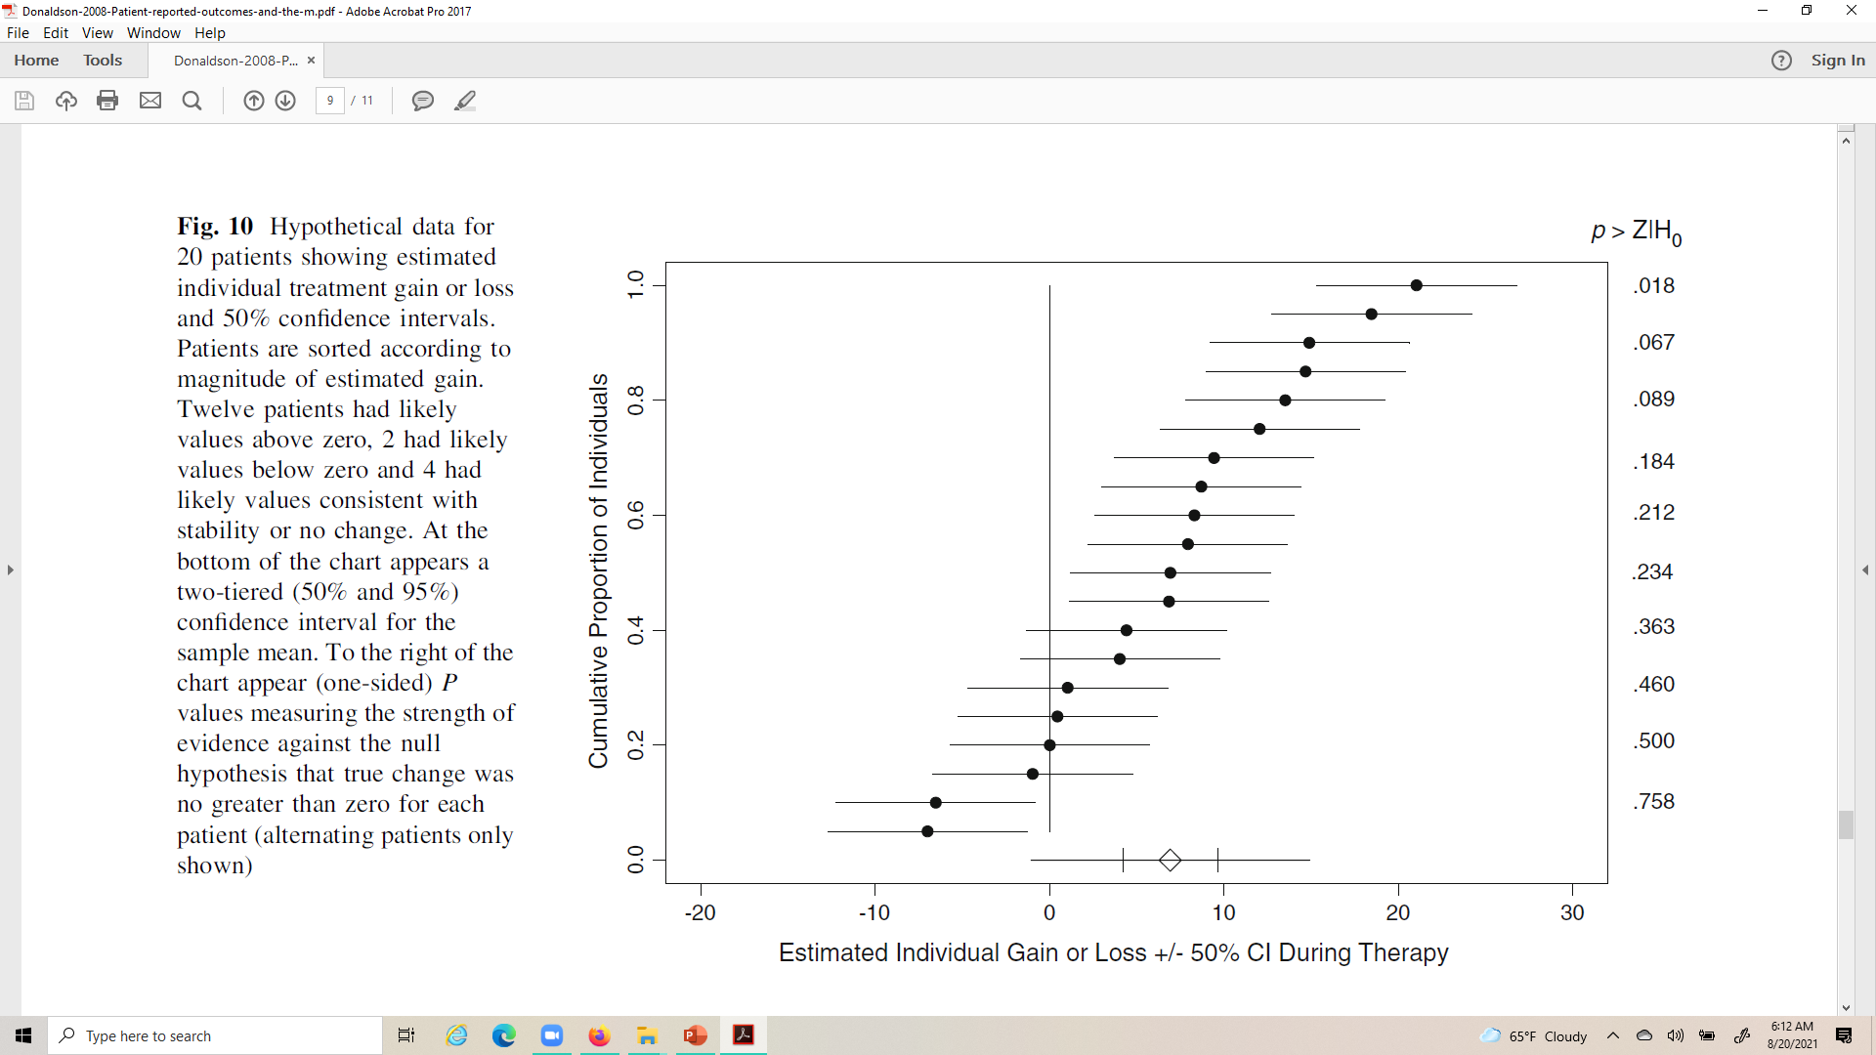
Likely Change (Donaldson, 2008)

Slide 28




Likely Change (Donaldson, 2008)

Slide 29

Likely Change (Donaldson, 2008)

Slide 30

Likely Change (Donaldson, 2008)

Slide 31

Likely Change (Donaldson, 2008)

Slide 32
Peer Reviewer’s Comment
If a person's change surpasses the RCI-50% threshold it means that, if the person were unchanged, probability of observing that change is 50%.
What does this tell us about the how likely it is that the person has really changed?
The scores observed are likely even if the person has not changed.

Slide 33
CR (two-tailed): 2.77*SEM
CR (one-tailed): 2.33*SEM

Slide 34


Notes:
Some have expressed dismay at the relatively small percentage of people classified as changed based on individual statistical significance.

Slide 35



Slide 36
Journal editor not in favor of estimating significance of individual change
"Surely we're not trying to conduct a statistical test for each person as to whether or not they changed? This would lead to a major multiple testing issue. It also doesn't make sense because the point of a statistical test is to make inferences to a population, whereas in this case we want to know whether a specific person experienced meaningful change. Statistical tests are not an appropriate way to do that.”

Slide 37
Peer Reviewer’s Comment
As no clinical or patient-reported anchors were included in the study, the authors are unable to classify people into change groups and subsequently compute individual-level change thresholds. This is contrary to the FDA's PRO Guidance, including their most recent updates, on use of anchor-based methods to compute within-patient meaningful change. To call the approaches used in this manuscript individual-level statistics is simply incorrect and cannot be published this way. This is a fatal flaw of this study.
See citation below for appropriate meaningful change methodology.
Wywrich, K.W., Norquist, J.M, Lenderking. W.R. (2013). Methods for interpreting change over time in patient-reported outcome measures. Quality of Life Research.

Slide 38

Meaningful individual change
Incorporating Clinical Outcome Assessments into Endpoints for Regulatory Decision-Making (December 6, 2019, patient-focused drug development guidance public workshop)
  “Distribution-based methods (e.g., effect sizes, certain proportions of the standard deviation and/or standard error of measurement) do not directly take into account the patient voice and as such cannot be the primary evidence for within-patient clinical meaningfulness.”
Guidance focuses on average change for patients who improved or got worse.

Slide 39
Distribution-based “estimates”
“Distribution-based” methods are simply a way of expressing the observed change in a standardized metric.
This makes it possible to compare change observed for measures that have a different raw metric but does not provide new information about the size of change in a measure that is minimally important.
Anchor-based methods are the only way to estimate minimally important change.

Slide 40
Retrospective Rating of Change Anchor Item
Is your ability to carry out your everyday physical activities such as walking, climbing stairs, carrying groceries, or moving a chair now compared to 6 months ago …
  A lot better?
  A little better?
  The same?
  A little worse?
  A lot worse?

Slide 41
Clinical Anchor
“Change” groups
  50% reduction in seizure frequency
  100% reduction in seizure frequency (seizure free)
Vickrey, B., Hays, R. D., Graber, J., Rausch, R., Engel, J., & Brook, R. H. (1992). A health-related quality of life instrument for patients evaluated for epilepsy surgery. Medical Care, 30, 299-319.

Slide 42
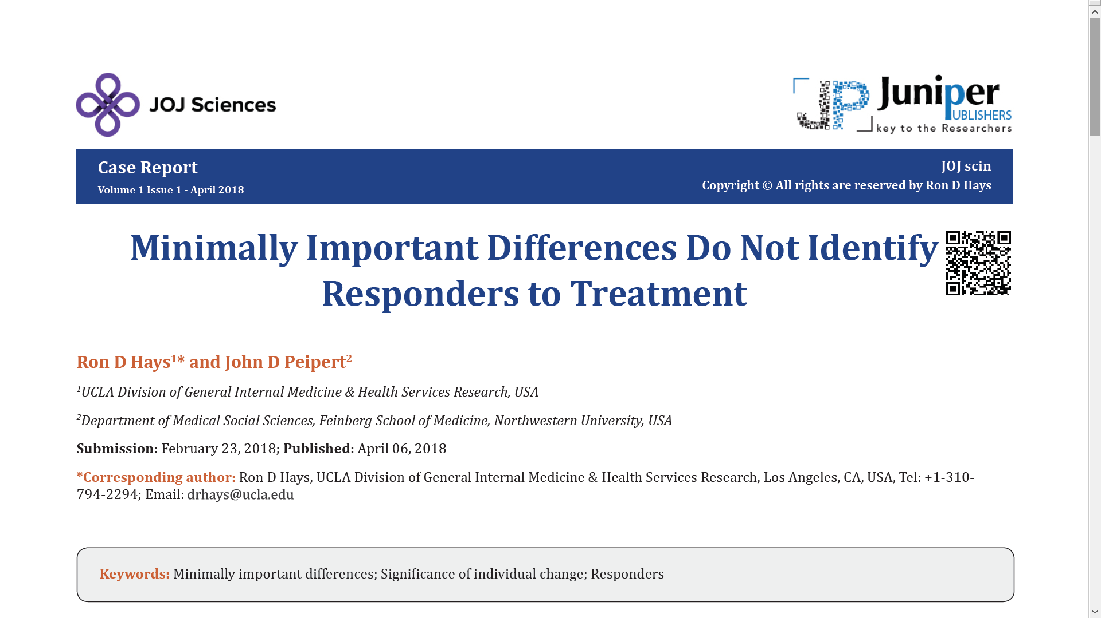
Minimally important change should not be used to identify responders to treatment
Underestimate the amount of change needed to be significant at the individual level due to large measurement error around individual change scores.

Slide 43
Statistically Significant and
Meaningful Individual Change
Jacobson and Truax (1991)
  Recovered
    Statistically significant and clinically significant improvement
  Improved
    Statistically significant but not clinically significant
  Unchanged
    Not statistically significant
  Deteriorated
    Statistically significantly worse

Slide 44

Impact Stratification Score
37% statistically significant improvement (using RCI) over 6 weeks in sample of 750 active-duty U.S. military personnel with low back pain.
59% reported they were a little better, moderately better, much better or their pain was completely gone post-baseline.
Most desirable: 33% improved significantly and reported being better
Intermediate:
  4% improved significantly but reported not being better
  26% did not improve significantly but reported being better
Least desirable: 37% did not improve significantly or report being better

Slide 45

Further
Further comparison of the SD of change and SD within subject versus the SD between subjects is needed.
Use
Use item response theory for more accurate standard error estimates.
Consider
Consider classifying change using less stringent cutoffs than p < 0.05
Report
Report statistically significant AND meaningful individual change.

Slide 46
Bibliography
Bland, J. M., & Altman, D. G. (1996). Measurement error. BMJ, 313: 744-753.
Brouwer, D., Meijer R. R., & Zevalkink, J. (2013). Measuring individual significant change on the Beck Depression Inventory-II through IRT-based statistics. Psychotherapy Research, 23(5):489-501.
De Vries, R., Meijer, R. R., Van Bruggen V., & Morey, R. D. (2016). Improving the analysis of routine outcome measurement data: What a Bayesian approach can do for you. Int J Methods Psychiatr Res, 25(3), 155-167.
Donaldson, G. (2008). Patient-reported outcomes and the mandate of measurement. Qual Life Res, 17(10):1303-13. .
Hays, R. D., & Peipert, J. (2021). Between-group minimally important change versus individual treatment responders. Qual Life Res. doi: 10.1007/s11136-021-02897-z
Hays, R. D., Spritzer, K. L., & Reise, S. P. (2021). Using item response theory to identify responders to treatment: Examples with the Patient-Reported Outcomes Measurement Information System (PROMIS®) physical functioning and emotional distress scales. Psychometrika, 86(3): 781-792.
Hurst, H., & Bolton, J. (2004). Assessing the clinical significance of change scores recorded on subjective outcome measures. Journal of Manipulative and Physiological Therapeutics, 27:26-35.
Jabrayilov, R., Emons, W. H. M., & Sijtsma, K. (2016). Comparison of classical test theory and item response theory in individual change assessment. Applied Psychological Measurement, 40(8):559-572.
Jacobson, N. S., & Truax, P. (1991). Clinical significance: A statistical approach to defining meaningful change in psychotherapy research. Journal of Consulting and Clinical Psychology, 59(1):12-19.
Reeve, B. B., Wyrwich, K. W., et al. (2013). ISOQOL recommends minimum standards for patient-reported outcome measures used in patient-centered outcomes and comparative effectiveness research. Quality of Life Research, 22: 1889-1905.
Swinton, P. A., Hemingway, B. S., et al. (2018). A statistical framework to interpret individual response to intervention: Paving the way for personalized nutrition and exercise prescription. Frontiers in Nutrition, 5: 41.
Terwee, C. B., Peipert, J. D., et al. (2021). Minimal important change (MIC): A conceptual clarification and systematic review of MIC estimates of PROMIS measures. Qual Life Res. doi: 10.1007/s11136-021-02925-y

Slide 47


Ron D. Hays (drhays@ucla.edu)

