Slide 1

Patient Reports about
Health and Health Care .
Ron D. Hays
International Society for Quality in Health Care
2022 Conference (Brisbane, Australia)
https://labs.dgsom.ucla.edu/hays/pages/presentations
October 18, 2022
~ 09:20 am-10:15 pm PT

Slide 2

Notes:
This is my wife, Pam, at Bryce Canyon 5 months ago. I was driving to Zion and Bryce when Gene Nelson called to give me the news about the career achievement award. It is an honor to be included with the 8 prior recipients (Nick Black, David Cella, Bryce Reeve, Arthur Stone, Ethan Basch, Madeline King, Albert Wu, and Melanie Calvert) and I am pleased to have the opportunity to speak with you this morning.

Slide 3

Patient Reports (PR) Outline
PR: self-reported health and patient reports about their healthcare.
1) Landmarks
2) Advancements
3) Fallacies
4) Future directions
Q&A
Notes:
Patient reports can be about demographic characteristics and behaviors, but my focus today is patient reports about health and their healthcare. I draw upon my experience in the United States, so I apologize in advance for being Americentric.
I will touch upon the 4 issues listed here.

Slide 4


1) PR Landmark # 1
Dartmouth COOP Project
(Nelson, Kirk et al., 1981; Nelson, Wasson …& Zubkoff, 1987, J Chron Dis)
Notes:
When I was a graduate student 40 years ago, Gene Nelson, John Wasson, and Michael Zubkoff were creating patient-reported measures that were easy to administer and use clinically. The Dartmouth COOP/WONCA charts are a landmark in assessing functional status within busy office practices.

Slide 5

1) PR Landmark #2
Medical Outcomes Study (MOS)
(Tarlov et al., 1989)
  Sandy Berry
  Shelly Greenfield
  Beth McGlynn
  Gene Nelson
  Bill Rogers
  Cathy Sherbourne
  Anita Stewart
  John E. Ware
  Ken Wells
  Michael Zubkoff
Notes:
Another landmark is the RAND Corporation Medical Outcomes Study initiated about the same time as the COOP Charts. The study had an all-star cast of investigators including Gene Nelson and Michael Zubkoff. The MOS produced an extensive battery of practical tools for routine monitoring of patient outcomes in medical practice, including the SF-36.
It was the first project I worked on in 1984 after getting my Ph.D..

Slide 6
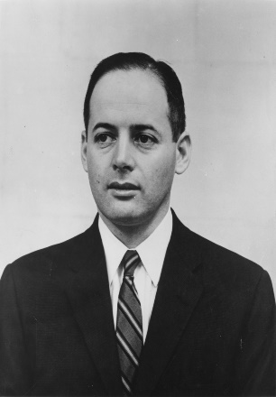

“Tarlov was confident in his belief that doctors need to view their patients as whole individuals — not merely organs or appendages.”
“Someday, all tools used to
measure each functional health
concept, including the best
single-item measure will be
scored on the same metric and
their results will be directly
comparable.” (2003)
Notes:
Alvin Tarlov and John Ware were most responsible for the success of the MOS. Tarlov’s focus on patient-reported outcomes as the primary indicator of the effectiveness of medical services brought about fundamental change in the practice of medicine. John Ware was a senior research psychologist at RAND and led the development of patient-reported measures in the RAND Health Insurance Experiment prior to being the principal investigator of the MOS. John hired me to work on the Medical Outcomes Study.

Slide 7

1) PR Landmark #3
Patient-Reported Outcomes Measurement Information System (PROMIS®)
  Used in clinical, observational, comparative effectiveness, health services and health policy research with adults and children.
Notes:
The 2014 HAL career achievement awardee, Dave Cella, lead the PROMIS Statistical Coordinating Center. PROMIS was motivated by concerns that “letting a thousand flowers bloom” in measurement resulted in a “Tower of Babel” with different concepts being measured using the same terms and similar concepts measured using different terms. PROMIS applied state-of-the-science methods and developed measures that allow flexibility in choice of computer-adaptive administration of item banks, long- and short-form instruments, and customized item sets.

Slide 8

1) PR Landmark #4
Consumer Assessment of Healthcare Providers and Systems (1995-)
Notes:
Twenty-seven years ago, public and private organizations assessed patient satisfaction, but the surveys varied by sponsor, changed from year to year, and did not provide actionable information about the delivery of care. The U.S. Agency for Healthcare Research and Quality launched the CAHPS project to help address the lack of standardized information about the quality of health plans. CAHPS advanced patient experience with care measurement.

Slide 9

2) Advancements
Methodological rigor
  Qualitative methods
- Quantitative methods
Use of measures
Research
Clinically
Notes:
Several major advancements in methods and the use of patient reported measures in research and clinical applications have been made.

Slide 10

Uniformity in Developing, Evaluating, and Selecting PR Measures
U.S. FDA Guidance Documents
  1) Conceptual framework
  2) Adjust framework as needed and draft items
  3) Confirm revised framework and draft instrument
  4) Collect, analyze and interpret data
  5) Modify instrument
  Rinse and repeat as necessary
https://www.cosmin.nl/
  COnsensus-based Standards for the selection of health Measurement INstruments
Notes:
For example, there has been extensive progress in standardizing how measures are developed and evaluated, such as FDA guidance and COSMIN.

Slide 11

Qualitative Methods
Patient/stakeholder input
  Focus groups
  Cognitive interviews
Notes:
Getting patient and other stakeholder input throughout is now routine. Focus groups are used to see what is important to patients, and cognitive interviews are used to evaluate the clarify of questions and revise them as needed.

Slide 12
Quantitative Methods (item characteristic curves)
Notes:
Use of item response theory methods to assess patient-reported questions is increasingly used in measurement development. Shown here are item characteristic curves from a graded response model that support the monotonicity assumption for 6 physical functioning items with 3 response options administered to Medicare beneficiaries in the U.S.

Slide 13
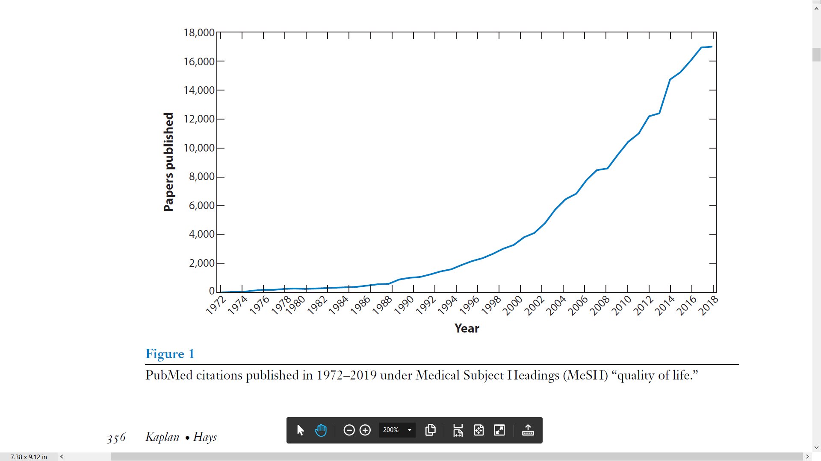
Steep Increase in Use of PR
Notes:
There has been an exponential growth of quality-of-life papers during the last 50 years--more than 17,000 articles were published in 2018.

Slide 14


Clinical Use of PR Measures
CAHPS®
.
.
Notes:
There has also been an increase in clinical use of patient-reported measures, such as these 3 measurement systems.

Slide 15
Effects of Shadow Coaching on
CAHPS® Patient Experience Scores
6-month average overall provider rating (OPR) on CG-CAHPS Survey
  Coached “medium performers” (OPRs 45-89 on 0-100 score)
    74 providers (of 320 total) from 2016-2018
CG-CAHPS provider communication scale and OPR item
Used 2012 to 2019 CG-CAHPS data
  69% Hispanic, 12% Non-Hispanic White patients
  68% English-preferring, 32% Spanish-preferring patients
Notes:
The CAHPS team developed an ambulatory care improvement guide and other materials to support survey users. A safety net provider in Los Angeles implemented shadow coaching of ambulatory care providers who scored in the middle of the score range on the CAHPS clinician and group survey. The coaching was directed at improving interpersonal care provided to patients.

Slide 16

Positive Effects of Shadow Coaching
2-point (0-100 scoring) improvement in CAHPS scores
  Faded over time (Quigley et al., 2021)
3.5-point improvement from re-coaching
  Gains maintained for about a year
Notes:
There were significant improvements in the CAHPS communication and overall provider rating for shadow coached providers, but these gains disappeared after 2.5 years.
There were also significant improvements in CAHPS scores for providers who were re-coached and these benefits faded after about a year.
This work emphasized the important of continuous quality improvement efforts and the need for boosters.

Slide 17
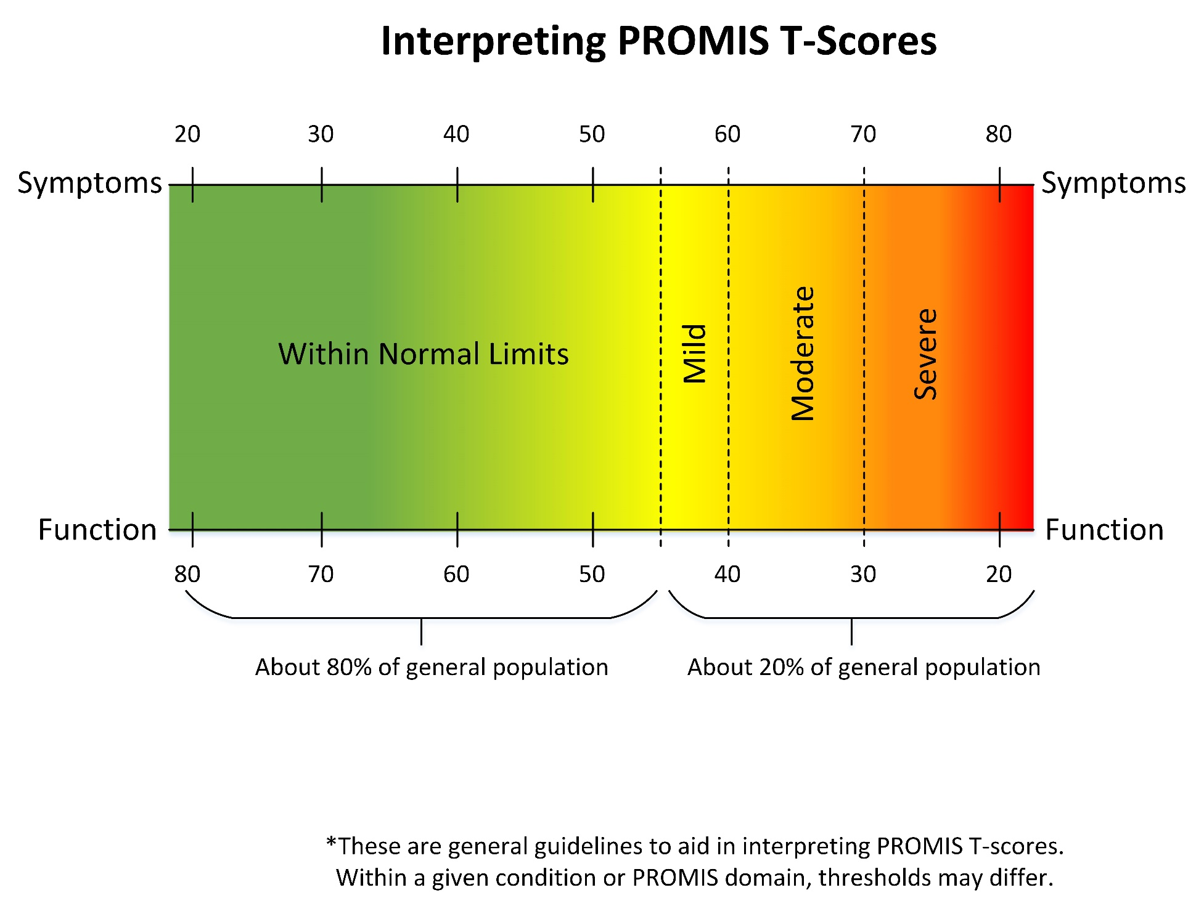
Notes:
This is an example of guidance available for PROMIS scores with thresholds given for the 20% of the general population that fall within normal limits, and mild, moderate or severe problems based on means of 50 and SD of 10 in the general population. Those who are 2 SDs worse than the general population fall into the severe category.

Slide 18
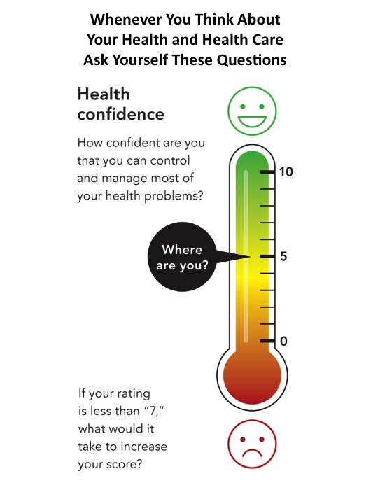
HowsYourHealth
What Matters Index (WMI)
  Bodily pain
  Bothered by emotional problems
  Number of meds taken 4-7 days/week
  Any pills making you sick
How have things been going for you in the past 4 weeks?
  Very well (could hardly be better)
  Pretty good
  Good and bad parts about equal
  Pretty bad
  Very bad (could hardly be worse)
What do you need to maintain or improve it?
Wasson, J. H. (2019)
Notes:
A quarter of a century ago, John Wasson conducted a randomized trial that showed improvements for patients 70 years and older when COOP chart assessments were linked to patient education materials and explicit directives to clinicians.
More recently, he examined the use of the What Matters Index (WMI) in a sample of 9,068 patients 65 and older. Based on this study, John documented improved quality of life by asking the WMI questions and asking about overall quality of life.

Slide 19
3) Fallacies (questionable beliefs)
1) Assessing “patient satisfaction” leads to worse medical care
2) SEM and 0.50 SD estimate the minimally important difference (MID)
3) “Responders to treatment” are defined by change > MID
4) Item response theory (e.g., Rasch) is better than simple-summated scoring.
Notes:
Inaccurate beliefs about patient-reported measures exist. Four examples are listed here.

Slide 20
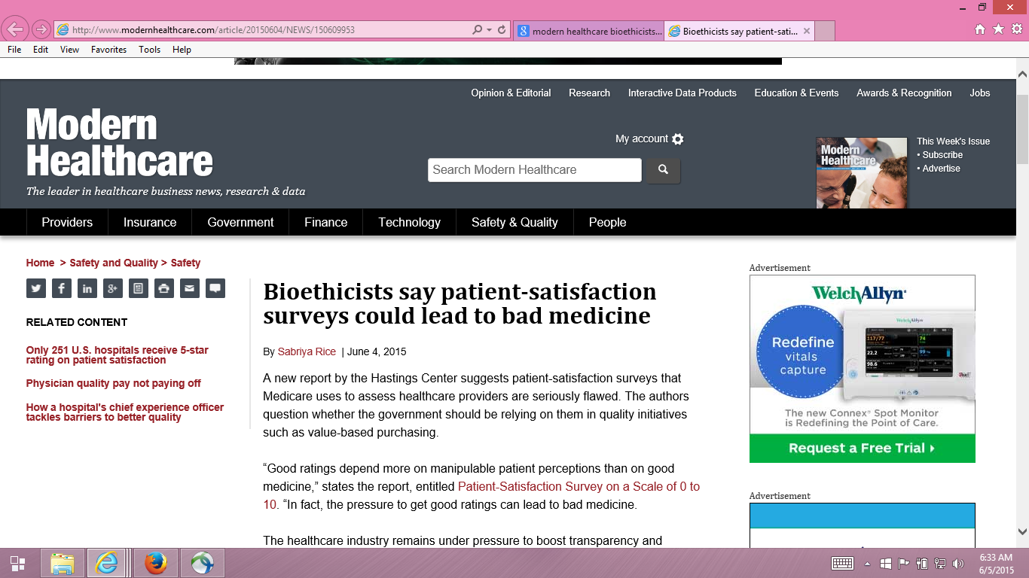
Notes:
Some believe that assessing patient satisfaction leads to worse healthcare because providers need to fulfill inappropriate requests for opiates and unnecessary care.

Slide 21
CAHPS Team Responses
Price, R. A. et al. (2014). Examining the role of patient experience surveys in measuring health care quality. Medical Care Research and Review, 71, 522-554.
Xu, X., et al. (2014). Methodological considerations when studying the association between patient-reported care experiences and mortality. Health Services Research. 50(4), 1146-61.
Price, R. A. et al. (2015). Should health care providers be accountable for patients’ care experiences? JGIM, 30, 253-256.
Cefalu M.S., et al. (2019). Hospital quality indicators are not unidimensional: A reanalysis of Lieberthal and Comer. Health Services Research, 54(2), 502-508.
Notes:
The CAHPS team has published several articles to counter this and related perceptions. For example, the second article noted here was a re-analysis of Medical Expenditure Panel data that showed that doctors spent more time with patients who ended up dying but no other aspects of patient experience differed for those who lived or died. That is, satisfying patients did not cause them to be more likely to die.

Slide 22
SEM and 0.50 SD are not estimates
PR measures need to be responsive to change
  Need external indicators of change (Anchors)
Minimally important difference is subset of responsiveness to change
SEM = SD x SQRT (1-reliability)
0.50 SD is half of the SD
Notes:
The standard error of measurement and a half SD are frequently reported to be estimates of the minimally important amount of change in patient-reported health that is important. But the SD and reliability of a measure are insufficient for identifying the amount of change that is important to patients.

Slide 23
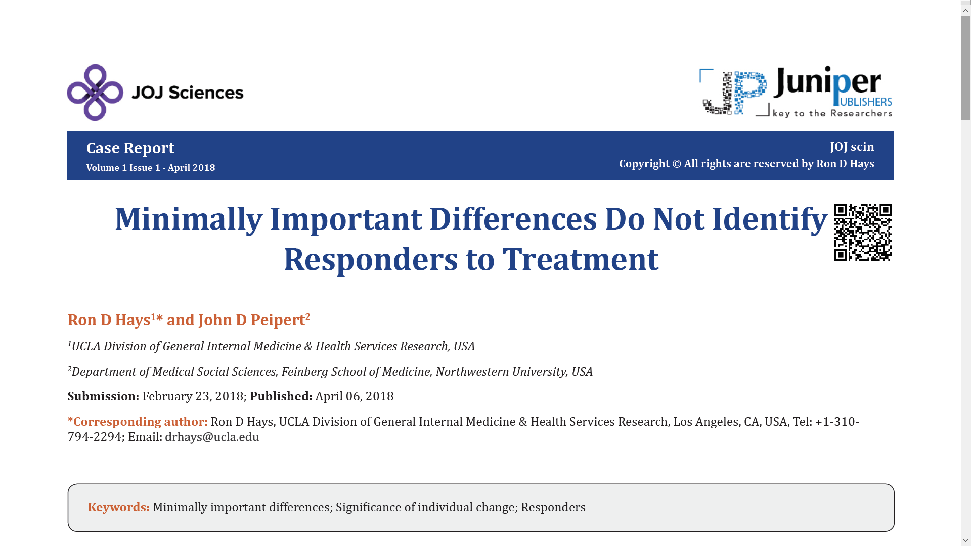
Notes:
In addition, MID estimates are for group-level change. They are not appropriate for identifying if an Individual has responded to treatment.

Slide 24
Amount of Change in Observed Score Needed To be Statistically Significant
= 2.77 *
SD
∗
1
−
r
= 2.77 * SEM
xx
“Coefficient of repeatability” (aka “minimally detectable change,” “smallest real difference,” and “smallest detectable change”).
Note: SD = standard deviation and r_{xx} = reliability
Notes:
The coefficient of repeatability indicates the amount of change needed for significant individual change. Shown here is the formula for probability of 0.05—it is equal to 2.77 times the SEM.
This coefficient is also known as the minimally detectable change, smallest detectable change, and smallest real difference.

Slide 25
Simple-Sum and Item Response Theory (IRT) Scores
IRT latent trait metric is a rescaling of the “optimally weighted” summed score metric to maximize internal consistency.
Different weighted combination of items (including simple-summated) are very highly correlated; associations with other variables tend to be robust.
e.g., 5-item self-rated vision scale (US FDA, AAO, pharma)
  r’s range: 0.95-0.97 (Rasch and graded response models)
Notes:
Item response theory provides estimates of item difficulty and person location on the same metric and facilitates evaluation of response options using item characteristic curves. But claims about the superiority of IRT estimated scores are greatly exaggerated. The correlations between simple-summated scores and IRT estimated scores is usually 0.95 or higher.

Slide 26
Future Directions for PR
Continue to enhance their clinical usefulness
Improve survey participation rates
Evaluate reliability at appropriate unit (e.g., plan, group, provider)
Evaluate individual patient change as well as group change
Enhance collaboration between international societies
  ISOQOL: https://www.isoqol.org/
    Maurice Staquet, M.D.
      Founder and host of 1st conference, Brussels, Feb. 2, 1994
    Quality of Life Research; Journal of Patient-Reported Outcomes
  ISQOLS: https://www.isqols.org/
    Established 1995 to promote research on QOL, happiness, and well-being
    Applied Research in Quality of Life
      Australian Centre on Quality of Life
      Physical functioning among Medicare beneficiaries. ISQOLS annual meeting, Phoenix, AZ, October 2015.
Notes:
I close by noting 5 future directions.
There is ongoing need to facilitate use of patient-reported measures in clinical settings.
Survey response rates have been declining for several years and efforts to maximize participation such as the use of multiple modes of administration including web administration are needed.
When patient-reported measures are used to assess healthcare providers, then reliability at the appropriate unit of assessment such as provider or plan needs to be evaluated.
In addition to looking at average changes, how many patients and which ones have significant improvements or declines should be examined.
Finally, there are international societies with many overlapping interests such as ISOQOL and ISQLS that could benefit from more cross-collaboration.

Slide 27


Ron D. Hays (drhays@ucla.edu)
Notes:
Thank you.

Slide 28
References
Cella, D., Riley, W., Stone, A., Rothrock, N., Reeve, B., Young, S., Amtmann, D., Bode, R., Buysse, D., Choi, S., Cook, K., DeVellis, R., DeWalt, D., Fries, J. F., Gershon, R., Hahn, E. A., Pilkonis, P., Revicki, D., Rose, M., Weinfurt, K., Lai, J., & Hays, R. D. (2010). Initial item banks and first wave testing of the Patient-Reported Outcomes Measurement Information System (PROMIS) network: 2005-2008. Journal of Clinical Epidemiology, 63 (11), 1179-1194
Hays, R. D., Mallett, J. S., Gaillot, S., & Elliott, M. N. (2016). Performance of the Medicare Consumer Assessment of Healthcare Providers and Systems (CAHPS®) Physical Functioning Items. Medical Care, 54, 205-259. PMCID: PMC4713233.
Hays, R. D., & Peipert, J. (2021). Between-group minimally important change versus individual treatment responders. Quality of Life Research, 30, 2765-2772.
Nelson, E., Kirk, J., Bise, B., Chapman, R., Hale, F. A., Stamps, P., et al. (1981). The cooperative information project part 1: A sentinel practice network for service and research in primary care Journal of Family Practice, 13(5), 641-649.
Nelson E, Wasson J, Kirk J, Keller A, Clark D, Dietrich A, Stewart A, Zubkoff M. (1987). Assessment of function in routine clinical practice: description of the COOP Chart method and preliminary findings. J Chronic Dis. , 40, Suppl 1:55S-69S
Quigley, D. D., Elliott, M. N., Slaughter, M. E., Burkhart, Q., Chen, A. Y., Talamentes, E., & Hays, R. D. (2021). Shadow coaching improves patient experience with care, but gains erode later. Medical Care, 59(11), 950-960
Tarlov AR, Ware JE Jr, Greenfield S, Nelson EC, Perrin E, Zubkoff M. (1989). The Medical Outcomes Study. An application of methods for monitoring the results of medical care. JAMA, 18, 262(7), 925-30
Wasson, J. H. (2019). A brief review of single-item and multi-item quality of life measures for Medicare patients. Journal of Ambulatory Care Management, 42, 21–26.
Wasson, J. H. (2021). Standardized assessment, information, and networking technologies (SAINTs): lessons from three decades of development and testing. Quality of Life Research, 30, 3145-3155.

