Slide 1

PROMIS-29 V2.0 Physical and
Mental Health Summary Scores
Ron D. Hays
Karen L. Spritzer, Ben Schalet, Dave Cella
September 27, 2017, 3:30-3:50pm
HealthMeasures User Conference
Track B: Enhancing Quality Measurement
Prentice Women’s Hospital Conference Center
250 E. Superior Street, Chicago, Illinois

Slide 2
PROMIS-29 V 2.0
4 items each
  Ability to participate in social roles and activities
  Anxiety
  Depressive symptoms
  Fatigue
  Pain interference
  Physical functioning
  Sleep disturbance.
Pain intensity with 0–10 numeric rating item

Slide 3
Preference-Based Scores Estimated from PROMIS-29
Indirect (mapping to):
  EQ-5D-3L (Revicki et al., 2009, Qual Life Res)
  HUI-3 (Hays, Revicki et al., 2016, Qual Life Res)
Preference scoring functions
  Craig et al. (2014, Value in Health)
  Hanmer et al. (2015, Health Qual Life Outcomes)

Slide 4
Sample 1: Op4G Panel
n = 3,000
51% female
60% non-Hispanic White, 17% Hispanic, 14% Black, 9% Asian, 1% other
Mean age = 46 (range: 18-88 years old)
14% less than high school, 31% high school graduates, 28% some college, 47% college degree
57% married or living with a partner

Slide 5
Sample 2: Toluna/Greenfield panel
n = 2,000
50% female
81% non-Hispanic White, 6% Hispanic, 7% Black, 4% Asian, 2% other
Mean age = 52 (range: 18-93 years old)
3% less than high school, 25% high school graduates, 42% some college, 30% college degree
56% married or living with a partner

Slide 6
Analysis Plan
Exploratory and Confirmatory Factor analyses
Reliability
  Coefficient alpha for multi-item scales
  Mosier’s formula for weighted composites
Product-moment correlations among PROMIS-29 scales
Associations of PROMIS-29 Summary Scores with:
  EQ-5D-3L, HUI-3, PROMIS Global Physical and Mental Health, SF-36 PCS and MCS, and number of chronic conditions

Slide 7
Results

Slide 8
Reliability Estimates
Measure | Sample 1 | Sample 2
Physical Functioning | 0.91 | 0.93
Fatigue | 0.91 | 0.95
Pain Interference | 0.94 | 0.86
Depressive Symptoms | 0.93 | 0.95
Anxiety | 0.90 | 0.91
Ability to Participate in Social Roles and Activities | 0.93 | 0.96
Sleep Disturbance | 0.77 | 0.88
PROMIS-29 Physical Health Summary Score | 0.94 | 0.95
PROMIS-29 Mental Health Summary Score | 0.97 | 0.98

Slide 9
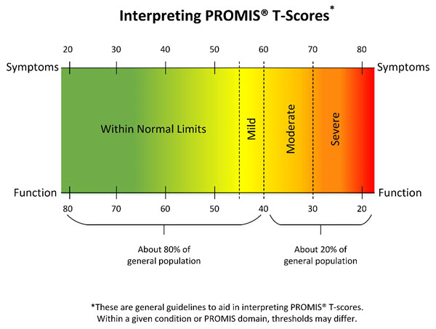
PROMIS Physical and Mental Health T-scores
z-scores = (T-score – 50)/10
  Pain z-score (pain intensity and pain interference)
  Emotional z-score (anxiety and depressive symptoms)
Summary health T-scores = 10*(Sum of z-scores*scoring coefficients) + 50
Higher score is better health

Slide 12


Correlations of Physical and Mental Health Summary Scores with Other Variables (Sample 1)
 | PROMIS-29 Physical Health Summary Score | PROMIS-29 Mental Health Summary Score
EQ-5D-3L (predicted from PROMIS global health items) | 0.82 | 0.73
HUI-3 | 0.73 | 0.67
PROMIS Global Physical | 0.80 | 0.66
PROMIS Global Mental | 0.58 | 0.64
Number of Chronic Conditions | -.50 | -.45
Hypertension, angina, coronary artery disease, heart failure, heart attack, stroke, liver disease, kidney disease, arthritis, migraines, asthma, chronic lung disease, diabetes, cancer, depression, anxiety, alcohol or drug problem, sleep disorder, HIV/AIDS, spinal cord injury,and multiple sclerosis.

Slide 13


Correlations of Physical and Mental Health Summary Scores with Other Variables (Sample 2)
 | PROMIS-29 Physical Health Summary Score | PROMIS-29 Mental Health Summary Score
SF-36 Physical Component Score | 0.82 | 0.38
SF-36 Mental Component Score | 0.54 | 0.82
Number of Chronic Conditions | -.53 | -.42
Hypertension, angina, coronary artery disease, heart failure, heart attack, stroke, liver
disease, kidney disease, arthritis, migraines, asthma, chronic lung disease, diabetes,
cancer, depression, anxiety, alcohol or drug problem, sleep disorder, HIV/AIDS, and
multiple sclerosis.

Slide 14
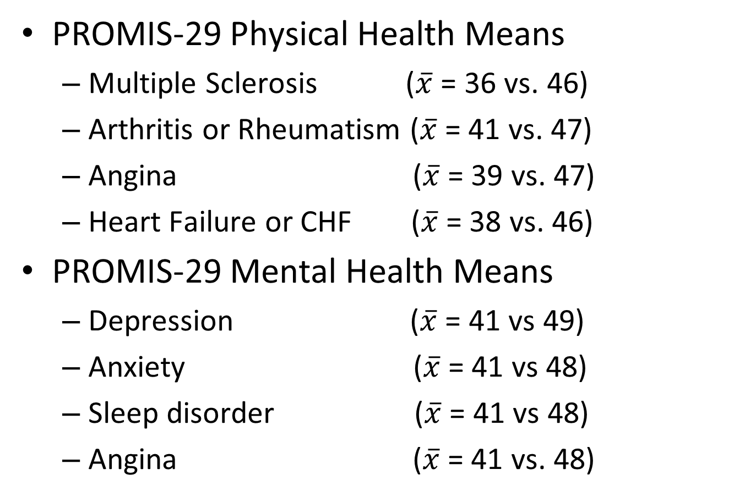
Largest Associations with Chronic Conditions (Sample 1)
PROMIS-29 Physical Health Means
  Multiple Sclerosis ($\overline{x}$ = 36 vs. 46)
  Arthritis or Rheumatism ($\overline{x}$ = 41 vs. 47)
  Angina ($\overline{x}$ = 39 vs. 47)
  Heart Failure or CHF ($\overline{x}$ = 38 vs. 46)
PROMIS-29 Mental Health Means
  Depression ($\overline{x}$ = 41 vs 49)
  Anxiety ($\overline{x}$ = 41 vs 48)
  Sleep disorder ($\overline{x}$ = 41 vs 48)
  Angina ($\overline{x}$ = 41 vs. 48)

Slide 15
Conclusions
These studies provide support for the reliability and validity of the PROMIS-29 Physical and Mental Health Summary scores.
Further work is needed to evaluate these summary scores in other samples.
Alternative scoring approaches such as higher-order factor models should be explored.

Slide 16

Funding for HealthMeasures was provided by the National Institutes of Health grant U2C CA186878.

