Slide 1

PROMIS-29 V2.0 Physical and
Mental Health Summary Scores
Ron D. Hays
Karen L. Spritzer, Ben Schalet, Dave Cella
October 20, 2017, 4:20-4:33pm
ISOQOL, Philadelphia, Grand ABC
Oral Session 208: Measurement in General Populations

Slide 2
PROMIS-29 V 2.0
4 items each
  Ability to participate in social roles and activities
  Anxiety
  Depressive symptoms
  Fatigue
  Pain interference
  Physical functioning
  Sleep disturbance
Pain intensity (0–10 numeric rating item)

Slide 3
Preference-Based Scores Estimated from PROMIS-29
Indirect (mapping to):
  EQ-5D-3L
    Revicki et al., 2009, Qual Life Res
    Thompson et al., 2017 epub, Pharmacoeonomics
  HUI-3 (Hays et al., 2016, Qual Life Res)
Preference scoring functions
  Craig et al. (2014, Value in Health)
  Hanmer et al. (2015, Health Qual Life Outcomes)

Slide 4
Sample 1: Op4G Panel
n = 3,000
51% female
60% non-Hispanic White, 17% Hispanic, 14% Black, 9% Asian, 1% other
Mean age = 46 (range: 18-88 years old)
14% less than high school, 31% high school graduates, 28% some college, 47% college degree
57% married or living with a partner

Slide 5
Sample 2: Toluna/Greenfield panel
n = 2,000
50% female
81% non-Hispanic White, 6% Hispanic, 7% Black, 4% Asian, 2% other
Mean age = 52 (range: 18-93 years old)
3% less than high school, 25% high school graduates, 42% some college, 30% college degree
56% married or living with a partner

Slide 6
Analysis Plan
Coefficient alpha for 7 multi-item scales
Factor analyses (exploratory and confirmatory)
Reliability of weighted composites
  Mosier’s formula
Correlations among PROMIS-29 “scales”
Associations of PROMIS-29 Summary Scores with number of chronic conditions and:
  EQ-5D-3L, HUI-3, PROMIS Global Physical and Mental
  SF-36v2 PCS and MCS, SF-6D

Slide 7
Internal Consistency Reliability
Measure | Sample 1 | Sample 2
Physical Functioning | 0.91 | 0.93
Fatigue | 0.91 | 0.95
Pain Interference | 0.94 | 0.86
Depressive Symptoms | 0.93 | 0.95
Anxiety | 0.90 | 0.91
Ability to Participate in Social Roles and Activities | 0.93 | 0.96
Sleep Disturbance | 0.77 | 0.88

Slide 8
Standardized CFA Loadings for Two Factors (Sample 1)

Slide 9
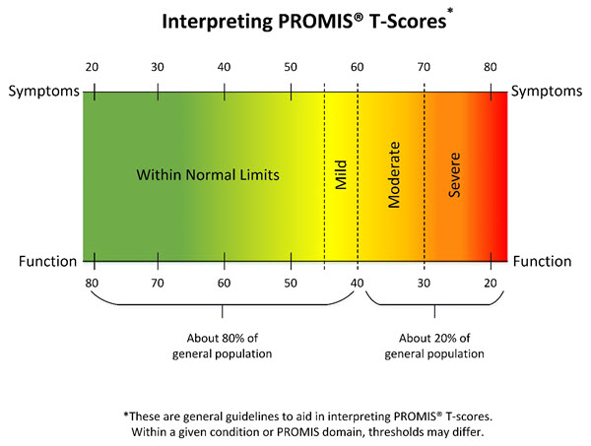
PROMIS Physical and Mental Health T-scores
z-scores = (T-score – 50)/10
Summary health T-scores = 10*(Sum of z-scores*scoring coefficients) + 50
Higher score is better health

Slide 12


Correlations of Physical and Mental Health Summary Scores with Other Variables (Sample 1)
 | PROMIS-29 Physical Health Summary Score | PROMIS-29 Mental Health Summary Score
EQ-5D-3L (predicted from PROMIS global health items) | 0.82 | 0.73
HUI-3 | 0.73 | 0.67
PROMIS Global Physical | 0.80 | 0.66
PROMIS Global Mental | 0.58 | 0.64
Number of Chronic Conditions | -.50 | -.45
Hypertension, angina, coronary artery disease, heart failure, heart attack, stroke, liver disease, kidney disease, arthritis, migraines, asthma, chronic lung disease, diabetes, cancer, depression, anxiety, alcohol or drug problem, sleep disorder, HIV/AIDS, spinal cord injury, and multiple sclerosis.

Slide 13


Correlations of Physical and Mental Health Summary Scores with Other Variables (Sample 2)
 | PROMIS-29 Physical Health Summary Score | PROMIS-29 Mental Health Summary Score
SF-36 Physical Component Score | 0.82 | 0.38
SF-36 Mental Component Score | 0.54 | 0.82
SF-6D Number of Chronic Conditions | 0.81 -.53 | 0.74 -.42
SF-6D Mean = 0.71, SD = 0.14; Brazier, J., Rowen, D., & Hanmer, J. (2008). Revised SF-6D scoring programmes:
A summary of improvements. Patient Reported Outcomes Newsletter, 48, 16–17. Fall.
Hypertension, angina, coronary artery disease, heart failure, heart attack, stroke, liver disease, kidney disease,
arthritis, migraines, asthma, chronic lung disease, diabetes, cancer, depression, anxiety, alcohol or drug problem,
sleep disorder, HIV/AIDS, and multiple sclerosis.

Slide 14
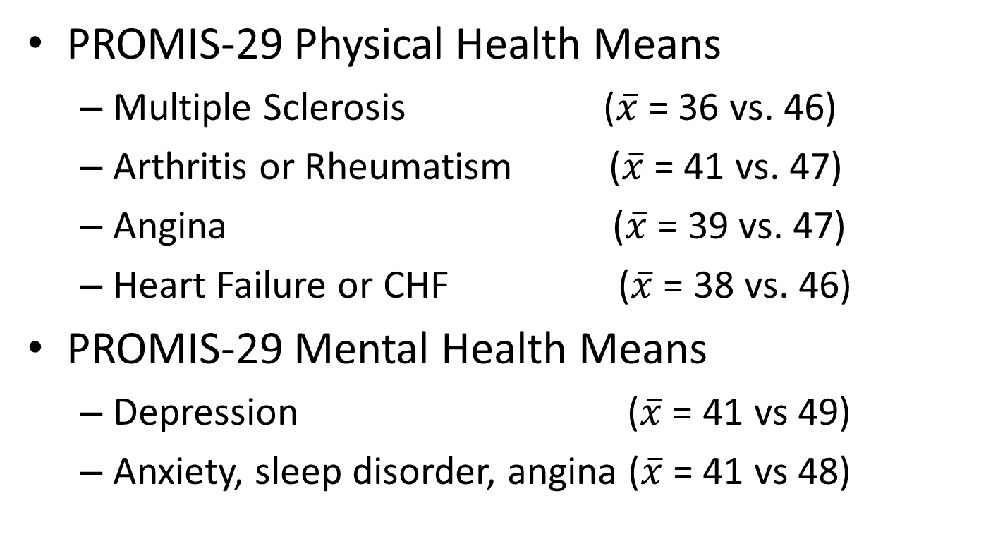
Largest Associations with Chronic Conditions (Sample 1)
PROMIS-29 Physical Health Means
  Multiple Sclerosis ($\overline{x}$ = 36 vs. 46)
  Arthritis or Rheumatism ($\overline{x}$ = 41 vs. 47)
  Angina ($\overline{x}$ = 39 vs. 47)
  Heart Failure or CHF ($\overline{x}$ = 38 vs. 46)
PROMIS-29 Mental Health Means
  Depression ($\overline{x}$ = 41 vs 49)
  Anxiety, sleep disorder, angina ($\overline{x}$ = 41 vs 48)

Slide 15
Conclusions
These studies provide support for the reliability and validity of the PROMIS-29 Physical and Mental Health Summary scores.
Further work is needed to evaluate these summary scores in other samples.
Alternative scoring approaches such as higher-order factor models should be explored.

Slide 16

Funding for HealthMeasures was provided by the National Institutes of Health grant U2C CA186878.

