Slide 1
NIH: Patient-Reported Outcomes Measurement Information System (PROMIS®)
Ron D. Hays
Functional Vision and Visual Function
November 10, 2016, 8:55-9:15am

Slide 2
Disclosures
Professor, UCLA Department of Medicine, Division of General Internal Medicine and Health Services Research (drhays@ucla.edu)
Research funding from NIH for PROMIS and Patient-Centered Assessment Resource (PCAR)
Collaborator on prior vision-related projects with NEI, FDA, and Allergan

Slide 3

PROMIS
Self-report measures that assess physical, mental, and social health in adults and children.
Can be used with the general population and with individuals living with chronic conditions
T-score metric for U.S. general population (Mean = 50, SD = 10)

Slide 4
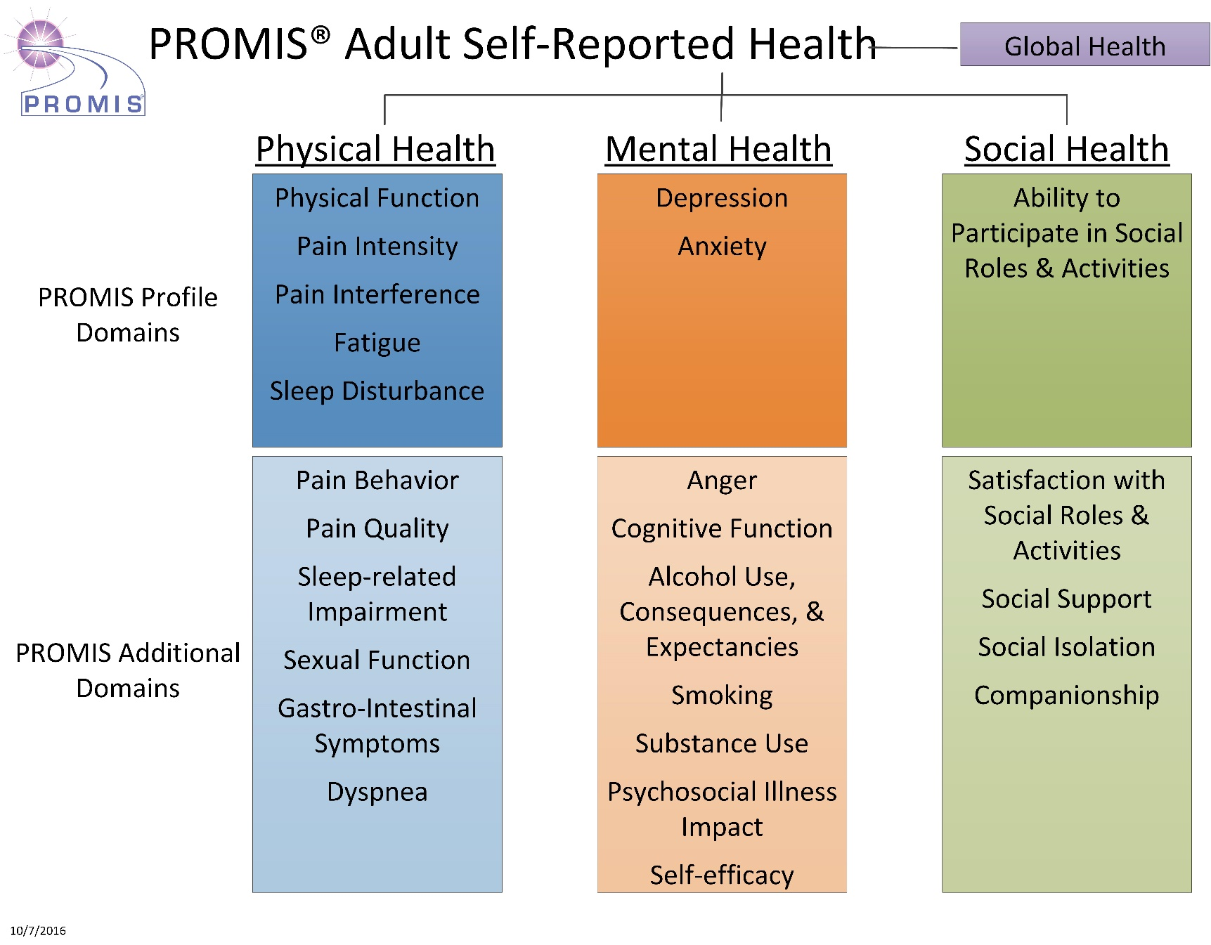
Notes:
PROMIS adult domains

Slide 5
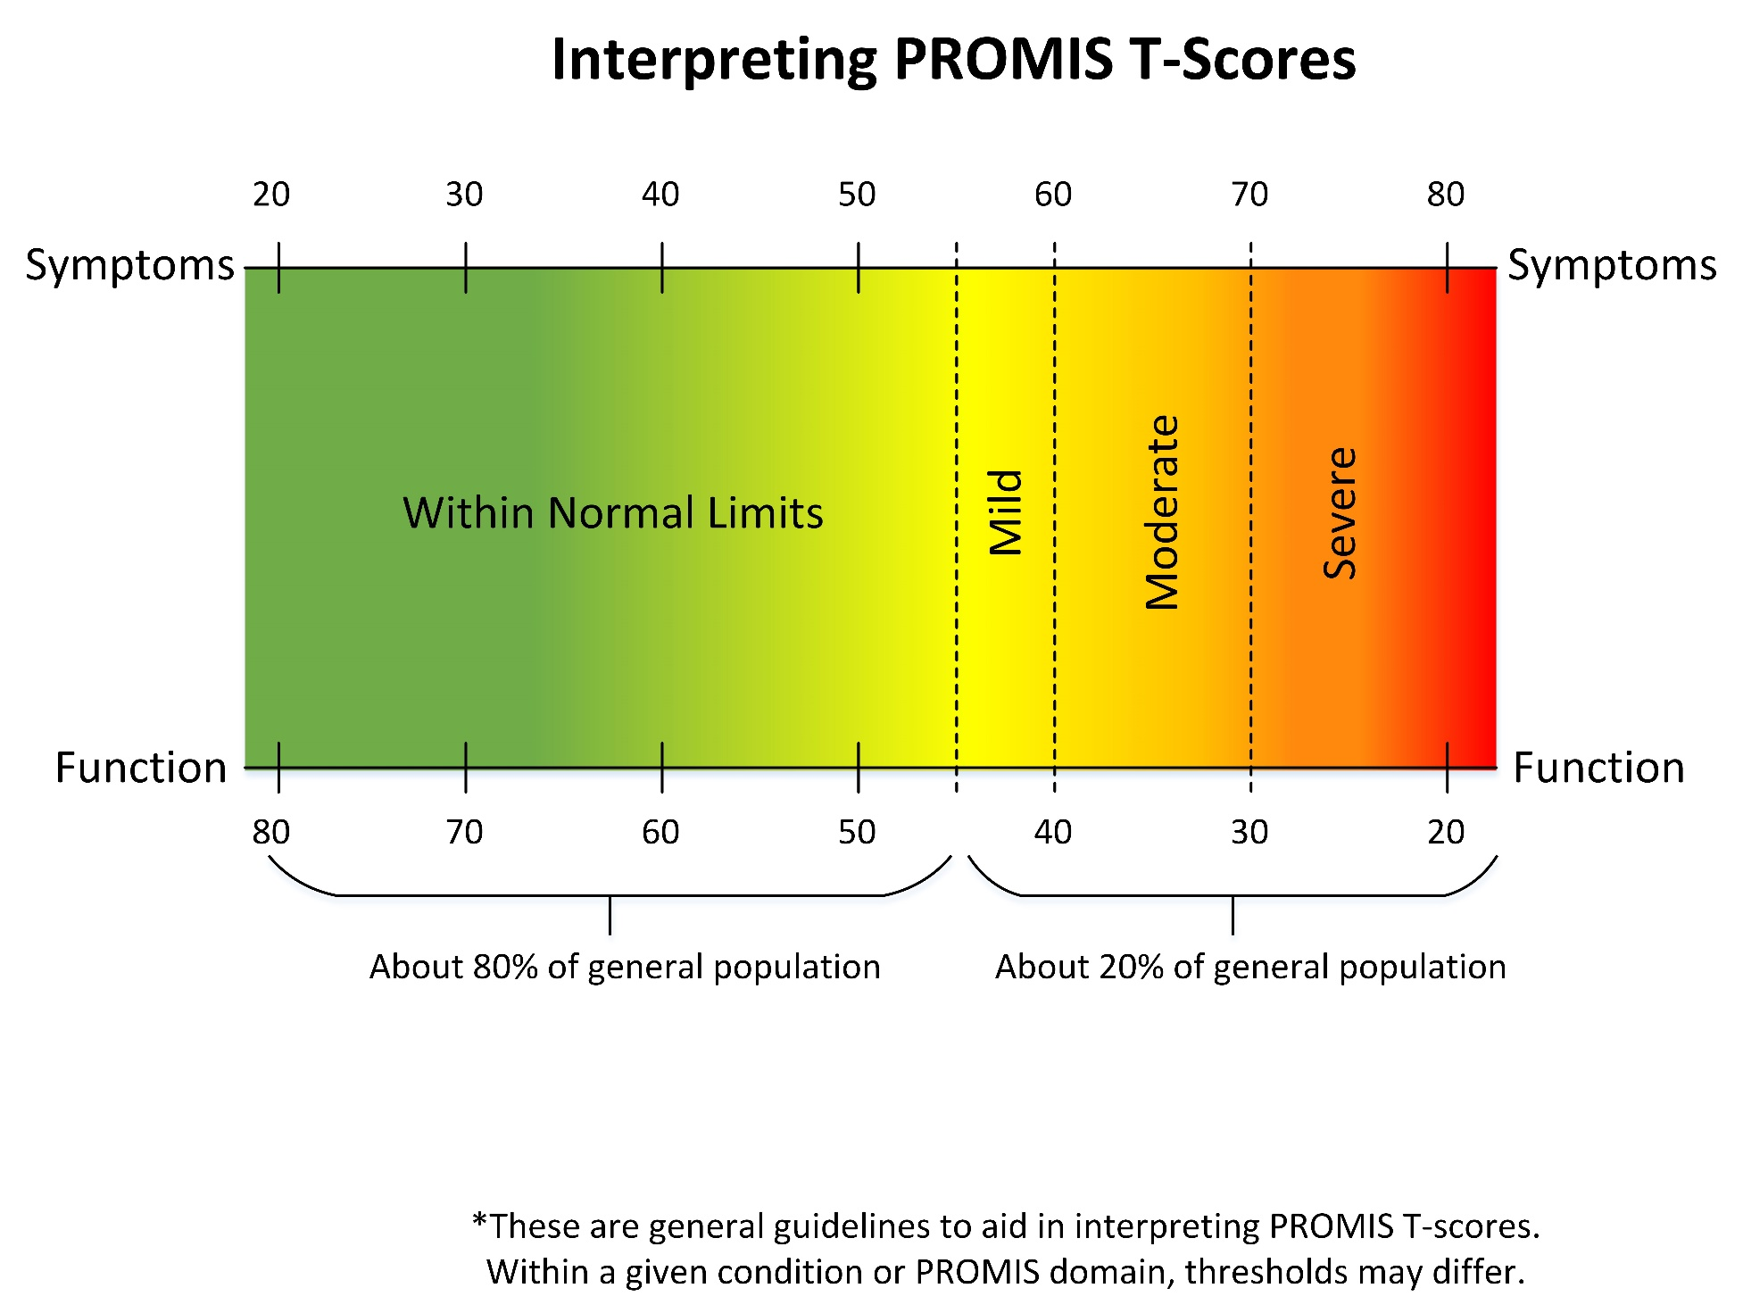

68%, 95%, and 99.6% within 1, 2 and 3 SDs, respectively

Slide 6
PROMIS Fatigue Across Five Clinical Conditions
Cancer
w/ benefit
(2 mos)
Cancer
Chemo
(B)
N = 310
N = 229
Back Pain
(3 mos)
Back Pain
(1 mo)
Back Pain
(B)
N = 114
Depression
(3 mos)
Depression
(1 mo)
Depression
(B)
N = 64
HF Post-transplant
HF Pre-transplant
Exacerbation to Stable
N = 125
COPD Stable (B)
COPD Exacerbation (B)
35
40
45
50
55
60
65
Average for General Population

Slide 7
Content can be expanded to be condition-specific: Pain Interference “Plus” Items
Existing PROMIS items (8)
How much did pain interfere with
  your enjoyment of life?
  your close personal relationships?
  your day-to-day activities?
  your ability to work (include work at home)?
  your ability to participate in social activities?
  your ability to remember things?
How irritable did you feel because of pain?
How often did pain prevent you from walking more than 1 mile?
New condition-specific “gap” items (5)
How much did knee pain
  limit your daily activities?
  interfere with your walking?
  interfere with going up stairs?
  interfere with going down stairs?
How often did knee pain make you feel depressed?

Slide 8
Administration Options
Paper (short forms and profiles only)
Computer (e.g., Assessment Center, REDCap)
App (e.g., PROMIS iPad app)

Slide 9
PROMIS® Profile Short Forms (v2)
(29-43-57 items)
8
6
4
Anxiety
29
Mental
Depression
28
Fatigue
95
Pain Interference
41
Physical
Sleep Disturbance
27
Physical Function
165
Social
Ability to Participate
35
(+ pain intensity)
Notes:
The 7 sub-domains were selected to represent three higher level PROMIS domains, Mental Health, Physical Health, and Social Health. The short forms of different lengths, 4, 6, and 8 items, were designed to provide incrementally more precision and coverage for clinical populations.
9

Slide 10
Computer Adaptive Tests
Question #1
high
physical
function
3
Question #2
Question #3
2
2
2
1
1
1
0
0
Questionnaire
with a high
precision -
AND a
wide range
- 1
- 2
low
physical
function
- 3
Notes:
Purpose of this slide is to walk the audience through the CAT process using an example …and thereby transmit the message of narrower measurement range and higher precision with each question …
I typically ese e.g. an example for depression, or any other topic I want to focus on … like first question “do you feel depressed”, answer “some of the time” … than we would like to know how depressed and the CAT might choose a question asking about self worth, and if the patient indicates that this is diminished also, a third question asking about thoughts of suicide might be appropriate … in this case the answer would be no, never …
And maybe compare it with another scenario like the participant would have answered the first question, no I am not at all depressed, asking about suicide would not make sense, instead the CAT might have chosen a question asking about happiness … bla bla
The conclusion is, we can make precise test over the entire range …

Slide 11
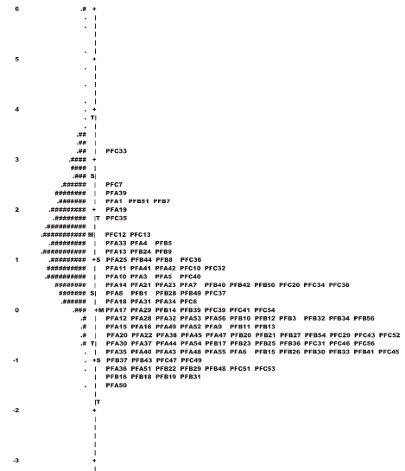
Patients Items
High PF
Low PF
Measurement floors/ceilings can be addressed by extending the item bank
New Item
New Item
New Item
New Item
New Item
New Item
New Item
New Item
New Item
New Item
New Item
New Item

Slide 12
Test Information Functions:
Separate and Combined
Notes:
Figure 2. Test information function of each instrument (after linking) and for the combined set of four instruments considered as a whole.

Slide 13
Choi et al, Psychological Assessment, 26(2): 513-527, 2014
Notes:
Figure 3. Comparison of clinical cut scores on the PROMIS Depression metric. CES-D: 16 or higher for positive clinical depression. PHQ-9: 5-9 (mild), 10-14 (moderate), 15-19 (moderately severe), 20 or higher (Severe). BDI-II: 0-13 (minimal), 14-19 (mild), 20-28 (moderate), 29 or higher (severe).

Slide 14

Questions?

