Slide 1

Evaluating the Significance of
Individual Change
May 14, 2018 (3:00 – 4:00 PDT)
RCMAR Methods Seminar Series
Hays, R. D., Brodsky, M., Johnston, M. F., Spritzer, K. L., & Hui, K. (2005). Evaluating the statistical significance of health-related quality of life change in individual patients. Evaluation and the Health Professions, 28, 160-171.
Ron D.Hays, Ph.D.
drhays@ucla.edu

Slide 2
Physical Functioning and Emotional Well-Being at Baseline for 54 Patients at UCLA-Center for East West Medicine
Mental
Physical
MS = multiple sclerosis; ESRD = end-stage renal disease; GERD = gastroesophageal reflux disease.
2

Slide 3

Physical Functioning and Emotional Well-Being at Baseline for 54 Patients at UCLA-Center for East West Medicine
Mental
Physical
MS = multiple sclerosis; ESRD = end-stage renal disease; GERD = gastroesophageal reflux disease.
3

Slide 4
Significant Improvement in all but 1 of SF-36 Scales (Change is in T-score metric)
Change
t-test
prob.
PF-10
1.7
2.38
.0208
RP-4
4.1
3.81
.0004
BP-2
3.6
2.59
.0125
GH-5
2.4
2.86
.0061
EN-4
5.1
4.33
.0001
SF-2
4.7
3.51
.0009
RE-3
1.5
0.96
.3400
EWB-5
4.3
3.20
.0023
PCS
2.8
3.23
.0021
MCS
3.9
2.82
.0067

Slide 5
Effect Size
(Follow-up – Baseline)/ SD_{baseline}
_{Cohen’s Rule of Thumb:}
_{ES = 0.20 Small}
_{ES = 0.50 Medium}
_{ES = 0.80 Large}

Slide 6
Effect Sizes for Changes in SF-36 Scores
Effect Size
0.13
0.35
0.35
0.21
0.53
0.36
0.11
0.41
0.24
0.30
PFI = Physical Functioning; Role-P = Role-Physical; Pain = Bodily Pain; Gen H=General Health; Energy = Energy/Fatigue; Social = Social Functioning; Role-E = Role-Emotional; EWB = Emotional Well-being; PCS = Physical Component Summary; MCS =Mental Component Summary.
0.11 0.13 0.21 0.24 0.30 0.35 0.35 0.36 0.41 0.53

Slide 7
Defining a Responder: Reliable Change Index (RCI)
Note: SD_{bl} = standard deviation at baseline
r_{xx} = reliability

Slide 8
Significant Change
> = 1.96

Slide 9
Amount of Change in Observed Score Needed To be Statistically Significant
= 2.77 * SD_{bl} * SQR (1- r_{xx})
“Coefficient of reproducibility”
Note: SD_{bl} = standard deviation at baseline and r_{xx} = reliability

Slide 10
How Reliability Relates to Amount of Individual Change Needed
Reliability | SQR (1- r_{xx}) | Change Needed
0.70 | 0.55 | 1.5 SD
0.80 | 0.44 | 1.2 SD
0.90 | 0.32 | 0.9 SD
0.95 | 0.22 | 0.6 SD
0.97 | 0.17 | 0.5 SD
2.77 * SQR (1- r_{xx}) * SD_{bl}

Slide 11
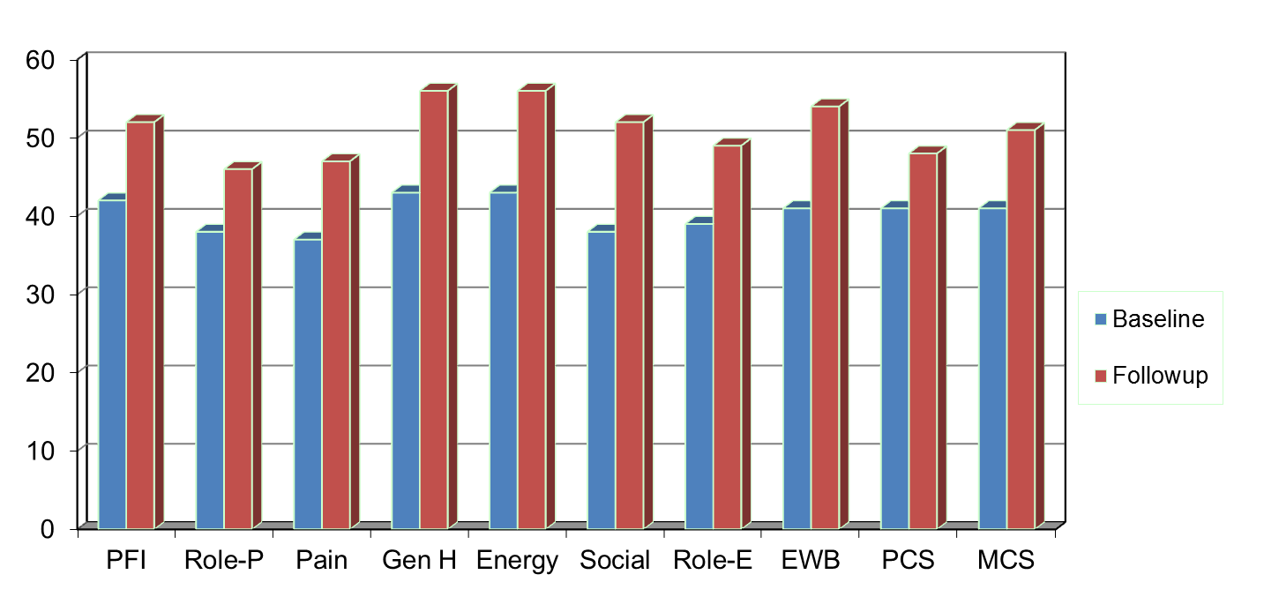
Amount of Change Needed for Significant Individual Change
Effect Size
0.67
0.72
1.01
1.13
1.33
1.07
0.71
1.26
0.62
0.73
PFI = Physical Functioning; Role-P = Role-Physical; Pain = Bodily Pain; Gen H=General Health; Energy = Energy/Fatigue; Social = Social Functioning;
Role-E = Role-Emotional; EWB = Emotional Well-being; PCS = Physical Component Summary; MCS =Mental Component Summary.

Slide 12
7-31% Improve Significantly
% Improving
% Declining
Difference
PF-10
13%
2%
+ 11%
RP-4
31%
2%
+ 29%
BP-2
22%
7%
+ 15%
GH-5
7%
0%
+ 7%
EN-4
9%
2%
+ 7%
SF-2
17%
4%
+ 13%
RE-3
15%
15%
0%
EWB-5
19%
4%
+ 15%
PCS
24%
7%
+ 17%
MCS
22%
11%
+ 11%

Slide 13
Observational Study of ~1800 Chiropractic Patients in Treatment for Chronic Low Back or Neck Pain
Notes:
Slide 45
The reliabilities of the PROMIS-29 v2.0 measures in this sample were 0.85 or higher.
Baseline means indicate that the sample of patients with chronic low back pain or neck pain are similar to the U.S. general population on emotional distress and better on social health. But they have worse physical functioning and more pain, fatigue, and sleep disturbance.

Slide 14
Notes:
Slide 46
From baseline to the end of the study 3 months later, we found no change in emotional distress but statistically significant and small improvements on all the other measures.
Note that improvements of about 3 points on the SF-36 summary scores over 3 months due to manipulation were found in the UK BEAM (back pain, exercise, and manipulation) randomized trial.

Slide 15
Notes:
Slide 47
13-30% of the sample got significantly better (“responders”) on the different health measures using the coefficient of reproducibility, which requires a change of at least 2.77 times the SEM, and is equivalent to the Reliable Change Index.

Slide 16
Item Responses and
Trait Levels
Person 1
Person 2
Person 3
Trait
Continuum
Item 1
Item 2
Item 3

Slide 17




Computer Adaptive Testing (CAT)

Slide 18
The PROMIS Metric
T Score
  Mean = 50
  SD = 10
  Referenced to US General Pop.
  T = 50 + (z * 10)
www.healthmeasures.net

Slide 19
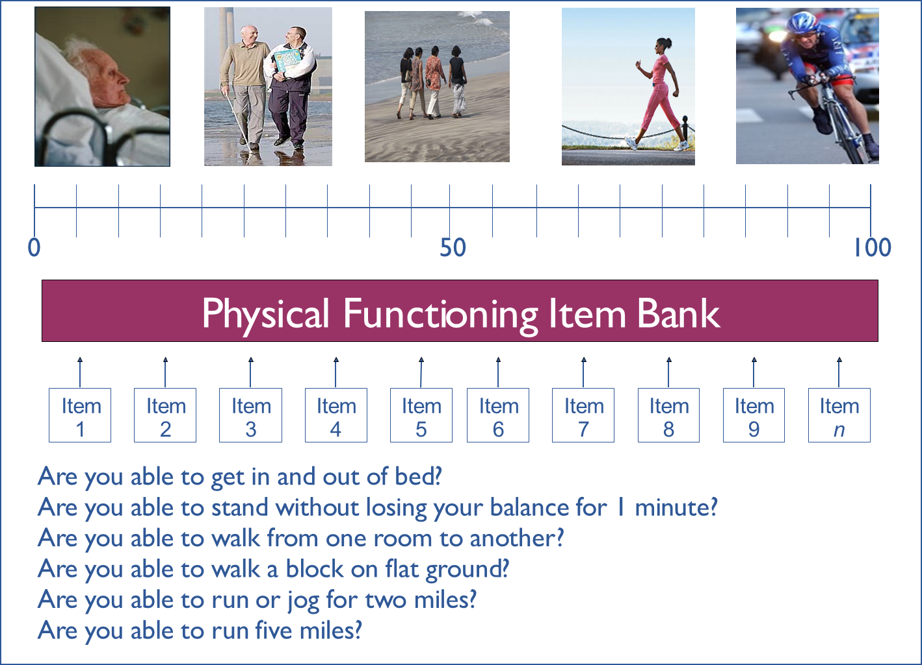

Slide 20
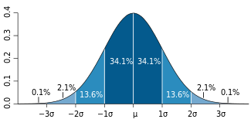
Normal Distribution
Within 1 SD = 68.2%, 2 SDs =95.4%; 3 SDs = 99.6%

Slide 21
Reliability Target for Use of Measures with Individuals
Reliability ranges from 0-1
  0.90 or above is goal
  SE (SEM) = SD (1- reliability)^{1/2}
  Reliability (T-score) = 1 – (SE/10)²
  Reliability = 0.90 when SE = 3.2
  95% CI = true score +/- 1.96 x SE
Notes:
T = z*10 + 50

Slide 22
In the past 7 days …
I was grouchy [1st question]
  Never [39]
  Rarely [48]
  Sometimes [56]
  Often [64]
  Always [72]
Estimated Anger = 56.1
SE = 5.7 (rel. = 0.68)

Slide 23
In the past 7 days …
I felt like I was ready to explode
[2nd question]
  Never
  Rarely
  Sometimes
  Often
  Always
Estimated Anger = 51.9
SE = 4.8 (rel. = 0.77)

Slide 24
In the past 7 days …
I felt angry [3rd question]
  Never
  Rarely
  Sometimes
  Often
  Always
Estimated Anger = 50.5
SE = 3.9 (rel. = 0.85)

Slide 25
In the past 7 days …
I felt angrier than I thought I should [4th question]
- Never
  Rarely
  Sometimes
  Often
  Always
Estimated Anger = 48.8
SE = 3.6 (rel. = 0.87)

Slide 26
In the past 7 days …
I felt annoyed [5th question]
  Never
  Rarely
  Sometimes
  Often
  Always
Estimated Anger = 50.1
SE = 3.2 (rel. = 0.90)

Slide 27
In the past 7 days …
I made myself angry about something just by thinking about it. [6th question]
  Never
  Rarely
  Sometimes
  Often
  Always
Estimated Anger = 50.2
SE = 2.8 (rel = 0.92)

Slide 28
Thank you
Finkleman, M. D. et al. (2010). Item selection and hypothesis testing for the adaptive measurement of change. Applied Psychological Measurement, 34, 238-254.
Jabrayilov, R. et al. (2016). Comparison of classical test theory and item response theory in individual change assessment. Applied Psychological Measurement, 40, 559-572.
Wang, C., & Weiss, D. J. (2018). Multivariate hypothesis testing methods for evaluating significant individual change. Applied Psychological Measurement, 42, 221-239.
drhays@ucla.edu (310-794-2294)
Powerpoint file available for downloading at: http://gim.med.ucla.edu/FacultyPages/Hays/
Notes:
28

