Slide 1
Two Self-report Questions about Glare
Ron D. Hays, Ph.D.
RCMAR Analysis Methods Seminar
May 18, 2020
3:00-4:00pm
UCLA Division of General Internal Medicine & Health Services Research
https://labs.dgsom.ucla.edu/hays/pages/presentations

Slide 2
Disclaimer
Preparation of this seminar was supported in part by the University of California, Los Angeles (UCLA), Resource Centers for Minority Aging Research Center for Health Improvement of Minority Elderly (RCMAR/CHIME) under NIH/NIA Grant P30-AG021684.
The opinions expressed do not necessarily represent those of the National Institute of Aging, National Eye Institute, or the United States Food and Drug Administration.
I am responsible for all errors or omissions.

Slide 3
Laser Eye Surgery
Refractive surgery used to correct near-sightedness, far-sightedness and astigmatism (irregularly shaped cornea).
  Reshapes corneas to improve visual acuity.
Possible complications/side effects include:
  Glare (Halos), dry eyes, sensitivity to light, night vision

Slide 4
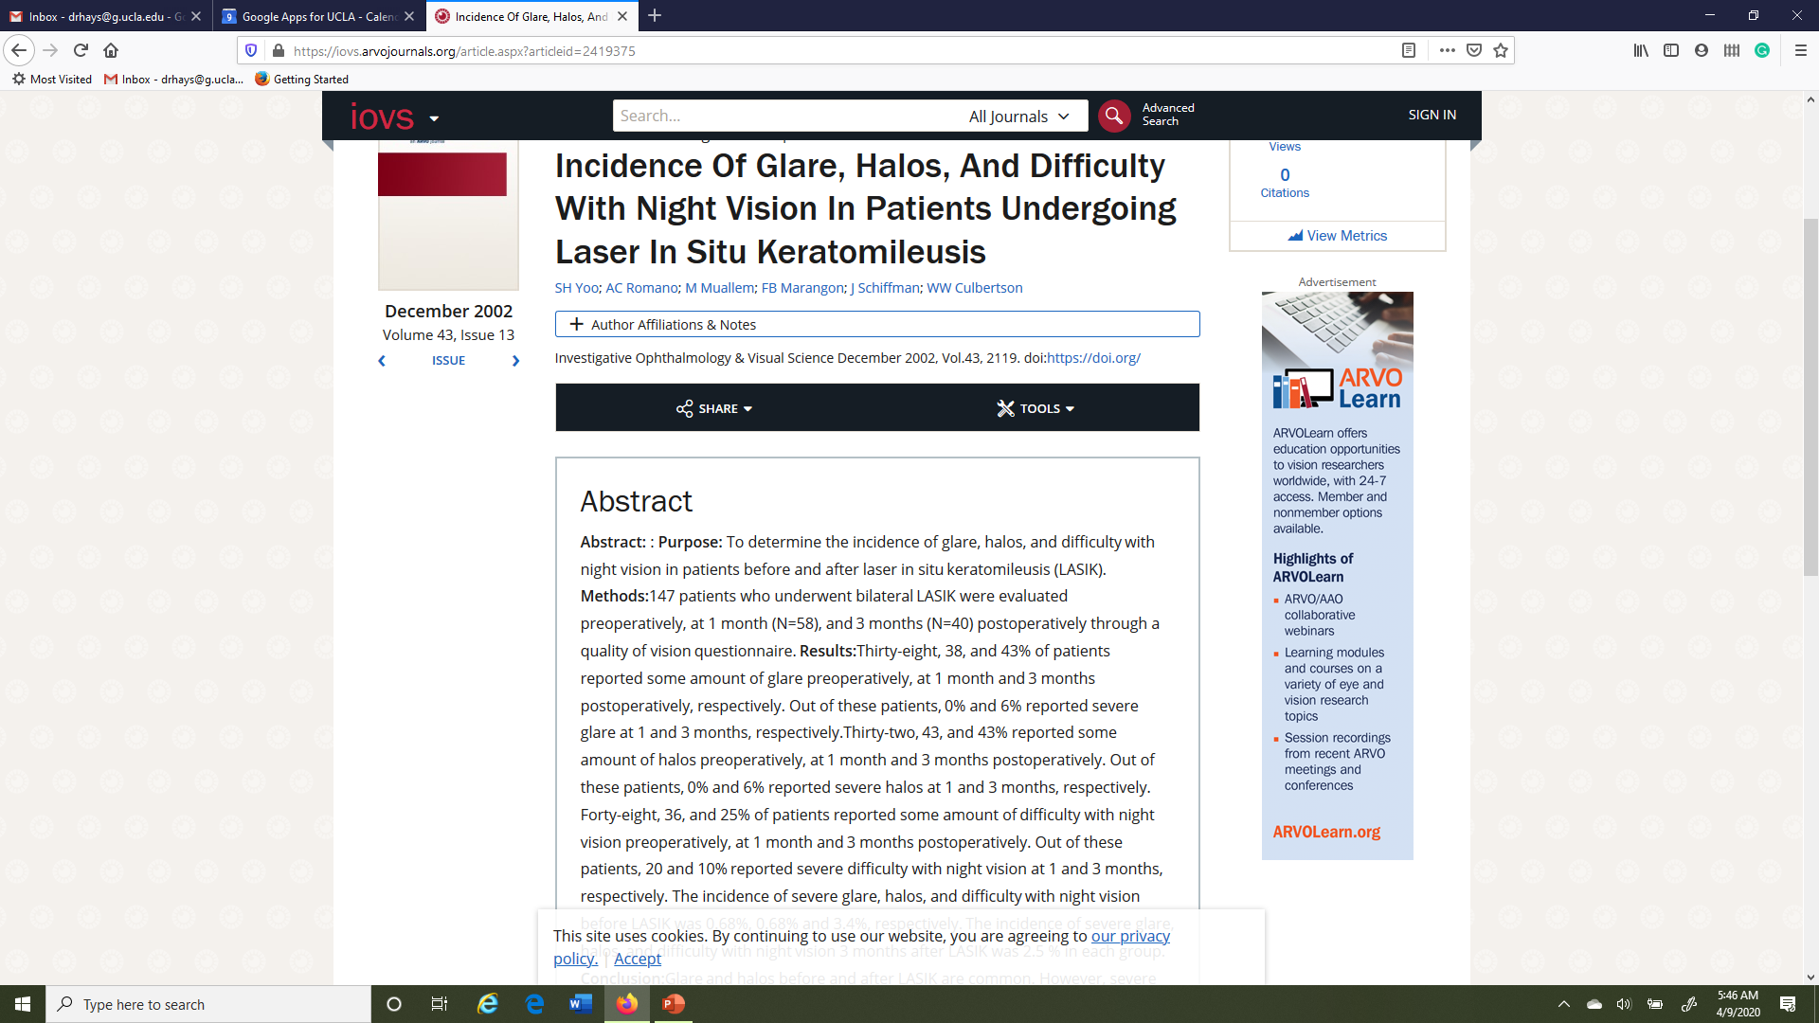
Glare reported by 38% before, 38% 1-month after, and 43% 3-months after LASIK

Slide 5
Glare
Glare occurs when the object in view is blocked partially or fully by a dazzling light. Glare can occur from bright lights such as streetlamps or headlights. Snowballs, halos, starbursts and streaks are all examples of glare and are shown below.

Slide 6
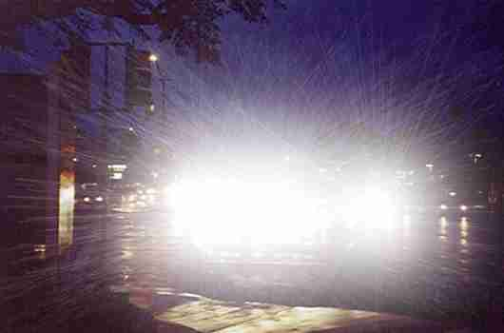
Discomfort and Disability Glare
“Discomfort glare” occurs when the intensity of the light source is annoying to one’s eyes.
“Disability glare” means there is visual impairment caused by the scattering of light entering one’s eyes.

Slide 7
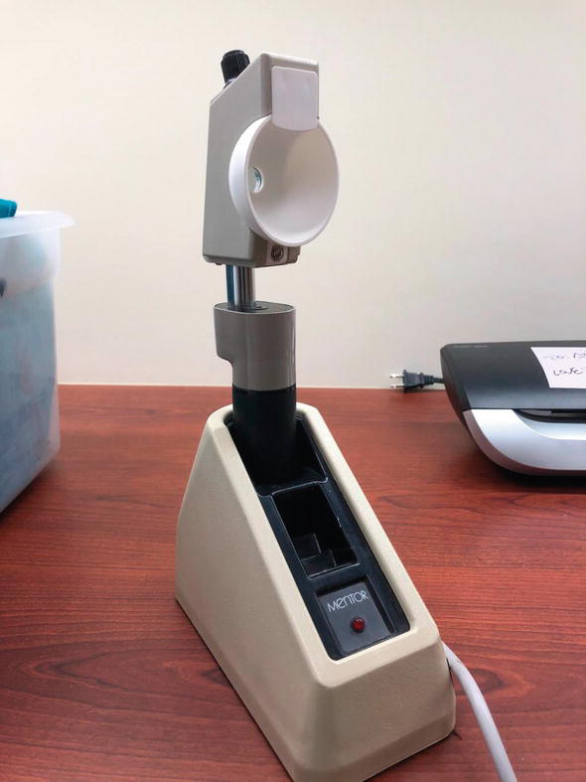
BAT (Brightness Acuity Test)
Glare disability assessed by seeing if vision worsens when mimicking partly cloudy day, bright overhead commercial lighting, and direct overhead sunlight.

Slide 8
Patient-Reported Outcomes With LASIK (PROWL)
Funded by the Department of Health and Human Services and the Department of Defense
Corresponding author: Malvina Eydelman, MD, Center for Devices and Radiological Health, US Food and Drug Administration
Hays, R. D., Tarver, M. E., Spritzer, K. L., Reise, S., Hilmantel, G., Hofmeister, E. M., Hanmel, K., May, J., Ferris, F., & Eydelman, M. (2017). Psychometric properties of a questionnaire assessing patient-reported outcomes with LASIK (PROWL). JAMA Ophthalmology, 135 (1), 3-12.
Eydelman, M., Hilmantel, G., Tarver, M. E., Hofmeister, E. M., May, J., Hammel, K., Hays, R. D., & Ferris, F. (2017). Symptoms and satisfaction in the LASIK Quality of Life Collaboration Project. JAMA Ophthalmology., 135 (1), 13-22.
.

Slide 9
PROWL
Observational study of 511 patients (analytic sample) who had LASIK surgery for myopia, hyperopia, or astigmatism and completed questionnaire online before and after (1-month and 3-months) surgery.
* PROWL-1: single-center study of 240 active-duty US Navy personnel.
55% white, 9% black, 9% Asian, 20% Hispanic
20% women; median age = 27 (range: 21-52)
* PROWL-2: 5-center study of 271 civilians.
76% white, 2% black, 12% Asian, 4% Hispanic
54% women; median age = 30 (range: 21-57)
PROWL study participants completed a questionnaire assessing eye-related symptoms (glare, starbursts, halos, and double images) using a secure website accessed by computer. Analytic sample completed baseline and at least one follow-up questionnaire.

Slide 10
PROWL Eligibility
21 years or older and English-language
Good candidates for LASIK based on surgeon’s assessment and no prior refractive surgery.
PROWL-1: Targeted refraction of bilateral emmetropia or slight hyperopia (+0.25 diopters)
PROWL-2: Targeted refraction of bilateral emmetropia. Oversampled those with higher refractive errors:
  Hyperopic: > +1.50 D (2%)
  Myopic: < -7.00 D (10%)
  >= -7.00 D and <=+1.25 D (88%)

Slide 11

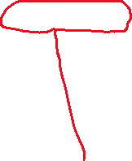
PROWL
Prospective observational study of 511 patients having LASIK surgery for myopia, hyperopia, or astigmatism.
“A recent clinical trial by the F.D.A. suggests that the complications experienced by Mr. Ramirez are not uncommon.” https://www.nytimes.com/2018/06/11/well/lasik-complications-vision.html

Slide 12
National Eye Institute (NEI)-RQL Glare Question
Have you experienced glare in the last 7 days?
- Yes
- No
Item 33 on 161-question baseline (preoperative) questionnaire (20%).
Item 27 on 129-question post-surgery questionnaires (21%).
Hays, R. D., Mangione, C. M., Ellwein, L., Lindblad, A. S., Spritzer, K. L., McDonnell, P. J., and NEI-RQL Research Group. (2003). Psychometric properties of the National Eye Institute – Refractive Error Quality of Life Instrument. Ophthalmology, 110 (12), 2292-2301.

Slide 13
Definition and Picture of Glare

Slide 14
Picture Glare Question
In the last 7 days, have you noticed any glare?
  - Yes, but ONLY when NOT wearing glasses or contact lenses
  - Yes, but ONLY when wearing glasses or contact lenses
  - Yes, when wearing AND when not wearing glasses or contact lenses
  - No, not at all
Item 50 on 161-item baseline questionnaire (31%).
Item 47 on 129-item post-surgery questionnaire (36%).

Slide 15
28% (150/544) glare on NEI-RQL item
Baseline
n = 544
(Note: This includes all available data so is larger than analytic sample.)
Have you experienced glare in the last 7 days? (NEI-RQL)
 | No | Yes
No | 297 | 35
Yes | 97 | 115
Column totals | 394 | 150 (28%)
In the last 7 days, have you noticed any glare? (Picture)

Slide 16
28% glare on NEI-RQL item
39% glare on Picture item
Baseline
N = 544
Have you experienced glare in the last 7 days? (NEI-RQL)
 | No | Yes | Row Totals
No | 297 | 35 | 332
Yes | 97 | 115 | 212 (39%)
Column totals | 394 | 150 (28%) | 544
In the last 7 days, have you noticed any glare? (Picture)
76% agreement; kappa =0.46 (r = 0.48)

Slide 17
Guidelines for Interpreting Kappa
Conclusion | Kappa | Conclusion | Kappa
 |  | Poor | < 0.0
 |  | Slight | .00 - .20
Poor | < .40 | Fair | .21 - .40
Fair | .40 - .59 | Moderate | .41 - .60
Good | .60 - .74 | Substantial | .61 - .80
Excellent | > .74 | Almost perfect | .81 - 1.00
Fleiss (1981) |  | Landis and Koch (1977)

Slide 18
I am more sensitive than other people.
MMPI 317
True
False
True
169
15
184
MMPI 362
False
21
95
116
190
110
88% agreement; kappa = 0.74 (r = 0.75)
Hays, R. D., & Revetto, J. P. (1992). Old and new MMPI-derived scales and the Short-MAST as screening tools
for alcohol disorder. Alcohol and Alcoholism, 27, 685-695.

Slide 19
Guidelines for Interpreting Kappa
Conclusion | Kappa | Conclusion | Kappa
 |  | Poor | < 0.0
 |  | Slight | .00 - .20
Poor | < .40 | Fair | .21 - .40
Fair | .40 - .59 | Moderate | .41 - .60
Good | .60 - .74 | Substantial | .61 - .80
Excellent | > .74 | Almost perfect | .81 - 1.00
Fleiss (1981) |  | Landis and Koch (1977)

Slide 20
Kappa of 0.46 is comparable to reliability of single items in multi-item scales
Item Reliability | Scale Reliability | Number of scale items
0.64 | 0.90 | 5
0.47 | 0.90 | 10
0.38 | 0.90 | 15
0.44 | 0.80 | 5
0.28 | 0.80 | 10
0.21 | 0.80 | 15
0.32 | 0.70 | 5
0.19 | 0.70 | 10
0.13 | 0.70 | 15

Slide 21
Two-Item Glare Scale (alpha = 0.64)
NEI | Picture | Sum Score
No | No | 0
Yes | No | 1
No | Yes | 1
Yes | Yes | 2
Excellent (0.90 or above), Good (0.80-0.89), Acceptable (0.70-0.79), Questionable (0.60-0.69), Poor (0.50-0.59), Unacceptable (<0.50)
George, D., & Mallery, P. (2003). SPSS for Windows step by step: A simple guide and
reference. 11.0 update (4th ed.). Boston: Allyn & Bacon (p. 231). Nunnally JC: Psychometric Theory, New York, McGraw-Hill, 1978

Slide 22
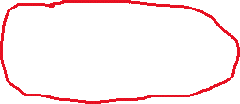
Cronbach’s Coefficient Alpha
Model
Reliability
Intraclass Correlation
One-way
Two-way mixed
Two-way random
BMS = Between Ratee Mean Square N = n of ratees
WMS = Within Mean Square k = n of items or raters
JMS = Item or Rater Mean Square
EMS = Ratee x Item (Rater) Mean Square
22
Notes:
22

Slide 23
Mean Scores By Combinations of Two Glare Items
(Baseline)
A B C D
 | No on Both (n = 297) | Yes on NEI-RQL only (n = 35) | Yes on Picture only (n = 97) | Yes on Both (n = 115)
Halos | 90ª | 69^{b} | 63^{a,b} | 56^{c}
Starbursts | 85ª | 57^{b} | 60^{b} | 53^{b}
Double images | 92ª | 84^{b} | 81^{b} | 79^{b}
Ocular Surface Disease Index (OSDI) - Ocular irritation consistent with dry eye disease. | 11^{b} | 22^{a,b} | 20^{b} | 26ª
Satisfaction with Vision | 45ª | 41^{a,b} | 37^{a,b} | 33^{b}
All scales on a 0-100 possible range. Higher score is better except for the OSDI.

Slide 24
Significant Product-Moment (Spearman) Correlations and Standardized OLS Regression Coefficients with Two-Item Glare Scale (Baseline)
 | Correlations | Standardized Betas
Halos (8 items) | -0.52 (-0.54) | -0.31
Starbursts (8 items) | -0.48 (-0.49) | -0.19
Ocular Surface Disease Index (OSDI, 5 items) | 0.41 ( 0.42) | 0.19
Double images (8 items) | -0.28 (-0.28) | NS
Optimism (6 items) | -0.19 (-0.17) | -0.11
Satisfaction with vision (1 item) | -0.18 (-0.17) | NS
Anxiety/depressive symptoms (PHQ-4) | 0.17 ( 0.13) | NS
All scales except OSDI and PHQ-4 scored so that higher is better. Adjusted R² = 35%

Slide 25
Summary of Results So Far
NEI-RQL and Picture glare items correlate as highly with one another as typical items in multi-item scales assessing the same concept.
Reporting glare on neither item suggests no glare, glare on only one of the items intermediate glare, and reporting glare on both items indicates the most glare.
  Sum of 2 glare items is associated most strongly with halos and starbursts.

Slide 26
Change in % Yes on NEI-RQL and Picture Glare Items From Baseline to Post-Surgery
NEI-RQL Picture
Baseline |  | 3-months |  | Baseline |  | 3-months
27% |  | 27% |  | 38% |  | 25%
Baseline -> 3-months significant

Slide 27
Change in % Yes on NEI-RQL and Picture Glare Items From Baseline to Post-Surgery
NEI-RQL Picture
Baseline | 1-month | 3-months |  | Baseline | 1-month | 3-months
27% | 42% | 27% |  | 38% | 34% | 25%
Baseline -> 1-month significant increase
Baseline -> 3-months significant decrease

Slide 28
Cross-tab of Two Glare Items (n = 492)
 | Baseline (Column %) | 1-month post-baseline (Column %)
No to Both | 270 (55%) | 243 (49%) ʇ 6% points
Yes to Both | 100 (20%) | 124 (25%) ʈ 5% points
Only NEI Yes (Picture No) | 32 (7%) | 83 (17%) ʈ 10% points
Only Picture Yes (NEI No) | 90 (18%) | 42 (9%) ʇ 9% points

Slide 29
Discussion
Results argue for 2-item (0, 1, 2) glare scale:
- Baseline (33%), 1-month (39%), 3-months (25%)
- If dichotomized (0 vs. 1 or 2) then:
- Baseline (~45%), 1-month (51%), 3-months (33%)
But we are still left wondering why at the 1-month follow-up when glare is only endorsed on one item…
NEI-RQL glare went up from 7% at baseline to 17%
  27% to 42% overall (15 percentage points up)
Picture glare went down from 18% to 9% ?
  39% to 34% overall (~5 percentage points down)
Targeted cognitive interviews may help.

Slide 30
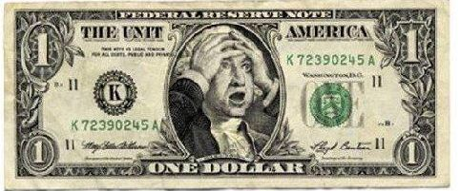
Questions?
https://www.fda.gov/media/101445/download
https://www.fda.gov/medical-devices/lasik/lasik-quality-life-collaboration-project
https://www.fda.gov/medical-devices/lasik/lasik-quality-life-collaboration-project#publications

Slide 31
Appendix
Glare (8 items)
In the last 7 days, have you noticed any glare?
[Yes, without glasses or contact lenses; Yes, even wearing glasses or contact lenses; No, not at all]
In the last 7 days, how often have you noticed glare when you are wearing your best vision correction (glasses or contact lenses)?
[Never; Rarely; Sometimes; Often; Always; I do not use any vision correction]
In the last 7 days, how often have you noticed glare when you are NOT wearing any vision correction?
[Never; Rarely; Sometimes; Often; Always; I always use vision correction]
In the last 7 days, how bothersome has the glare been when you are wearing your best vision correction (glasses or contact lenses)?
[Extremely bothersome; Very bothersome; Somewhat bothersome; A little bothersome; Not at all bothersome; I do not use any vision correction]
In the last 7 days, how bothersome has the glare been when you are NOT wearing any vision correction?
[Extremely bothersome; Very bothersome; Somewhat bothersome; A little bothersome; Not at all bothersome; I always use vision correction]
In the last 7 days, how much difficulty have you had doing your usual activities because you noticed glare when you are wearing your best vision correction (glasses or contact lenses)?
[No difficulty at all; Very little difficulty; Moderate difficulty; A lot of difficulty; So much difficulty that I can no longer do some of my usual activities; I do not use any vision correction]
In the last 7 days, how much difficulty have you had doing your usual activities because you notice glare when you are NOT wearing any vision correction?
[No difficulty at all; Very little difficulty; Moderate difficulty; A lot of difficulty; So much difficulty that I can no longer do some of my usual activities; I always use vision correction]
When you use your best vision correction (glasses or contact lenses) does the glare you notice:
[Go away completely; Go away mostly; Go away a little; Not change; Get a little worse; Get a lot worse; I do not use any vision correction (glasses or contact lenses)]

Slide 32
PROWL-2 Sites
20/20 Institute (Indiana)
Durrie Vision (Kansas)
Johns Hopkins University (Maryland)
Stanford University (California)
Vance Thompson (South Dakota)

