Slide 1

Associations of Cancer and Other Chronic Health Conditions with SF-6D Preference-based Scores among Medicare Beneficiaries
January 6, 2012 , 12-1pm, Los Angeles, CA
UCLA GIM/HSR Research Seminar Series
Ron D. Hays, Ph.D. (drhays@ucla.edu)
(Bryce B. Reeve, UNC; Ashley Wilder Smith, NCI; Bill Lawrence, AHRQ; Steven B. Clauser, NCI)
http://gim.med.ucla.edu/FacultyPages/Hays/

Slide 2
Existing Literature
Most chronic medical conditions have a negative impact on daily functioning and well-being.
  - Rothrock et al., J Clin Epidemiology, 2010
Medicare managed care beneficiaries with cancer report significantly worse physical health (SF-36 physical component summary score) than those without cancer.
- Smith et al., Health Care Financing Review, 2008
Significantly worse mental health is reported for some cancers (non-small cell lung, non-Hodgkin’s lymphoma, female breast, colorectal, and bladder)
    - Smith et al., Health Care Financing Review, 2008
Notes:
Didn’t compare those with cancer versus those without
Didn’t control for comorbidities

Slide 3
Specific Aims
Among Medicare managed care beneficiaries …
1) Do the associations of different types of cancer and (non-cancer) chronic conditions with health-related quality of life vary among Medicare managed care beneficiaries?
  main effects
2) Do the associations of non-cancer conditions with
health-related quality of life differ for those who have cancer versus do not?
  interaction effects
3) Do the associations between cancer and health- related quality of life vary by stage of disease?

Slide 4
SEER-MHOS Dataset (1)
Surveillance, Epidemiology and End Results (SEER) program of cancer registries that collect standardized clinical and demographic information for persons with newly diagnosed (incident) cancer in specific geographical areas
Began in 1973 and covers ̃ 26% of U.S. pop.
  http://seer.cancer.gov/registries/list.html
  California, Connecticut, Hawaii, Iowa, Kentucky, Louisiana, New Mexico, New Jersey, Utah
  Atlanta, Detroit, rural Georgia, Seattle-Puget Sound metropolitan areas

Slide 5
SEER-MHOS Dataset (2)
Medicare Health Outcomes Survey (MHOS)
  95-item survey administered to 1,000 randomly selected beneficiaries (including institutionalized and disabled) in Medicare managed care plans
  Baseline and follow-up survey (2 years later).
  63-72% response rates for baseline surveys
  MHOS respondents matched using identifiers to SEER-Medicare file for 4 cohorts (1998 to 2003).
http://outcomes.cancer.gov/surveys/seer-mhos/

Slide 6
Limitations
Does not include:
  Those who did not complete at least one MHOS survey.
    Medicare managed care beneficiaries not in MHOS (Including SEER cancer patients)
  Medicare fee-for-service beneficiaries
  Information on Medicare claims, prescription drug information, chemotherapy treatment, or cancer recurrences

Slide 7
Sample (n = 126,366)
MHOS
Cohort 1
(1998 & 2000)
MHOS
Cohort 2
(1999 & 2001)
MHOS
Cohort 3
(2000 & 2002)
MHOS
Cohort 4
(2001 & 2003)
Medicare Beneficiaries:
Aged 65 years or older
Cancer and non-cancer respondents reside in same SEER region
5,593 Prostate (4%)
4,311 Female breast (3%)
3,012 Colorectal (2%)
1,792 non-small cell lung (1%)
Cancer
No Cancer
n = 22,740 (18%)
n = 103,626 (82%)

Slide 8
Dependent Variable = SF-6D
SF-36 health survey, version 1
11 of 36 questions representing 6 of 8 domains
  Physical functioning
  Role limitations
  Social function
  Pain
  Emotional well-being
  Energy/fatigue
Standard gamble elicitation of preferences from a population sample in the UK.
Scores for those alive range from 0.30 to 1.00 (dead = 0.00).

Slide 9
Health state 424421 (0.59)
Your health limits you a lot in moderate activities (such as moving a table, pushing a vacuum cleaner, bowling or playing golf)
You are limited in the kind of work or other activities as a result of your physical health
Your health limits your social activities (like visiting friends, relatives etc.) most of the time.
You have pain that interferes with your normal work (both outside the home and housework) moderately
You feel tense or downhearted and low a little of the time.
You have a lot of energy all of the time

Slide 10
10 Cancer Conditions (n = 22,740; 18%)
Prostate cancer (n = 5,593; 4%)
Female breast Cancer (n = 4,311; 3%)
Colorectal cancer (n = 3,012; 2%)
Non-small cell lung cancer (n = 1,792; 1%)
Bladder cancer (n = 1,299; 1%)
Melanoma (n = 1,135; 1%)
Endometrial cancer (n = 902; 1%)
Non-Hodgkin’s lymphoma (n = 668; 1%)
Kidney cancer (n = 488; 0.4%)
Other cancer (n = 3,540; 3%)
Note: Those with more than one cancer diagnosis are excluded.

Slide 11
Historic Stage of Disease
(time of diagnosis)
Localized
  2045 breast, 2652 prostate, 1481 colorectal, 466 lung
Distant (metastatic)
  26 breast, 61 prostate, 48 colorectal, 47 lung
Unstaged
  347 breast, 633 prostate, 203 colorectal, 65 lung

Slide 12
13 Non-cancer Conditions
(mean number = 2.44)
Hypertension n = 66,968 (53%)
Arthritis of the hip n = 44,524 (35%)
Arthritis of the hand n = 40,402 (32%)
Sciatica n = 26,878 (21%)
Other heart disease n = 25,455 (20%)
Diabetes n = 20,089 (16%)
Angina/coronary artery disease n = 18,017 (14%)
Chronic obstructive pulmonary disease n = 15,445 (12%)
Depressed in the last year n = 14,815 (12%)
Myocardial infarction/heart attack n = 11,982 ( 9%)
Stroke n = 9,479 ( 8%)
Congestive heart failure n = 7,893 ( 6%)
Inflammatory bowel disease n = 5,882 ( 5%)
Has a doctor ever told you that you had: …
In the past year, have you felt depressed or sad much of the time?

Slide 13
Demographic & Administration Variables
Age (continuous)
Education (8th grade or less; some high school; high school graduate; some college; 4 year college grad; > 4 year college)
Gender (male; female)
Income (<10k, 10-19999, 20-29999, 30-39999, 40-49999, 50-79999, 80k and above, don’t know or missing)
Race/ethnicity (Hispanic, non-Hispanic white, black, Asian, American Indian, other race, missing)
Marital status (married, widowed, divorced/separated/never married)
Proxy completed survey (11%)
Mode of administration (88% mail vs. 12% phone)

Slide 14
Sample (n = 126,366)
55% female
79% non-Hispanic white, 7% Hispanic, 5% Black, 5% Asian
60% married
58% high school graduate or less
51% < $30,000 income

Slide 15
Results (1)
Adjusted R-squared of 39% for 43 dfs
Intercept = 0.80
  No chronic condition, average education and age, divorced/separated/never married, white, don’t know/missing income, phone mode)
  SD = 0.14
Only 2 of 23 conditions had non-significant associations (melanoma, endometrial cancer)

Slide 16
Results (2)
Adjusted means
  0.80 (colorectal cancer, myocardial infarction)
  0.79 (bladder cancer, kidney cancer, non-Hodgkin’s lymphoma, female breast cancer, prostate cancer, hypertension)
  0.78 (non-small cell lung cancer, other cancer, angina/CAD, other heart disease, diabetes, arthritis of the hand)
  0.77 (CHF, inflammatory bowel disease)
  0.76 (stroke, COPD/asthma, sciatica, arthritis of the hip)
  0.67 (depressive symptoms)

Slide 17
Results (3)
52 possible two-way interactions between four most prevalent cancers (female breast, prostate, colorectal, lung) and the 13 non-cancer conditions
  Only 6 were statistically significant.
  Two negative interaction coefficients (-0.01)
    Colorectal cancer and diabetes
    Lung cancer and COPD/asthma

Slide 18
Distant stage of cancer associated with 0.05-0.10 lower SF-6D Score

Slide 19
Summary
Unique associations of multiple chronic conditions on health-related quality of life are generally similar and additive, not interactive
The largest unique associations of chronic conditions with health-related quality of life among Medicare managed care beneficiaries was observed for four conditions
  Stroke, COPD/asthma, sciatica, arthritis of the hip
Advanced stage of cancer is associated with noteworthy decrement in health-related quality of life for four “big” cancers (breast, prostate, colorectal, lung)

Slide 20

Thank you
Notes:
20

Slide 21
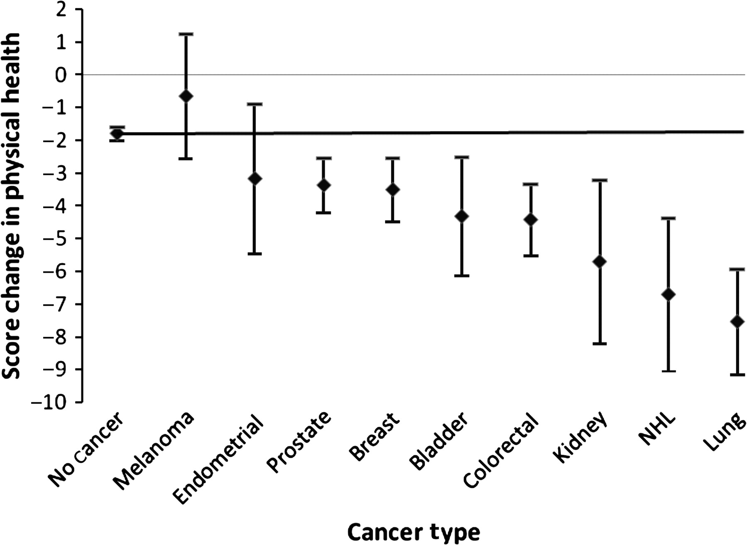

The adjusted mean decline in the Short Form-36 (version 1) physical component summary scores from baseline to follow-up assessment across the nine cancer types and the control subjects (No Cancer).
Reeve B B et al. JNCI J Natl Cancer Inst 2009;101:860-868
Published by Oxford University Press 2009.
Notes:
The adjusted mean decline in the Short Form-36 (version 1) physical component summary scores from baseline to follow-up assessment across the nine cancer types and the control subjects (No Cancer). The samples included 436 prostate, 320 breast, 240 colorectal, 112 non–small cell lung, 89 bladder, 56 endometrial, 53 non-Hodgkin lymphoma (NHL), and 46 kidney cancer patients; 80 melanoma patients; and 7160 control subjects. The horizontal line provides a reference to the mean change in score of the control subjects.

