Slide 1
Remaining Challenges and What to Do Next: Undiscovered Areas
Ron D. Hays
UCLA Division of General Internal Medicine & Health Services Research
(drhays@ucla.edu)
Item Response Theory in Health Measurement
University of Twente Symposium
Van der Valk Hotel Schiphol, Netherlands
September 17, 2013

Slide 2
This Presentation is Dedicated to Last Night’s Hero (Santa Claus)

Slide 3
Five Future Areas of Opportunity
Person fit
Distributional Issues
Presence/severity
Group-level Models
Multidimensional IRT/Hierarchical Models

Slide 4
Person Fit
Large negative Z_{L} values indicate misfit.
one person who responded to 14 of the PROMIS physical functioning items had a Z_{L} = -3.13
For 13 items the person could do the activity (including running 5 miles) without any difficulty.
But this person reported a little difficulty being out of bed for most of the day.

Slide 5
Person Fit
Item misfit significantly associated with
Less than high school education
More chronic conditions
Non-white
Including response time in the model lead to significant associations for:
Longer response time
More chronic conditions
Younger age

Slide 6
Distributional Issues
Normal distribution for latent trait assumed in estimating item parameters using marginal ML
Degree to which non-normality of latent distribution is consequential for IRT modeling
Extent to which violating normality assumption distorts item slope and threshold parameters
Ramsay Curve IRT (Carol Woods)
Detects and adjusts for non-normal latent variables
Need “enough” items and respondents

Slide 7
Memorial Symptom Assessment Scale Presence/Severity Example
(Liu & Verkuilen, 2013, Applied Psych Measurement)
Did you have diarrhea in the past 2 weeks?
No (0)
Yes
How much did diarrhea bother or distress you?
Not at all (1)
A little bit (2)
Somewhat (3)
Quite a bit (4)
Very much (5)

Slide 8
Presence/Severity Ordinal Scoring
0 = No diarrhea in the past 2 weeks.
1 = Diarrhea and bothered/distressed not at all.
2 = Diarrhea and bothered/distressed a little bit.
3 = Diarrhea and bothered/distressed somewhat.
4 = Diarrhea and bothered/distressed quite a bit.
5 = Diarrhea and bothered/distressed very much.

Slide 9
δ- plot for Diarrhea item (Nominal Response Model)
x axis = 0 -5 categories; y axis = a_{k} – a₀ category severity

Slide 10
δ- plot for Pain Item
x axis = 0 -5 categories; y axis = a_{k} – a₀ category severity

Slide 11
Alternatives to Logistic/Normal-Ogive for Item Response Curves
“Positive trait” item response models
Alcohol dependency (below average level of alcohol dependency is not meaningful)
Latent trait scale begins at theta = 0
Log-logistic (with B = 1 is Rasch’s original item response model)
Lognormal (similar to Steven’s psychophysical stimulus-response function)
Weibull (frequently used in biostatistics)
Markov Chain Monte Carlo
Lucke, J. F. http://works.bepress.com/joseph_lucke/34

Slide 12
CAHPS® Health Plan Survey
35,572 adults in 131 plans (n = 271 per plan)
Never/Sometimes/Usually/Always items
Got help/advice needed when phoned
Got appointment for routine care as soon as wanted
Got appointment when ill or injured as soon wanted
Doctors listed carefully to you
Doctors explained things so you could understand
Doctors respect what you had to say
Doctors spent enough time with you
Office staff treated you with courtesy and respect
Office staff helpful

Slide 13
Group-Level Modeling
Analogous to person-based IRT
Estimate relationships between group trait level and proportion of group members (patients) that endorse each item
Reise, Meijer et al., 2006, Multi Beh Res

Slide 14
Items Do Not Discriminate Between Groups As Well as Among Persons
Item | Person-Level Discrimination | Group (Plan) Level Discrimination
C1 | 0.83 | 0.13
C2 | 0.76 | 0.13
C3 | 0.68 | 0.12
C4 | 1.78 | 0.14
C5 | 1.16 | 0.10
C6 | 1.83 | 0.13
C7 | 1.50 | 0.18
C8 | 1.22 | 0.14
C9 | 1.37 | 0.14

Slide 15
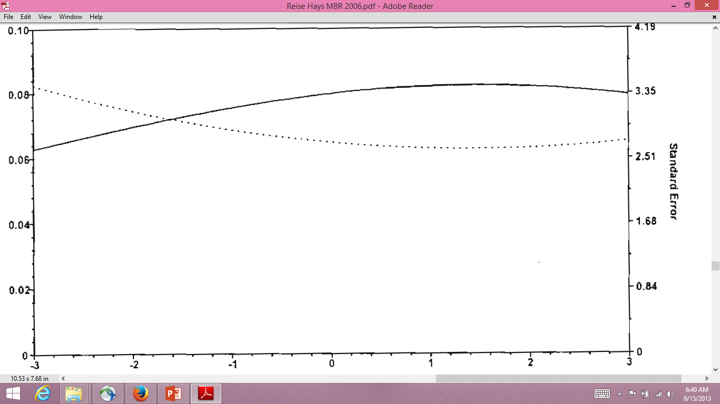
Health Plan-level Scale Information and SE for 9-Item Scale

Slide 16
Standard Error for Each Plan Depends Upon
Plan’s estimated theta
Number of respondents

Slide 17
Multidimensional and Other Hierarchical Item Factor Models
https://www.facebook.com/groups/370354816400530/members/
Multidimensional nominal models
Historically not easy to do, but IRTPRO makes it easier
Cai, L. (2010). A two-tier full-information item factor analysis model with applications. Psychometrika, 75, 581-612.
Includes correlated traits multidimensional IRT, bifactor model, and testlet response theory models

Slide 18
Questions?
Notes:
18

