Slide 1

Ron D. Hays (drhays@ucla.edu) August 1, 2014 (12:24-12:32pm) Powerpoint file posted at: http://gim.med.ucla.edu/FacultyPages/Hays/

Slide 2
Current Positions
UCLA Department of Medicine
UCLA Department of Health Services
RAND, Senior Behavioral Scientist
Pardee RAND Graduate School Faculty
NCI Consultant
FDA Staff Fellow/Medical Officer
VA Affiliate

Slide 3
PROs
Patient-Reported Outcomes
Patient evaluations of care
Health-related quality of life

Slide 4
Consumer Assessment of Healthcare Providers and Systems (CAHPS®)
Weidmer, B., Cleary, P. D., Keller, S., Evensen, C., Hurtado, M., Kosiak, B., Gallagher, P., Levine, R., & Hays, R. D. (2014). Development and evaluation of the CAHPS (Consumer Assessment of Healthcare Providers and Systems) survey for in-center hemodialysis patients. American Journal of Kidney Diseases. Epub.
Hays, R. D., Berman, L. J., Kanter, M. H., Hugh, M., Oglesby, R. R., Kim, C. Y., Cui, M., & Brown, J. (2014). Evaluating the psychometric properties of the CAHPS patient-centered medical home survey. Clinical Therapeutics, 36 (5), 689-696.

Slide 5
Patient-Reported Outcomes Information Measurement System (PROMIS®)
Spiegel, B., Hays, R. D., Bolus, R., Melmed, G. Y., Chang, L., Whiteman, C., Khanna, P. P., Paz, S. H., Hays, T., Reise, S., & Khanna, D. (in press). Development of the NIH Patient Reported Outcomes Measurement Information System (PROMIS®) Gastrointestinal Symptom Scales. American Journal of Gastroenterology.
Hays, R. D., Spritzer, K. L., Amtmann, D., Lai, J-S., DeWitt, E. M., Rothrock, N., DeWalt, D. A., Riley, W. T., Fries, J. F., & Krishnan, E. (2013). Upper-extremity and mobility subdomains from the Patient-Reported Outcomes Measurement Information System (PROMIS) adult physical functioning item bank. Archives of Physical Medicine and Rehabilitation, 94, 2291-2296

Slide 6

Health-Related Behavior
Positive
Exercise
Medication adherence
Negative
Alcohol use
Drug use
Smoking

Slide 7
Behavior and HRQOL
Hays, R. D., Smith, A. W., Reeve, B. B., Spritzer, K. L., Marcus, S. E., & Clauser, S. B. (2008). Cigarette smoking and health-related quality of life in Medicare beneficiaries. Health Care Financing Review, 29 (4), 57-68.
Drake, C., Hays, R. D., Morlock, R., Wang, F., Shikiar, R., Frank, L., Downey, R., & Roth, T. (2014). Development and evaluation of a measure to assess restorative sleep. Journal of Clinical Sleep Medicine, 10, 733-741.

Slide 8
Teaching
HPM 214: Measurement of Effectiveness and Outcomes in Health Care
HPM 216: Making the Business Case for Quality
HPM 249F: Quality of Care
HS 265: Challenges in Clinical Health Services Research

Slide 9
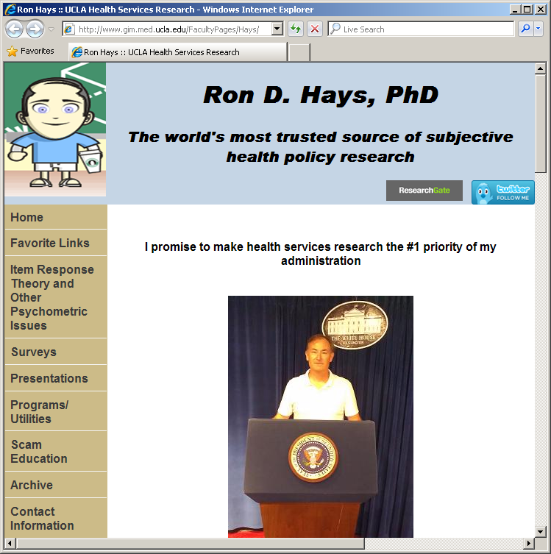
Thank you

