Slide 1
Measuring Health-Related Quality of Life
Ron D. Hays, Ph.D.
UCLA Department of Medicine
UCLA School of Public Health
RAND Health Program
November 16, 2015, 8-9:50am (M218, 41-268)
Notes:
1

Slide 2

U.S. Health Care Issues
Access to care
  ~ 50 million people without health insurance
Costs of care
  Expenditures ~ $ 2.7 Trillion
Effectiveness (quality) of care

Slide 3
How Do We Know If Care Is Effective?
Effective care maximizes probability of desired health outcomes
  Health outcome measures indicate whether care is effective
Cost ↓
Effectiveness ↑

Slide 4
Indicators of Health
Signs and Symptoms of Disease

Slide 5
Indicators of Health
Signs and Symptoms of Disease
Functioning
Well-Being

Slide 6

Health-Related Quality of Life (HRQOL)
How the person FEELs (well-being)
  Emotional well-being
  Pain
  Energy
What the person can DO (functioning)
  Self-care
  Role
  Social

Slide 7
Indicators of Health
Signs and Symptoms of Disease
Functioning
Well-Being

Slide 8
KDQOL Symptoms/Problems
During the past 4 weeks, to what extent were you bothered by each of the following?
Soreness in your muscles?
Chest pain?
Itchy skin?
Shortness of breath?
Faintness or dizziness?

Slide 9
Health-Related Quality of Life (HRQOL)
Quality of environment
Type of housing
Level of income
Social Support

Slide 10
Determinants of Health
Quality
Of Care
Health
Characteristics
Behavior
Environment
Chronic
Conditions

Slide 11
Patient-Reported Measures (PRMs)
Mediators
  Health behaviors (adherence)
Health Care Process
  Reports about care (e.g., communication)
Outcomes (PROs)
  Patient satisfaction with care
  Health-Related Quality of Life (HRQOL)

Slide 12
Types of HRQOL Measures
Single item
  In general, how would you rate your health?
Multiple Scores (Profile)
  Generic (SF-36)
    How much of the time during the past 4 weeks have you been happy? (None of the time → All of the time)
  Targeted (“Disease specific”)
    KDQOL-36
      My kidney disease interferes too much with my life.
Single Score
  Preference-based (EQ-5D, HUI, SF-6D)

Slide 13
HRQOL Scoring Options
0-100 possible range
T-scores (mean = 50, SD = 10)
  (10 * z-score) + 50
    z-score = (score – mean)/SD
0 (dead) to 1 (perfect health)

Slide 14
In general, how would you rate your health?
62 = Excellent
54 = Very Good
47 = Good
38 = Fair
29 = Poor
Hays, Spritzer, Thompson, & Cella (2015, JGIM)
Reliability = 0.52 (compared to 0.81 for 4-item scale).

Slide 15
HRQOL in HIV Compared to other
Chronic Illnesses and General Population
T-score metric
Hays et al. (2000), American Journal of Medicine

Slide 16
HRQOL in HIV Compared to other
Chronic Illnesses and General Population
T-score metric
Hays et al. (2000), American Journal of Medicine

Slide 17
HRQOL in HIV Compared to other
Chronic Illnesses and General Population
T-score metric
Hays et al. (2000), American Journal of Medicine

Slide 18
HRQOL in HIV Compared to other
Chronic Illnesses and General Population
T-score metric
Hays et al. (2000), American Journal of Medicine

Slide 19
Item Responses and
Trait Levels
Person 1
Person 2
Person 3
Trait
Continuum
Item 1
Item 2
Item 3
www.nihpromis.org

Slide 20
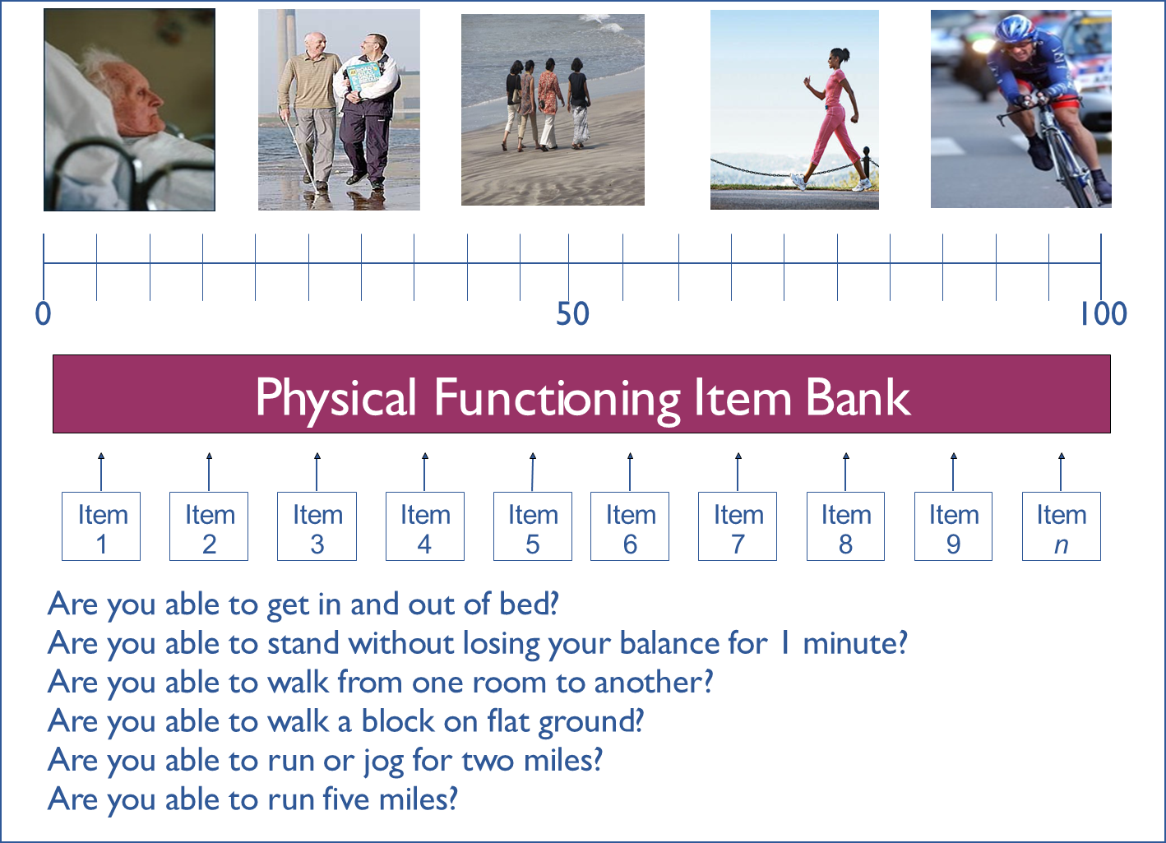
20 30 40
60 70 80

Slide 21
Reliability Target for Use of Measures with Individuals
Reliability ranges from 0-1
  0.90 or above is goal
  SE = SD (1- reliability)^{1/2}
  Reliability = 1 – (SE/10)²
  Reliability = 0.90 when SE = 3.2
  95% CI = true score +/- 1.96 x SE
Notes:
T = z*10 + 50

Slide 22
In the past 7 days …
I was grouchy [1st question]
  Never [39]
  Rarely [48]
  Sometimes [56]
  Often [64]
  Always [72]
Estimated Anger = 56.1
SE = 5.7 (rel. = 0.68)
Notes:
Never: 39
Rarely: 48
Sometimes = 56
Often = 64
Always = 72

Slide 23
In the past 7 days …
I felt like I was ready to explode
[2nd question]
  Never
  Rarely
  Sometimes
  Often
  Always
Estimated Anger = 51.9
SE = 4.8 (rel. = 0.77)

Slide 24
In the past 7 days …
I felt angry [3rd question]
  Never
  Rarely
  Sometimes
  Often
  Always
Estimated Anger = 50.5
SE = 3.9 (rel. = 0.85)

Slide 25
In the past 7 days …
I felt angrier than I thought I should [4th question]
- Never
  Rarely
  Sometimes
  Often
  Always
Estimated Anger = 48.8
SE = 3.6 (rel. = 0.87)

Slide 26
In the past 7 days …
I felt annoyed [5th question]
  Never
  Rarely
  Sometimes
  Often
  Always
Estimated Anger = 50.1
SE = 3.2 (rel. = 0.90)

Slide 27
In the past 7 days …
I made myself angry about something just by thinking about it. [6th question]
  Never
  Rarely
  Sometimes
  Often
  Always
Estimated Anger = 50.2
SE = 2.8 (rel = 0.92) (95% CI: 44.7-55.7)

Slide 28
PROMIS Physical Functioning vs. “Legacy” Measures
10 20 30 40 50 60 70

Slide 29
In general, how would you rate your health?
Excellent
Very Good
Good
Fair
Poor

Slide 31
Is CAM Better than Standard Care (SC)?
CAM
SC
CAM
SC
Physical
Health
CAM > SC
Mental
Health
SC > CAM

Slide 32
Is Acupuncture Related to Worse HRQOL?
Subject Acupuncture General Health
1 No dead
2 No dead
3 No 50
4 No 60
5 No 70
6 Yes 40
7 Yes 50
8 Yes 50
9 Yes 55 10 Yes 55
  Group n HRQOL
  No Acupuncture 3 60
  Yes Acupuncture 5 50

Slide 33
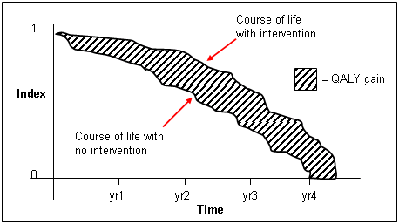
http://www.ukmi.nhs.uk/Research/pharma_res.asp

Slide 34
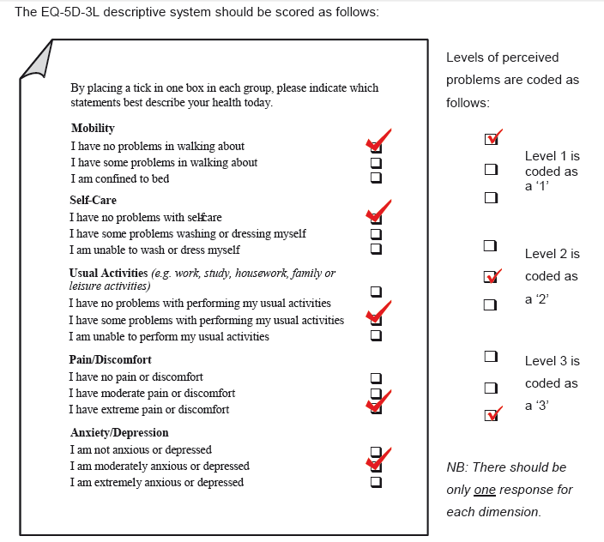
0.435

Slide 35
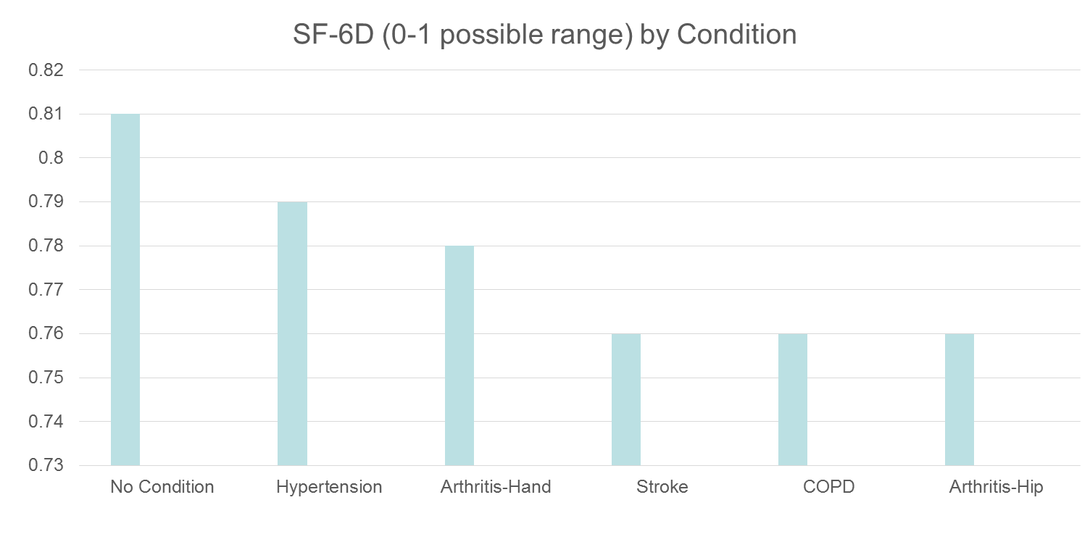
HRQOL in SEER-Medicare Health Outcomes Study (n=126,366)
Controlling for age, gender, race/ethnicity, education, income, and marital status.

Slide 36
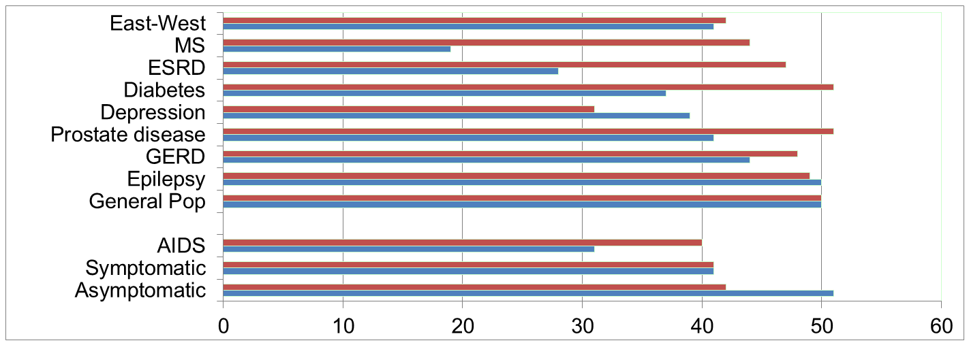
Physical Functioning and Emotional Well-Being at Baseline for 54 Patients at UCLA-Center for East West Medicine
EWB
Physical
MS = multiple sclerois; ESRD = end-stage renal disease; GERD = gastroesophageal reflux disease.
36

Slide 37
Significant Improvement in all but 1 of SF-36 Scales (Change is in T-score metric)
Change
t-test
prob.
PF-10
1.7
2.38
.0208
RP-4
4.1
3.81
.0004
BP-2
3.6
2.59
.0125
GH-5
2.4
2.86
.0061
EN-4
5.1
4.33
.0001
SF-2
4.7
3.51
.0009
RE-3
1.5
0.96
.3400
EWB-5
4.3
3.20
.0023
PCS
2.8
3.23
.0021
MCS
3.9
2.82
.0067

Slide 38
Effect Size
(Follow-up – Baseline)/ SD_{baseline}
_{Cohen’s Rule of Thumb:}
_{ES = 0.20 Small}
_{ES = 0.50 Medium}
_{ES = 0.80 Large}

Slide 39
Effect Sizes for Changes in SF-36 Scores
Effect Size
0.13
0.35
0.35
0.21
0.53
0.36
0.11
0.41
0.24
0.30
PFI = Physical Functioning; Role-P = Role-Physical; Pain = Bodily Pain; Gen H=General Health; Energy = Energy/Fatigue; Social = Social Functioning; Role-E = Role-Emotional; EWB = Emotional Well-being; PCS = Physical Component Summary; MCS =Mental Component Summary.

Slide 40
Defining a Responder: Reliable Change Index (RCI)
Note: SD_{bl} = standard deviation at baseline
r_{xx} = reliability

Slide 41
Amount of Change in Observed Score Needed To be Statistically Significant
Note: SD_{bl} = standard deviation at baseline and r_{xx} = reliability

Slide 42
Amount of Change in Observed Score
Needed for Significant Individual Change
Scale
RCI
Effect size
Cronbach’s alpha
PF-10
8.4
0.67
0.94
RP-4
8.4
0.72
0.93
BP-2
10.4
1.01
0.87
GH-5
13.0
1.13
0.83
EN-4
12.8
1.33
0.77
SF-2
13.8
1.07
0.85
RE-3
9.7
0.71
0.94
EWB-5
13.4
1.26
0.79
PCS
7.1
0.62
0.94*
MCS
9.7
0.73
0.93*
* Mosier’s formula (not coefficient alpha).
42

Slide 43
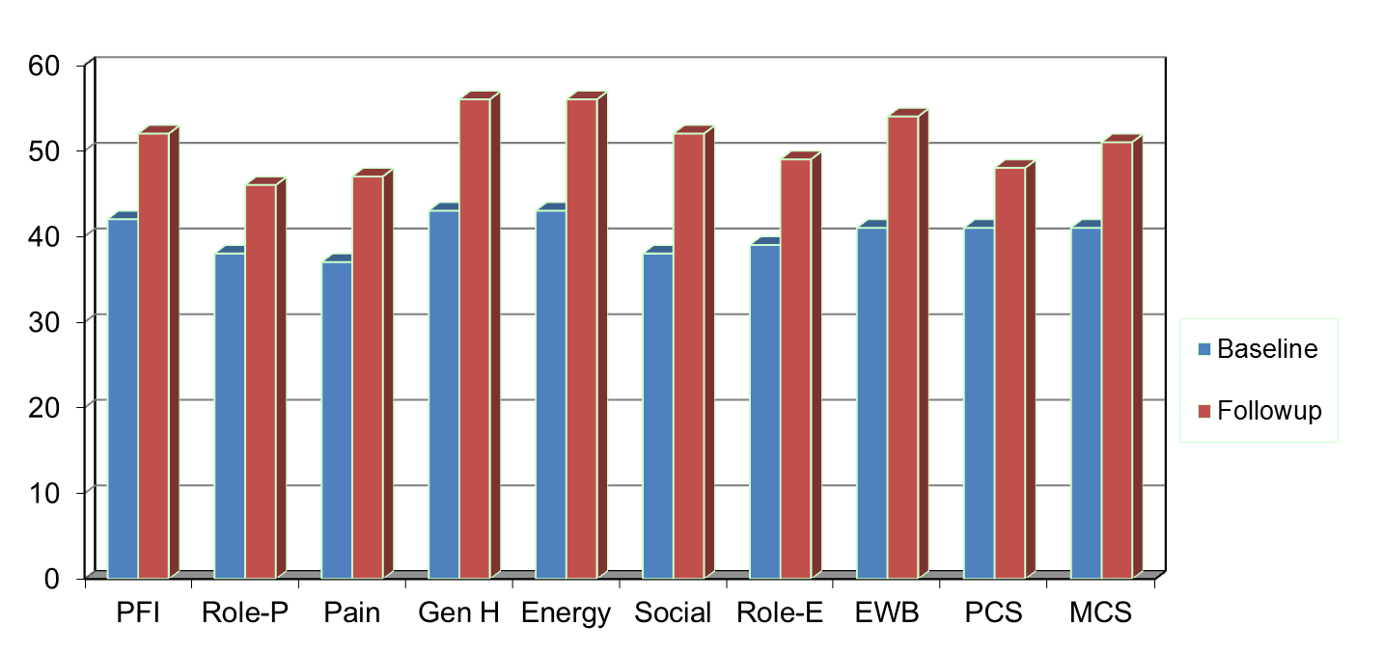
Amount of Change Needed for Significant Individual Change
Effect Size
0.67
0.72
1.01
1.13
1.33
1.07
0.71
1.26
0.62
0.73
PFI = Physical Functioning; Role-P = Role-Physical; Pain = Bodily Pain; Gen H=General Health; Energy = Energy/Fatigue; Social = Social Functioning;
Role-E = Role-Emotional; EWB = Emotional Well-being; PCS = Physical Component Summary; MCS =Mental Component Summary.

Slide 44
7-31% of People in Sample Improve Significantly
% Improving
% Declining
Difference
PF-10
13%
2%
+ 11%
RP-4
31%
2%
+ 29%
BP-2
22%
7%
+ 15%
GH-5
7%
0%
+ 7%
EN-4
9%
2%
+ 7%
SF-2
17%
4%
+ 13%
RE-3
15%
15%
0%
EWB-5
19%
4%
+ 15%
PCS
24%
7%
+ 17%
MCS
22%
11%
+ 11%

Slide 45


HRQOL vs SWB
HRQOL
SWB
International Society of Quality of Life Research (ISOQOL)
Founded 1994
Quality of Life Research
  Springer
International Society of Quality of Life Studies (ISQOLS)
Founded around 1994
Applied Research in Quality of Life
  Springer

Slide 46

Experienced Well-Being
Emotional states or mood over short periods of time.
“Did you experience anger
during a lot of the day
yesterday?”
  Yes
  No

Slide 47

Eudemonic Well-Being
Perceived purpose and fulfillment
“Overall, to what extent do
you feel that the things you
do in your life are worthwhile?”
  Not at all (0) – 10 (Completely)

Slide 48

Evaluative Well-Being
Overall appraisal of one’s life
“How satisfied are you with your life in general?”
  Very satisfied
  Somewhat satisfied
  Somewhat dissatisfied
  Very dissatisfied

Slide 49

Thank you.
drhays@g.ucla.edu
Powerpoint file at:
http://gim.med.ucla.edu/FacultyPages/Hays/
Notes:
49

