Slide 1
Measuring Health-Related Quality of Life
Ron D. Hays, Ph.D.
UCLA Department of Medicine
RAND Health Program
UCLA Fielding School of Public Health 41-268
November 26, 2014, 8-9:50am (M218)
Notes:
1

Slide 2


Slide 3

U.S. Health Care Issues
Access to care
  ~ 50 million people without health insurance
Costs of care
  Expenditures ~ $ 2.7 Trillion
Effectiveness (quality) of care

Slide 4
How Do We Know If Care Is Effective?
Effective care maximizes probability of desired health outcomes
  Health outcome measures indicate whether care is effective
Cost ↓
Effectiveness ↑

Slide 5
Health Outcomes Measures
Traditional clinical endpoints
  Survival
  Clinical/biological indicators
    Vital signs (e.g., blood pressure)
    Rheumatoid factor
    Hematocrit
Patient-Reported Outcomes

Slide 6
Patient-Reported Measures (PRMs)
Mediators
  Health behaviors (adherence)
Health Care Process
  Reports about care (e.g., communication)
Outcomes (PROs)
  Patient satisfaction with care
  Health-Related Quality of Life (HRQOL)

Slide 7
Satisfaction
With Care
Patient Characteristics
Health
Behaviors
(Adherence)
Technical Quality
Quality
of Care
HRQOL
Patient Reports About Care

Slide 8

Health-Related Quality of Life (HRQOL)
How the person FEELs (well-being)
  Emotional well-being
  Pain
  Energy
What the person can DO (functioning)
  Self-care
  Role
  Social

Slide 9

HRQOL is Not
Quality of environment
Type of housing
Level of income
Social Support

Slide 10
Targeted HRQOL Measures
Designed to be relevant to particular group.
Sensitive to small, clinically-important change.
More familiar and actionable for clinicians.
Enhance respondent cooperation.

Slide 11
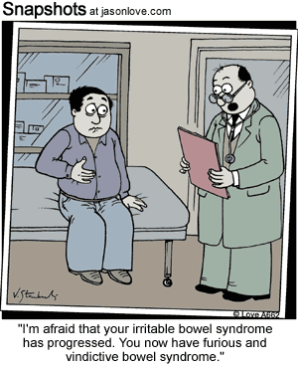
IBS-Targeted Item
During the last 4 weeks, how often were you angry about your irritable bowel syndrome?
None of the time
A little of the time
Some of the time
Most of the time
All of the time

Slide 12
In general, how would you rate your health?
Excellent
Very Good
Good
Fair
Poor

Slide 13
Does your health now limit you in walking more than a mile?
(If so, how much?)
Yes, limited a lot
Yes, limited a little
No, not limited at all

Slide 14
SF-36 Generic Profile Measure
Physical functioning (10 items)
Role limitations/physical (4 items)
Role limitations/emotional (3 items)
Social functioning (2 items)
Emotional well-being (5 items)
Energy/fatigue (4 items)
Pain (2 items)
General health perceptions (5 items)

Slide 15
Scoring HRQOL Profile Scales
Average or sum all items in the same scale.
Transform average or sum to
  0 (worse) to 100 (best) possible range
  z-score (mean = 0, SD = 1)
  T-score (mean = 50, SD = 10)

Slide 16
Linear Transformations
X =
(original score - minimum) *100
(maximum - minimum)
Y
= target mean + (target SD * Zx)
(X - X)
Z_{X} =
SD_{X}

Slide 17
SF-36 PCS and MCS
PCS_z = (PF_Z * 0.42) + (RP_Z * 0.35) + (BP_Z * 0.32) + (GH_Z * 0.25) + (EF_Z * 0.03) + (SF_Z * -.01) + (RE_Z * -.19) + (EW_Z * -.22)
MCS_z = (PF_Z * -.23) + (RP_Z * -.12) + (BP_Z * -.10) + (GH_Z * -.02) + (EF_Z * 0.24) + (SF_Z * 0.27) + (RE_Z * 0.43) + (EW_Z * 0.49)
PCS = (PCS_z*10) + 50
MCS = (MCS_z*10) + 50

Slide 18
HRQOL is Predictive of
Mortality (5 years later)
%
Dead
(n=676)
(n=754)
(n=1181)
(n=609)
SF-36 Physical Health Component Score (PCS)—T score
Ware et al. (1994). SF-36 Physical and Mental Health Summary Scales: A User’s Manual.

Slide 19
HRQOL in HIV Compared to other
Chronic Illnesses and General Population
T-score metric
Hays et al. (2000), American Journal of Medicine

Slide 20
Course of Emotional Well-being Over
2-years for Patients in the MOS
General Medical Sector
Hypertension
Diabetes
0-100 range
Major Depression
Baseline
2-Years
Hays, R.D., Wells, K.B., Sherbourne, C.D., Rogers, W., & Spritzer, K. (1995).
Functioning and well-being outcomes of patients with depression compared
to chronic medical illnesses. Archives of General Psychiatry, 52, 11-19.

Slide 21
Physical Functioning in Relation to Time
Spent Exercising 2-years Before
84
82
80
78
76
74
72
70
68
66
64
62
Hypertension
Diabetes
0-100 range
Current Depression
Low
High
Total Time Spent Exercising
Stewart, A.L., Hays, R.D., Wells, K.B., Rogers, W.H., Spritzer, K.L., & Greenfield, S. (1994). Long-term
functioning and well-being outcomes associated with physical activity and exercise in patients with
chronic conditions in the Medical Outcomes Study. Journal of Clinical Epidemiology, 47, 719-730.

Slide 22
Is New Treatment (X) Better
Than Standard Care (O)?
X
0
X
0
Physical
Health
X > 0
Mental
Health
0 > X

Slide 23
Is Medicine Related to Worse HRQOL?
Medication
Person Use HRQOL (0-100)
1 No dead
2 No dead
3 No 50
4 No 75
5 No 100
6 Yes 0
7 Yes 25
8 Yes 50
9 Yes 75
10 Yes 100
  Group n HRQOL
  No Medicine 3 75
  Yes Medicine 5 50

Slide 24
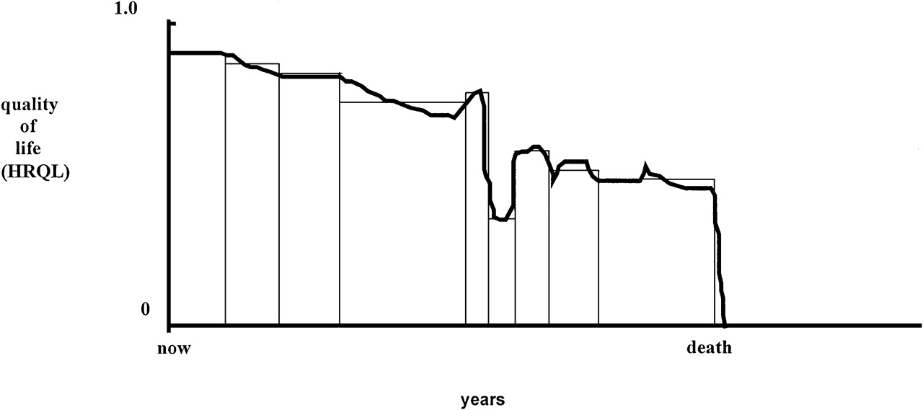
Quality of Life for Individual Over Time

Slide 25
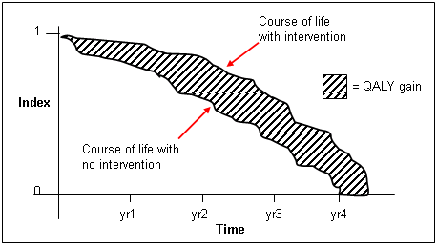
http://www.ukmi.nhs.uk/Research/pharma_res.asp

Slide 26
SF-6D
— 6-dimensional classification (collapsed role scales, dropped general health)
— 18,000 possible states
-— 249 states rated by sample of 836 from UK general population
Brazier et al. (1998, 2002)
http://www.shef.ac.uk/scharr/sections/heds/mvh/sf-6d

Slide 27
Health state 424421 (0.59)
Your health limits you a lot in moderate activities (such as moving a table, pushing a vacuum cleaner, bowling or playing golf)
You are limited in the kind of work or other activities as a result of your physical health
Your health limits your social activities (like visiting friends, relatives etc.) most of the time.
You have pain that interferes with your normal work (both outside the home and housework) moderately
You feel tense or downhearted and low a little of the time.
You have a lot of energy all of the time

Slide 28
HRQOL in SEER-Medicare Health Outcomes Study (n = 126,366)
Controlling for age, gender, race/ethnicity, education, income, and marital status.
65

Slide 29
Distant stage of cancer associated with 0.05-0.10 lower SF-6D Score
67

Slide 30
Item Responses and Trait Levels
Person 1
Person 2
Person 3
Trait
Continuum
Item 1
Item 2
Item 3
www.nihpromis.org

Slide 31




Computer Adaptive Testing (CAT)
Notes:
Early research on CAT was funded by the U.S. military to enhance mental measurement.
NASD = National Association of Security Dealers. In 1978 they began developing CAT for regulatory exam to assess knowledge of securities and securities future products among licensed brokers.
The National Council of State Boards of Nursing starting using CAT in 1994.

Slide 32
Reliability Target for Use of Measures with Individuals
Reliability ranges from 0-1
  0.90 or above is goal
Reliability = 0.90 when SE = 3.2
  T-scores (mean = 50, SD = 10)
  Reliability = 1 – (SE/10)²
T = 50 + (z * 10)
Notes:
T = z*10 + 50

Slide 33
In the past 7 days …
I was grouchy [1st question]
  Never [39]
  Rarely [48]
  Sometimes [56]
  Often [64]
  Always [72]
Estimated Anger = 56.1
SE = 5.7 (rel. = 0.68)
Notes:
Never: 39
Rarely: 48
Sometimes = 56
Often = 64
Always = 72

Slide 34
In the past 7 days …
I felt like I was ready to explode
[2nd question]
  Never
  Rarely
  Sometimes
  Often
  Always
Estimated Anger = 51.9
SE = 4.8 (rel. = 0.77)

Slide 35
In the past 7 days …
I felt angry [3rd question]
  Never
  Rarely
  Sometimes
  Often
  Always
Estimated Anger = 50.5
SE = 3.9 (rel. = 0.85)

Slide 36
In the past 7 days …
I felt angrier than I thought I should [4th question]
- Never
  Rarely
  Sometimes
  Often
  Always
Estimated Anger = 48.8
SE = 3.6 (rel. = 0.87)

Slide 37
In the past 7 days …
I felt annoyed [5th question]
  Never
  Rarely
  Sometimes
  Often
  Always
Estimated Anger = 50.1
SE = 3.2 (rel. = 0.90)

Slide 38
In the past 7 days …
I made myself angry about something just by thinking about it. [6th question]
  Never
  Rarely
  Sometimes
  Often
  Always
Estimated Anger = 50.2
SE = 2.8 (rel = 0.92)

Slide 39
PROMIS Physical Functioning vs. “Legacy” Measures
10 20 30 40 50 60 70

Slide 40
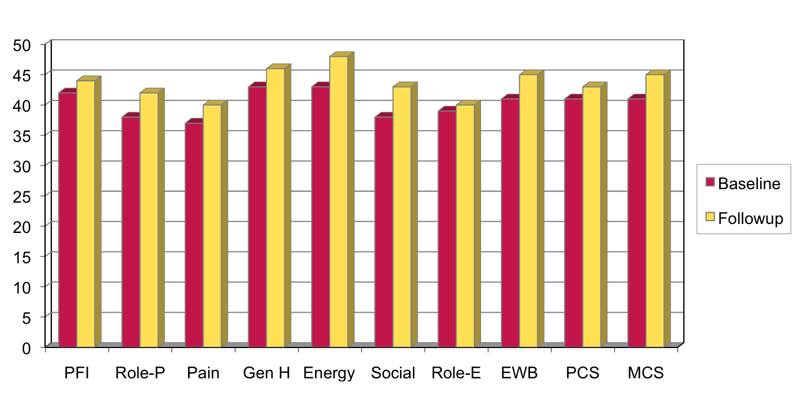
Effect Sizes for Changes in
SF-36 Scores
Effect Size
0.13
0.35
0.35
0.21
0.53
0.36
0.11
0.41
0.24
0.30
Energy = Energy/Fatigue; EWB = Emotional Well-being; Gen H=General Health; MCS =Mental Component Summary; Pain = Bodily Pain; PCS = Physical Component Summary; PFI = Physical Functioning; Role-E = Role-Emotional; Role-P = Role-Physical; Social = Social Functioning

Slide 41
Significant Improvement in all but 1 of SF-36 Scales (Change is in T-score metric)
Change
t-test
prob.
PF-10
1.7
2.38
.0208
RP-4
4.1
3.81
.0004
BP-2
3.6
2.59
.0125
GH-5
2.4
2.86
.0061
EN-4
5.1
4.33
.0001
SF-2
4.7
3.51
.0009
RE-3
1.5
0.96
.3400
EWB-5
4.3
3.20
.0023
PCS
2.8
3.23
.0021
MCS
3.9
2.82
.0067

Slide 42
Defining a Responder: Reliable Change Index (RCI)
RCI >=1.96 is statistically significant individual change..

Slide 43
Amount of Change in Observed Score
Needed for Significant Individual Change
Scale
RCI
Effect size
Cronbach’s alpha
PF-10
8.4
0.67
0.94
RP-4
8.4
0.72
0.93
BP-2
10.4
1.01
0.87
GH-5
13.0
1.13
0.83
EN-4
12.8
1.33
0.77
SF-2
13.8
1.07
0.85
RE-3
9.7
0.71
0.94
EWB-5
13.4
1.26
0.79
PCS
7.1
0.62
0.94
MCS
9.7
0.73
0.93
43

Slide 44
7-31% of People in Sample Improve Significantly
% Improving
% Declining
Difference
PF-10
13%
2%
+ 11%
RP-4
31%
2%
+ 29%
BP-2
22%
7%
+ 15%
GH-5
7%
0%
+ 7%
EN-4
9%
2%
+ 7%
SF-2
17%
4%
+ 13%
RE-3
15%
15%
0%
EWB-5
19%
4%
+ 15%
PCS
24%
7%
+ 17%
MCS
22%
11%
+ 11%

Slide 45

Questions?
Contact Information:
drhays@ucla.edu (310-794-2294)
Powerpoint file available for downloading at: http://gim.med.ucla.edu/FacultyPages/Hays/
Notes:
45

