Slide 1
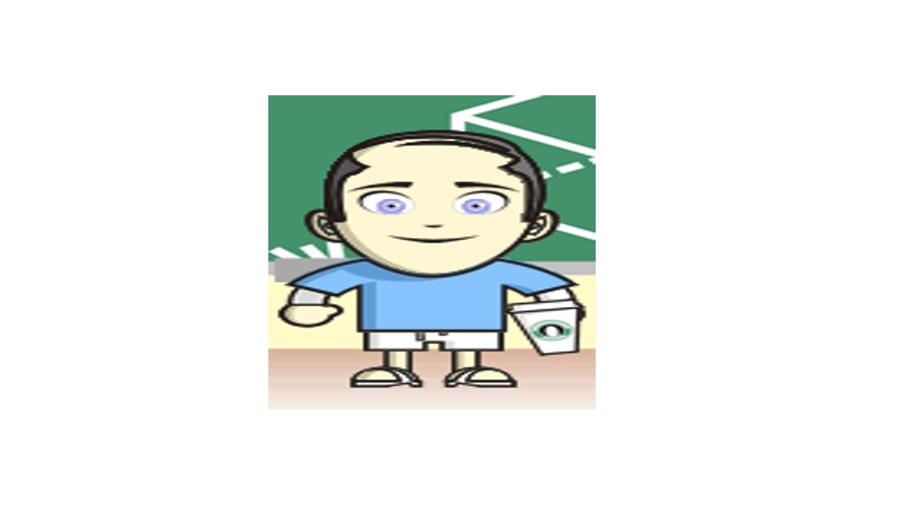
Patient-Centered Outcomes of Health Care
CTSI Training Module 3C
Comparative Effectiveness Research
January 23, 2014
8:30am – 12:30pm
CHS 17-187
Ron D.Hays, Ph.D.

Slide 2
Introduction to Patient-Reported Outcomes
8:30-9:30am

Slide 3

U.S. Health Care Issues
Access to care
~ 50 million people without health insurance
Costs of care
Expenditures ~ $ 2.7 Trillion
Effectiveness (quality) of care

Slide 4
How Do We Know If Care Is Effective?
Effective care maximizes probability of desired health outcomes
Health outcome measures indicate whether care is effective
Cost ↓
Effectiveness ↑

Slide 5
Health Outcomes Measures
Traditional clinical endpoints
Survival
Clinical/biological indicators
Rheumatoid factor
Blood pressure
Hematocrit
Patient-Reported Outcomes

Slide 6
Patient-Reported Measures (PRMs)
Mediators
Health behaviors (adherence)
Health Care Process
Reports about care (e.g., communication)
Outcomes (PROs)
Patient satisfaction with care
Health-Related Quality of Life (HRQOL)

Slide 7
Satisfaction With Care
Patient Characteristics
Health
Behaviors
(Adherence)
Quality
of Care
HRQOL
Technical Quality
Patient Reports About Care

Slide 8

Health-Related Quality of Life (HRQOL)
How the person FEELs (well-being)
Emotional well-being
Pain
Energy
What the person can DO (functioning)
Self-care
Role
Social

Slide 9

HRQOL is Not
Quality of environment
Type of housing
Level of income
Social Support

Slide 10
Types of HRQOL Measures
- Targeted vs. Generic
- Profile vs. Preference-based

Slide 11
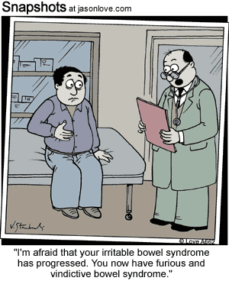
Targeted Item
During the last 4 weeks, how often were you angry about your irritable bowel syndrome?
None of the time
A little of the time
Some of the time
Most of the time
All of the time

Slide 12
Burden of Kidney Disease (Targeted Scale)
My kidney disease interferes too much with my life.
Too much of my time is spent dealing with my kidney disease.
I feel frustrated with my kidney disease.
I feel like a burden on my family.

Slide 13
Generic Item
In general, how would you rate your health?
Excellent
Very Good
Good
Fair
Poor

Slide 14
Does your health now limit you in walking more than a mile?
(If so, how much?)
Yes, limited a lot
Yes, limited a little
No, not limited at all

Slide 15
How much of the time during the past 4 weeks have you been happy?
None of the time
A little of the time
Some of the time
Most of the time
All of the time

Slide 16
Generic Profile (SF-36)
Physical functioning (10 items)
Role limitations/physical (4 items)
Role limitations/emotional (3 items)
Social functioning (2 items)
Emotional well-being (5 items)
Energy/fatigue (4 items)
Pain (2 items)
General health perceptions (5 items)

Slide 17
Scoring HRQOL Scales
Average or sum all items in the same scale.
Transform average or sum to
0 (worse) to 100 (best) possible range
z-score (mean = 0, SD = 1)
T-score (mean = 50, SD = 10)

Slide 18
Linear Transformations
X =
(original score - minimum) *100
(maximum - minimum)
Y
= target mean + (target SD * Zx)
(X - X)
Z_{X} =
SD_{X}

Slide 19
HRQOL in HIV Compared to other
Chronic Illnesses and General Population
T-score metric
Hays et al. (2000), American Journal of Medicine

Slide 20
Physical Health
Physical Health
Physical function
Role functionphysical
Pain
General Health

Slide 21
Mental Health
Mental Health
Emotional Well-Being
Role function-emotional
Energy
Social function

Slide 22
SF-36 PCS and MCS
PCS_z = (PF_Z * 0.42) + (RP_Z * 0.35) + (BP_Z * 0.32) + (GH_Z * 0.25) + (EF_Z * 0.03) + (SF_Z * -.01) + (RE_Z * -.19) + (EW_Z * -.22)
MCS_z = (PF_Z * -.23) + (RP_Z * -.12) + (BP_Z * -.10) + (GH_Z * -.02) + (EF_Z * 0.24) + (SF_Z * 0.27) + (RE_Z * 0.43) + (EW_Z * 0.49)
PCS = (PCS_z*10) + 50
MCS = (MCS_z*10) + 50

Slide 23
536 Primary Care Patients
Initiating Antidepressant Tx
3-month improvements in physical functioning, role—physical, pain, and general health perceptions ranging from 0.28 to 0.49 SDs.
Trivial < 0.20 SD
Small = 0.20 SD
Medium = 0.50 SD
Large = 0.80 SD
Yet SF-36 PCS did not improve.
Simon et al. (Med Care, 1998)

Slide 24
n = 194 with Multiple Sclerosis
Lower scores than general population on
Emotional well-being (↓ 0.3 SD)
Role—emotional (↓ 0.7 SD)
Energy (↓1.0 SD)
Social functioning (↓1.0 SD)
Yet SF-36 MCS was only 0.2 SD lower.
Nortvedt et al. (Med Care, 2000)

Slide 25
Farivar et al. alternative weights
PCS_z = (PF_z * .20) + (RP_z * .31) + (BP_z * .23) +
(GH_z * .20) + (EF_z * .13) + (SF_z * .11) +
(RE_z * .03) + (EW_z * -.03)
MCS_z = (PF_z * -.02) + (RP_z * .03) + (BP_z * .04) +
(GH_z * .10) + (EF_z * .29) + (SF_z * .14) +
(RE_z * .20) + (EW_z * .35)
Farivar, S. S., Cunningham, W. E., & Hays, R. D. (2007). Correlated physical and mental health summary scores for the SF-36 and SF-12 health survey, V. 1. Health and Quality of Life Outcomes, 5: 54. [PMCID: PMC2065865]

Slide 26
Is New Treatment (X) Better
Than Standard Care (O)?
X
0
X
0
Physical
Health
X > 0
Mental
Health
0 > X

Slide 27
Is Medicine Related to Worse HRQOL?
Medication
Person Use HRQOL (0-100)
1 No dead
2 No dead
3 No 50
4 No 75
5 No 100
6 Yes 0
7 Yes 25
8 Yes 50
9 Yes 75
10 Yes 100
Group n HRQOL
No Medicine 3 75
Yes Medicine 5 50

Slide 28
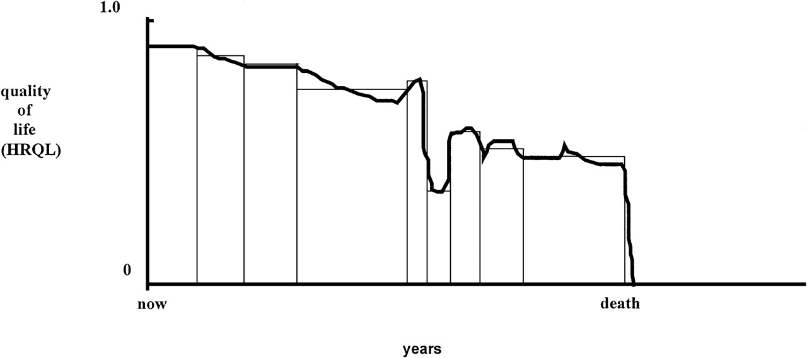
Quality of Life for Individual Over Time

Slide 29
Ultimate Use of HRQOL Measures-- Helping to Ensure Access to Cost-Effective Care
Cost ↓
Effectiveness (“Utility”) ↑

Slide 30
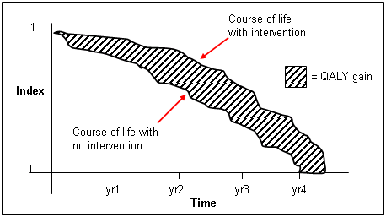
http://www.ukmi.nhs.uk/Research/pharma_res.asp

Slide 31
“QALYs: The Basics” Milton Weinstein, George Torrance, Alistair McGuire (Value in Health, 2009, vol. 12 Supplement 1)
What is value?
Preference or desirability of health states
How are QALYs used?
Societal resource allocation
Personal decisions such as decision about whether to have a treatment
Societal or program audit
Evaluate programs in terms of health of the population.

Slide 32
Direct Preference Measures
Underlying attributes unknown
Rating Scale
Standard gamble
Time tradeoff

Slide 33
Rating Scale
Overall, how would you rate your current health?
(Circle One Number)
0 1 2 3 4 5 6 7 8 9 10
Worst possible
health (as bad or
worse than
being dead)
Half-way
between worst
and best
Best
possible
health

Slide 34
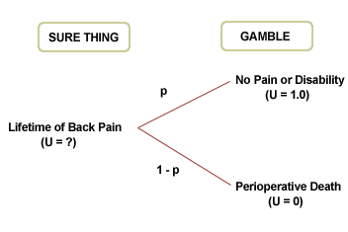
Standard Gamble

Slide 35
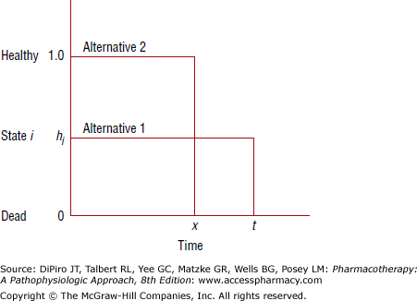
Time Tradeoff
Alternative 1 is current health for time “t” (given), followed by death.
Alternative 2 is full health for time “x” (elicited), followed by death.
x/t = preference for current health

Slide 36
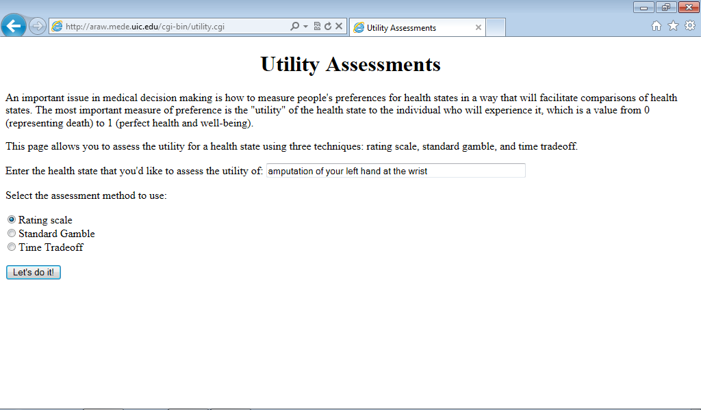
http://araw.mede.uic.edu/cgi-bin/utility.cgi
http://araw.mede.uic.edu/cgi-bin/utility.cgi

Slide 37
SG>TTO>RS
SG = TTOª
SG = RS^{b}
^{Where a and b are less than 1}

Slide 38
Indirect Preference Measures
Attributes know
Based on “societal preferences” a single score is assigned
Quality of Well-Being (QWB) Scale
EQ-5D
HUI2 and HUI3
SF-6D

Slide 39
Quality of Well-Being (QWB) Scale
• Summarize HRQOL in QALYs
– Mobility (MOB)
– Physical activity (PAC)
– Social activity (SAC)
– Symptom/problem complexes (SPC)
Dead
Well-Being
0
1
• Well-Being Formula: w = 1 + MOB + PAC + SAC + SPC

Slide 40
Quality of Well-Being Weighting Procedure
Each page in this booklet tells how an imaginary person is affected by a health problem on one day of his or her life. I want you to look at each health situation and rate it on a ladder with steps numbered from zero to ten.
The information on each page tells 1) the person's age group, 2) whether the person could drive or use public transportation, 3) how well the person could walk, 4) how well the person could perform the activities usual for his or her age, and 5) what symptom or problem was bothering the person.
Adult (18-65)
Drove car or used public transportation without help (MOB)
Walked without physical problems (PAC)
Limited in amount or kind of work, school, or housework (SAC)
Problem with being overweight or underweight (SYM)
10
Perfect Health
9
8
7
6
5
4
3
2
1
0
Death

Slide 41
EQ-5D (243 states, 3 levels each)
Mobility
Self-care
Usual activities
Pain/discomfort
Anxiety/depression
http://www.euroqol.org/

Slide 43
SF-6D
Brazier et al. (1998, 2002)
— 6-dimensional classification (collapsed role scales, dropped general health)
— Uses 11 SF-36 items (8 SF-12 and 3 additional physical functioning items)
--- 18,000 possible states
-— 249 states rated by sample of 836 from UK general population
http://www.shef.ac.uk/scharr/sections/heds/mvh/sf-6d

Slide 44
Health state 424421 (0.59)
Your health limits you a lot in moderate activities (such as moving a table, pushing a vacuum cleaner, bowling or playing golf)
You are limited in the kind of work or other activities as a result of your physical health
Your health limits your social activities (like visiting friends, relatives etc.) most of the time.
You have pain that interferes with your normal work (both outside the home and housework) moderately
You feel tense or downhearted and low a little of the time.
You have a lot of energy all of the time

Slide 45
Correlations Among Indirect Measures
 | EQ-5D | HUI2 | HUI3 | QWB-SA | SF-6D
EQ-5D | 1.00
HUI2 | 0.71 | 1.00
HUI3 | 0.68 | 0.89 | 1.00
QWB | 0.64 | 0.66 | 0.66 | 1.00
SF-6D | 0.70 | 0.71 | 0.69 | 0.65 | 1.00
Fryback, D. G. et al., (2007). US Norms for Six Generic Health-Related Quality-of-Life Indexes from the National Health Measurement Study. Medical Care, 45, 1162- 1170.

Slide 46
Change in Indirect Preference Measures Over Time
 | Cataract (1 mon. – B) | Heart F (6 mons. – B)
HUI3 | 0.05 | 0.02
HUI2 | 0.03 | 0.00
QWB-SA | 0.02 | 0.03
EQ-5D | 0.02 | 0.00
SF-6D | 0.00 | 0.01
Kaplan, R. M. et al. (2011). Five preference-based indexes in cataract and heart failure patients were not equally responsive to change. J Clinical Epidemiology, 64, 497-506.
ICC for change was 0.16 for cataract and 0.07 for heart failure.
Feeny, D. et al. (2011). Agreement about identifying patients who change over time: Cautionary results in cataract and heart failure patients. Medical Decision Making, 32 (2), 273-286.

Slide 47

Break #1

Slide 48
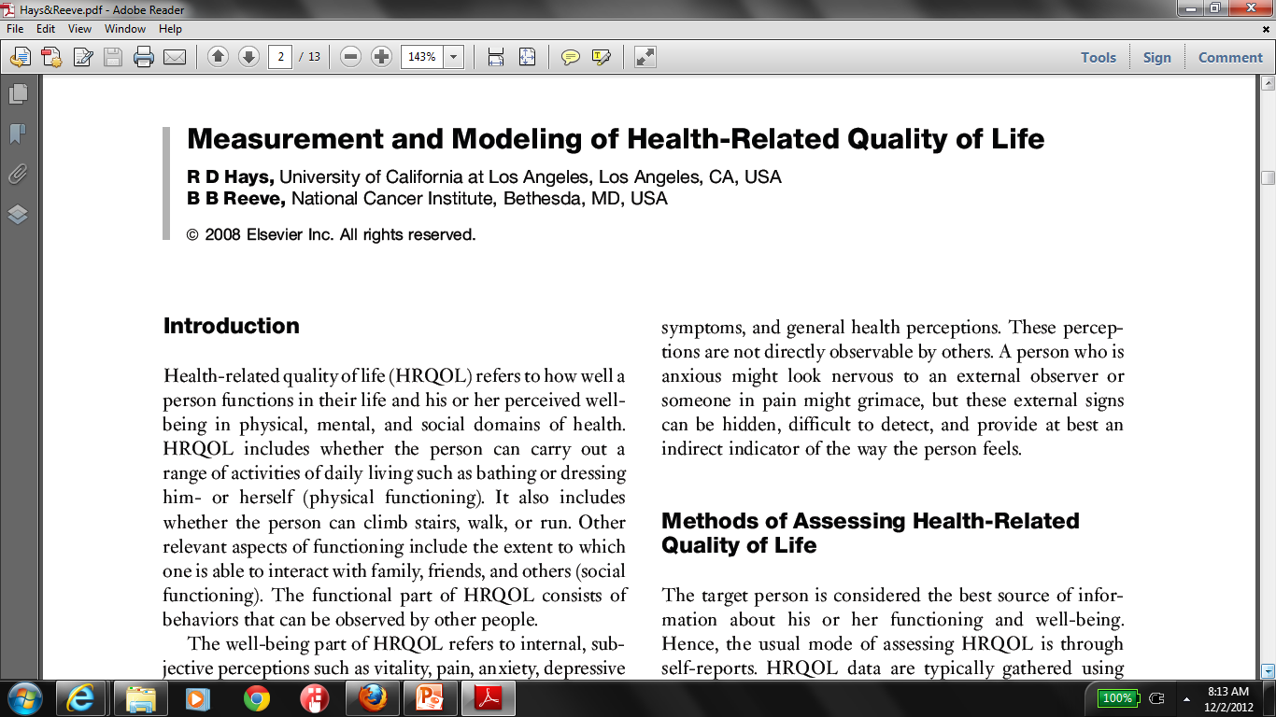
Development and Evaluation of Patient-reported Outcomes
9:45-10:45am

Slide 49
End goal is measure that is “Psychometrically Sound”
Same people get same scores
Different people get different scores and differ in the way you expect
Measure works the same way for different groups (age, gender, race/ethnicity)
Measure is practical

Slide 50
Measurement Steps
Review literature
Focus groups
Define constructs and draft items
Pretest (cognitive interviews)
Revise items
Field test
Analyze and finalize items

Slide 51
Focus Groups
Discuss feelings, attitudes, perceptions
Learn
Vocabulary and thinking patterns
Conversational meeting
Moderator and 6-12 people
Questions posed
Group synergy
Economical

Slide 52
Pretesting
“Cut and try, see how it looks and sounds, see how people react to it, and then cut again, and try again” Converse & Presser (1986, p. 78)
Identify problems with
Comprehension of items (stem/response options)
Retrieval of information
Skip patterns
Response burden

Slide 53
Cognitive Interviews
“Think aloud”
Intermittent probes
Retrospective recall

Slide 54
Flesch-Kincaid Grade Level
FK GL = 0.39 * (n of words/n of sentences) + 11.8 * (n of syllables/n of words)
– 15.59
Driven by sentence length and syllables per word
U.S. school grade level (e.g., 8.0 implies that 8th grader can understand the document).
Possible minimum = -3.4
Green eggs and ham averages 5.7 words per sentence and 1 syllable per word
(FK GL = -1.3)

Slide 55
Listed below are a few statements about your relationships with others. How much is each statement TRUE or FALSE for you Definitely Mostly Don’t Mostly Definitely True True Know False False
1. I am always courteous even
to people who are disagreeable. 1 2 3 4 5
2. There have been occasions when
I took advantage of someone. 1 2 3 4 5
3. I sometimes try to get even rather
than forgive and forget. 1 2 3 4 5
4. I sometimes feel resentful when I
don’t get my way. 1 2 3 4 5
5. No matter who I’m talking to, I’m
always a good listener. 1 2 3 4 5

Slide 56
Scoring Multi-Item Scales
Average or sum all items in the same scale.
Transform average or sum to
0 (worse) to 100 (best) possible range
z-score (mean = 0, SD = 1)
T-score (mean = 50, SD = 10)

Slide 57
Listed below are a few statements about your relationships with others. How much is each statement TRUE or FALSE for you Definitely Mostly Don’t Mostly Definitely True True Know False False
1. I am always courteous even
to people who are disagreeable. 100 75 50 25 0
2. There have been occasions when
I took advantage of someone. 0 25 50 75 100
3. I sometimes try to get even rather
than forgive and forget. 0 25 50 75 100
4. I sometimes feel resentful when I
don’t get my way. 0 25 50 75 100
5. No matter who I’m talking to, I’m
always a good listener. 100 75 50 25 0

Slide 58
Create T-score
z-score = (score – 36)/31
T-score = (10 * z-score) + 50
z-score = (100- 36)/31 = 2.06
T-score = 71

Slide 59
Reliability
Extent to which measure yields similar result when the thing being measured hasn’t changed
Ranges from 0-1
Notes:
59

Slide 60
Reliability and Intraclass Correlation
Model
Reliability
Intraclass Correlation
One-way
Two-way fixed
Two-way random
BMS = Between Ratee Mean Square N = n of ratees
WMS = Within Mean Square k = n of items or raters
JMS = Item or Rater Mean Square
EMS = Ratee x Item (Rater) Mean Square
Notes:
60

Slide 61
Two-Way Fixed Effects (Cronbach’s Alpha)
01 34
02 45
03 33
04 21
05 54
06 22
Respondents (BMS) 5 15.67 3.13
Items (JMS) 1 0.00 0.00
Resp. x Items (EMS) 5 2.00 0.40
Total 11 17.67
Source
df
SS
MS
Alpha =
3.13 - 0.40 = 2.93 = 0.87
ICC = 0.77
3.13
3.13
Notes:
61

Slide 62
Reliability Minimum Standards
0.70 or above (for group comparisons)
0.90 or higher (for individual assessment)
SEM = SD (1- reliability)^{1/2}
95% CI = true score +/- 1.96 x SEM
if true z-score = 0, then CI: -.62 to +.62
Width of CI is 1.24 z-score units
Notes:
62

Slide 63
Range of reliability estimates
0.80-0.90 for blood pressure
0.70-0.90 for multi-item self-report scales
Hahn, E. A., Cella, D., et al. (2007). Precision of health-related
quality-of-life data compared with other clinical measures.
Mayo Clin Proceedings, 82 (10), 1244-1254.

Slide 64
Category Response Curves
Appreciating each day.
No change
Very great change
Great change
Moderate change
Small change
Very small change
No Change
Great Change
θ

Slide 65

Item-scale correlation matrix
Notes:
65

Slide 66

Item-scale correlation matrix
66
Notes:
66

Slide 67
Validity
Content validity
Patients and/or experts judge the items to be representing the intended concept adequately
Construct validity
Extent to which associations with other variables are consistent with prior hypotheses

Slide 68
Self-Reports of Physical Health Predict Five-Year Mortality
%
Dead
(n=676)
(n=754)
(n=1181)
(n=609)
SF-36 Physical Health Component Score (PCS)—T score
Ware et al. (1994). SF-36 Physical and Mental Health Summary Scales: A User’s Manual.

Slide 69
Mortality Prediction with a Single General Self-Rated Health Question
DeSalvo, K. B., Bloser, N., Reynolds, K., He, J., & Muntner, P. (2005). Mortality prediction with a single general self-rated health question: A meta-analysis. JGIM, 20, 267-275.

Slide 70
Evaluating Construct Validity
Scale | Age | Obesity | ESRD | Nursing Home Resident
Physical Functioning | Medium (-) | Small (-) | Large (-) | Large (-)
Depressive Symptoms | ? | Small (+) | ? | Small (+)
Cohen effect size rules of thumb (d = 0.2, 0.5, and 0.8):
Small correlation = 0.100
Medium correlation = 0.243
Large correlation = 0.371
r = d / [(d² + 4)^{.5}] = 0.8 / [(0.8² + 4)^{.5}] = 0.8 / [(0.64 + 4)^{.5}] = 0.8 / [( 4.64)^{.5}] = 0.8 / 2.154 = 0.371
Beware: r’s of 0.10, 0.30 and 0.50 are often cited as small, medium, and large.

Slide 71
Responsiveness to Change
Valid measures should be responsive to interventions that change the thing being measured.
Compare change on measure to change indicated on external indicator of change (“anchor”)

Slide 72
Listed below are a few statements about your relationships with others. How much is each statement TRUE or FALSE for you?
I am always courteous even to people who are disagreeable.
There have been occasions when I took advantage of someone.
I sometimes try to get even rather than forgive and forget.
I sometimes feel resentful when I don’t get my way.
No matter who I’m talking to, I’m always a good listener.
Definitely True/Mostly True/Don’t Know/Mostly False/Definitely False

Slide 73
Break #2

Slide 74

Use of Patient-Reported Outcome Measures in Research
11:00-11:50am

Slide 75
Course of Emotional Well-being Over 2-years for Patients in the MOS General Medical Sector
Hypertension
Diabetes
0-100 range
Major Depression
Baseline
2-Years
Hays, R.D., Wells, K.B., Sherbourne, C.D., Rogers, W., & Spritzer, K. (1995). Functioning and well-being outcomes of patients with depression compared to chronic medical illnesses. Archives of General Psychiatry, 52, 11-19.

Slide 76
Physical Functioning in Relation to Time Spent Exercising 2-years Before
84
82
80
78
76
74
72
70
68
66
64
62
Hypertension
Diabetes
0-100 range
Current Depression
Low
High
Total Time Spent Exercising
Stewart, A.L., Hays, R.D., Wells, K.B., Rogers, W.H., Spritzer, K.L., & Greenfield, S. (1994). Long-term functioning and well-being outcomes associated with physical activity and exercise in patients with chronic conditions in the Medical Outcomes Study. Journal of Clinical Epidemiology, 47, 719-730.

Slide 77
Specific Aims
Among Medicare managed care beneficiaries …
1) Do the associations of different types of cancer and (non-cancer) chronic conditions with health-related quality of life vary among Medicare managed care beneficiaries?
2) Do the associations between cancer and health-related quality of life vary by stage of disease?
Hays, R. D., Reeve, B. B., Smith, A. W., & Clauser, S. B. (2013, epub). Associations of cancer and other chronic medical conditions with SF-6D preference-based scores in Medicare beneficiaries. Quality of Life Research.

Slide 78
Surveillance, Epidemiology and End Results (SEER) program of cancer registries that collect standardized clinical and demographic information for persons with newly diagnosed (incident) cancer in specific geographical areas
Began in 1973 and covers ̃ 26% of U.S. pop.
http://seer.cancer.gov/registries/list.html
California, Connecticut, Hawaii, Iowa, Kentucky, Louisiana, New Mexico, New Jersey, Utah
Atlanta, Detroit, rural Georgia, Seattle-Puget Sound metropolitan areas

Slide 79
Medicare Health Outcomes Survey (MHOS)
95-item survey administered to 1,000 randomly selected beneficiaries (including institutionalized and disabled) in Medicare managed care plans
Baseline and follow-up survey (2 years later).
63-72% response rates for baseline surveys
MHOS respondents matched using identifiers to SEER-Medicare file for 4 cohorts (1998 to 2003).
http://outcomes.cancer.gov/surveys/seer-mhos/

Slide 80
Sample (n = 126,366)
55% female
79% non-Hispanic white, 7% Hispanic, 5% Black, 5% Asian
60% married
58% high school graduate or less
51% < $30,000 income

Slide 81
Dependent Variable = SF-6D
SF-36 health survey, version 1
11 of 36 questions representing 6 of 8 domains
Physical functioning
Role limitations
Social function
Pain
Emotional well-being
Energy/fatigue
Standard gamble elicitation of preferences from a population sample in the UK.
Scores for those alive range from 0.30 to 1.00 (dead = 0.00).

Slide 82
10 Cancer Conditions (n = 22,740; 18%)
Prostate cancer (n = 5,593; 4%)
Female breast Cancer (n = 4,311; 3%)
Colorectal cancer (n = 3,012; 2%)
Non-small cell lung cancer (n = 1,792; 1%)
Bladder cancer (n = 1,299; 1%)
Melanoma (n = 1,135; 1%)
Endometrial cancer (n = 902; 1%)
Non-Hodgkin’s lymphoma (n = 668; 1%)
Kidney cancer (n = 488; 0.4%)
Other cancer (n = 3,540; 3%)
Note: Those with more than one cancer diagnosis are excluded.

Slide 83
Historic Stage of Disease (time of diagnosis)
Localized
2045 breast, 2652 prostate, 1481 colorectal, 466 lung
Distant (metastatic)
26 breast, 61 prostate, 48 colorectal, 47 lung
Unstaged
347 breast, 633 prostate, 203 colorectal, 65 lung

Slide 84
13 Non-cancer Conditions (mean number = 2.44)
Hypertension n = 66,968 (53%)
Arthritis of the hip n = 44,524 (35%)
Arthritis of the hand n = 40,402 (32%)
Sciatica n = 26,878 (21%)
Other heart disease n = 25,455 (20%)
Diabetes n = 20,089 (16%)
Angina/coronary artery disease n = 18,017 (14%)
Chronic obstructive pulmonary disease n = 15,445 (12%)
Depressed in the last year n = 14,815 (12%)
Myocardial infarction/heart attack n = 11,982 ( 9%)
Stroke n = 9,479 ( 8%)
Congestive heart failure n = 7,893 ( 6%)
Inflammatory bowel disease n = 5,882 ( 5%)
Has a doctor ever told you that you had: …
In the past year, have you felt depressed or sad much of the time?

Slide 85
Demographic & Administration Variables
Age (continuous)
Education (8th grade or less; some high school; high school graduate; some college; 4 year college grad; > 4 year college)
Gender (male; female)
Income (<10k, 10-19999, 20-29999, 30-39999, 40-49999, 50-79999, 80k and above, don’t know or missing)
Race/ethnicity (Hispanic, non-Hispanic white, black, Asian, American Indian, other race, missing)
Marital status (married, widowed, divorced/separated/never married)
Proxy completed survey (11%)
Mode of administration (88% mail vs. 12% phone)

Slide 86
Results
Adjusted R-squared of 39% for 43 dfs
Intercept = 0.81
No chronic condition, average education and age, divorced/separated/never married, white, don’t know/missing income, phone mode)
SD = 0.14
Only 2 of 23 conditions had non-significant associations (melanoma, endometrial cancer)

Slide 87
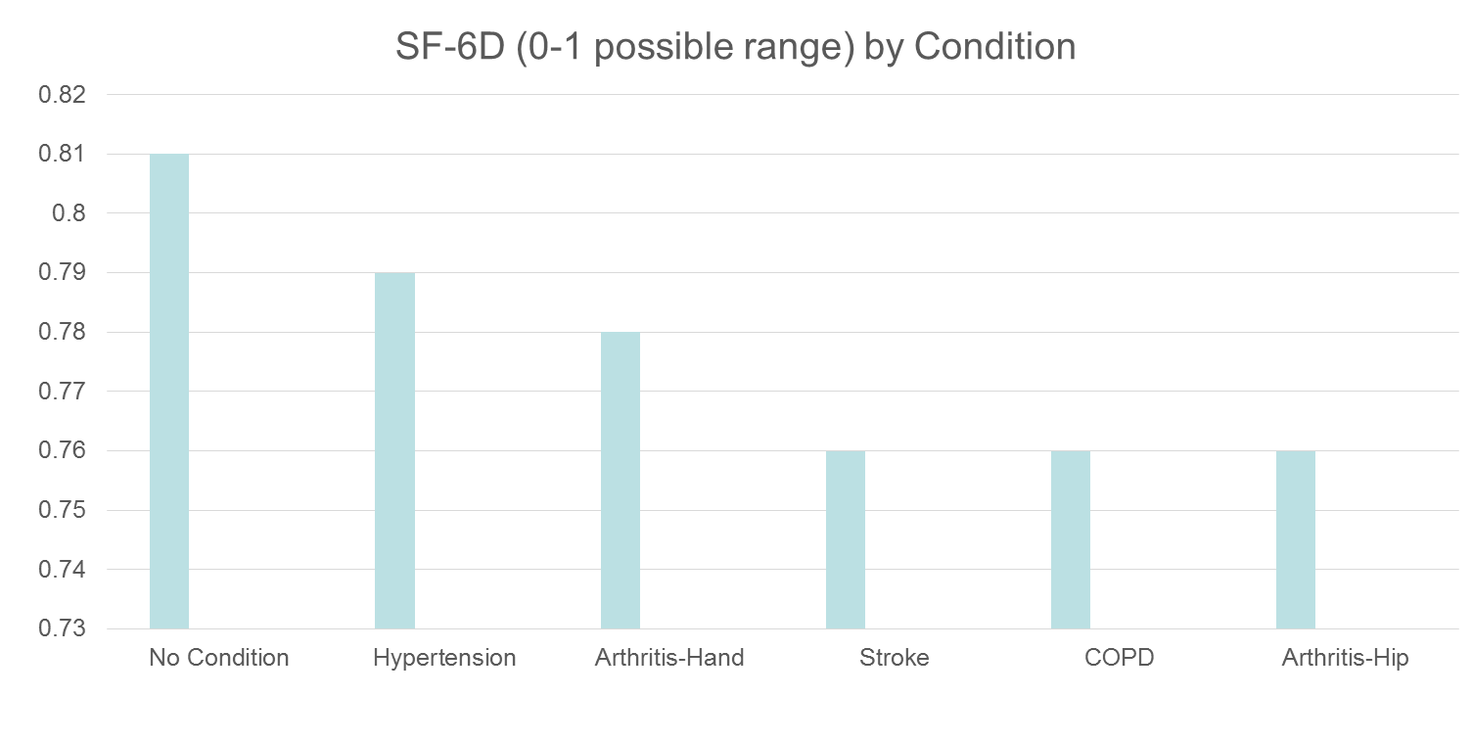
HRQOL in SEER-Medicare Health Outcomes Study (n = 126,366)
Controlling for age, gender, race/ethnicity, education, income, and marital status.

Slide 88
Distant stage of cancer associated with 0.05-0.10 lower SF-6D Score

Slide 89
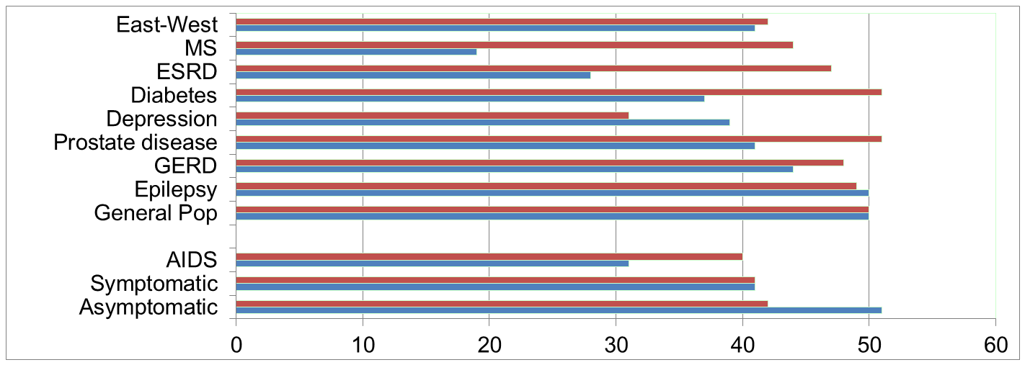
Physical Functioning and Emotional Well-Being at Baseline for 54 Patients at UCLA-Center for East West Medicine
EWB
Physical
MS = multiple sclerois; ESRD = end-stage renal disease; GERD = gastroesophageal reflux disease.
89

Slide 90
Significant Improvement in all but 1 of SF-36 Scales (Change is in T-score metric)
Change
t-test
prob.
PF-10
1.7
2.38
.0208
RP-4
4.1
3.81
.0004
BP-2
3.6
2.59
.0125
GH-5
2.4
2.86
.0061
EN-4
5.1
4.33
.0001
SF-2
4.7
3.51
.0009
RE-3
1.5
0.96
.3400
EWB-5
4.3
3.20
.0023
PCS
2.8
3.23
.0021
MCS
3.9
2.82
.0067

Slide 91
Effect Size
(Follow-up – Baseline)/ SD_{baseline}
_{Cohen’s Rule of Thumb:}
_{ES = 0.20 Small}
_{ES = 0.50 Medium}
_{ES = 0.80 Large}

Slide 92
Effect Sizes for Changes in SF-36 Scores
Effect Size
0.13
0.35
0.35
0.21
0.53
0.36
0.11
0.41
0.24
0.30
PFI = Physical Functioning; Role-P = Role-Physical; Pain = Bodily Pain; Gen H=General Health; Energy = Energy/Fatigue; Social = Social Functioning; Role-E = Role-Emotional; EWB = Emotional Well-being; PCS = Physical Component Summary; MCS =Mental Component Summary.

Slide 93
Break #3

Slide 94

Use of Patient-Reported Outcome Measures in Clinical Practice
12:00-12:30 pm

Slide 95
Defining a Responder: Reliable Change Index (RCI)
Note: SD_{bl} = standard deviation at baseline
r_{xx} = reliability

Slide 96
Amount of Change in Observed Score Needed To be Statistically Significant
Note: SD_{bl} = standard deviation at baseline and r_{xx} = reliability

Slide 97
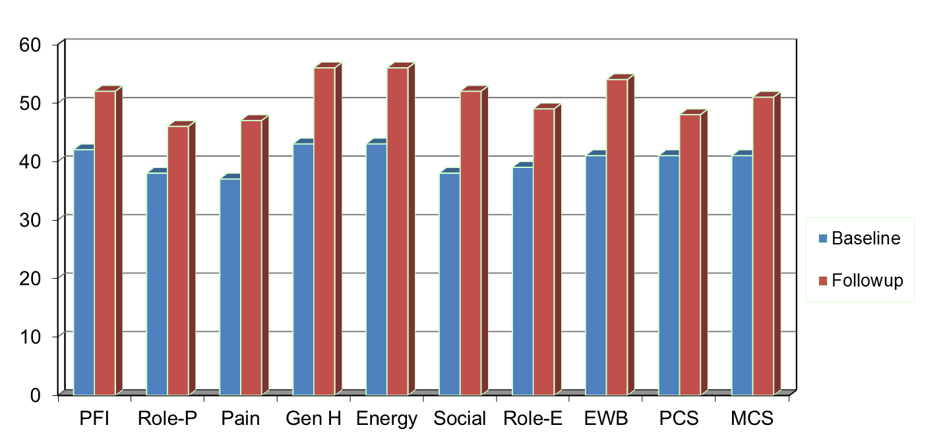
Amount of Change Needed for Significant Individual Change
Effect Size
0.67
0.72
1.01
1.13
1.33
1.07
0.71
1.26
0.62
0.73
PFI = Physical Functioning; Role-P = Role-Physical; Pain = Bodily Pain; Gen H=General Health; Energy = Energy/Fatigue; Social = Social Functioning;
Role-E = Role-Emotional; EWB = Emotional Well-being; PCS = Physical Component Summary; MCS =Mental Component Summary.

Slide 98
7-31% of People in Sample Improve Significantly
% Improving
% Declining
Difference
PF-10
13%
2%
+ 11%
RP-4
31%
2%
+ 29%
BP-2
22%
7%
+ 15%
GH-5
7%
0%
+ 7%
EN-4
9%
2%
+ 7%
SF-2
17%
4%
+ 13%
RE-3
15%
15%
0%
EWB-5
19%
4%
+ 15%
PCS
24%
7%
+ 17%
MCS
22%
11%
+ 11%

Slide 99
Item Responses and Trait Levels
Person 1
Person 2
Person 3
Trait
Continuum
Item 1
Item 2
Item 3
www.nihpromis.org

Slide 100




Computer Adaptive Testing (CAT)
Notes:
Early research on CAT was funded by the U.S. military to enhance mental measurement.
NASD = National Association of Security Dealers. In 1978 they began developing CAT for regulatory exam to assess knowledge of securities and securities future products among licensed brokers.
The National Council of State Boards of Nursing starting using CAT in 1994.

Slide 101
Reliability Target for Use of Measures with Individuals
Reliability ranges from 0-1
0.90 or above is goal
SEM = SD (1- reliability)^{1/2}
95% CI = true score +/- 1.96 x SEM
if true z-score = 0, then CI: -.62 to +.62
Width of CI is 1.24 z-score units
Reliability = 0.90 when SE = 3.2
T-scores (mean = 50, SD = 10)
Reliability = 1 – (SE/10)²
T = 50 + (z * 10)
Notes:
T = z*10 + 50

Slide 102
Reliability and SEM
For z-scores (mean = 0 and SD = 1):
Reliability = 1 – SE²
So reliability = 0.90 when SE = 0.32
For T-scores (mean = 50 and SD = 10):
Reliability = 1 – (SE/10)²
So reliability = 0.90 when SE = 3.2

Slide 103
In the past 7 days …
I was grouchy [1st question]
Never [39]
Rarely [48]
Sometimes [56]
Often [64]
Always [72]
Estimated Anger = 56.1
SE = 5.7 (rel. = 0.68)
Notes:
Never: 39
Rarely: 48
Sometimes = 56
Often = 64
Always = 72

Slide 104
In the past 7 days …
I felt like I was ready to explode
[2nd question]
Never
Rarely
Sometimes
Often
Always
Estimated Anger = 51.9
SE = 4.8 (rel. = 0.77)

Slide 105
In the past 7 days …
I felt angry [3rd question]
Never
Rarely
Sometimes
Often
Always
Estimated Anger = 50.5
SE = 3.9 (rel. = 0.85)

Slide 106
In the past 7 days …
I felt angrier than I thought I should [4th question]
- Never
Rarely
Sometimes
Often
Always
Estimated Anger = 48.8
SE = 3.6 (rel. = 0.87)

Slide 107
In the past 7 days …
I felt annoyed [5th question]
Never
Rarely
Sometimes
Often
Always
Estimated Anger = 50.1
SE = 3.2 (rel. = 0.90)

Slide 108
In the past 7 days …
I made myself angry about something just by thinking about it. [6th question]
Never
Rarely
Sometimes
Often
Always
Estimated Anger = 50.2
SE = 2.8 (rel = 0.92)

Slide 109
PROMIS Physical Functioning vs. “Legacy” Measures
10 20 30 40 50 60 70

Slide 110
“Implementing patient-reported outcomes assessment in clinical practice: a review of the options and considerations”
Snyder, C.F., Aaronson, N. K., et al. Quality of Life Research, 21, 1305-1314, 2012.
HRQOL has rarely been collected in a standardized fashion in routine clinical practice.
Increased interest in using PROs for individual patient management.
Research shows that use of PROs:
Improves patient-clinician communication
May improve outcomes

Slide 111

Thank you
drhays@ucla.edu (310-794-2294). Powerpoint file available for downloading at: http://gim.med.ucla.edu/FacultyPages/Hays/
Disclosures. This presentation was supported by NIA Grant P30-AG021684. Dr. Hays receives no UCLA CTSI support.
Notes:
111

