Slide 1
Psychometric Evaluation of
DATA
Questionnaire Design and Testing Workshop
December 7 2015, 10:00-11:30 am
10940 Wilshire Suite 710
Notes:
1

Slide 2
Patient-Reported Outcomes (PROs)
“Any report of the status of a patient’s health condition that comes directly from the patient, without interpretation of the patient’s response by a clinician or anyone else”
Patient reports about their health
What they can do (functioning)
How they feel (well-being)
Notes:
Read slide
The PRO assesses a concept which can be..symptom, etc. or any other information that can only come from the patient and not from another objective or semi-objective measures.
The PRO should be evaluated and have evidence to support its validity in assessing a given concept prior to enrollment in the pivotal trial. This is of particular importance since PRO development is often an iterative process requiring multiple modifications of the measurement tool.

Slide 3
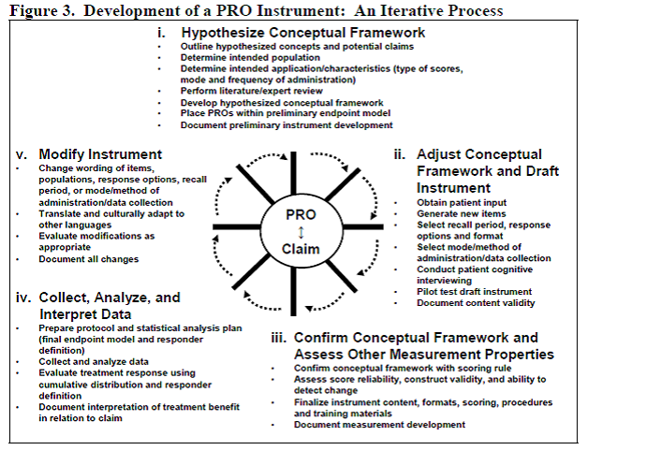
PRO Development Process
http://www.fda.gov/downloads/Drugs/GuidanceComplianceRegulatoryInformation/Guidances/UCM205269.pdf

Slide 4
PRO Development Process
http://www.fda.gov/downloads/Drugs/GuidanceComplianceRegulatoryInformation/Guidances/UCM205269.pdf

Slide 5
PRO Iterative Development Process
http://www.fda.gov/downloads/Drugs/GuidanceComplianceRegulatoryInformation/Guidances/UCM205269.pdf

Slide 6
PRO Iterative Development Process
http://www.fda.gov/downloads/Drugs/GuidanceComplianceRegulatoryInformation/Guidances/UCM205269.pdf

Slide 7
Physical Functioning
Ability to conduct a variety of activities ranging from self-care to running
Predictor of
Hospitalizations, institutionalization, and mortality
Six physical functioning items included in 2010 Consumer Assessment of Healthcare Providers and Systems (CAHPS®) Medicare Survey

Slide 8
Because of a health or physical problem are you unable to do or have any difficulty doing the following activities?
Walking?
Getting in our out of chairs?
Bathing?
Dressing?
Using the toilet?
Eating?
I am unable to do this activity (0)
Yes, I have difficulty (1)
No, I do not have difficulty (2)

Slide 9
Medicare beneficiary sample (n = 366,701)
58% female
57% high school education or less
14% 18-64; 48% 65-74, 29% 75-84, 9% 85+

Slide 10
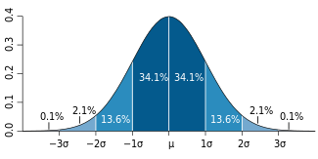
Normal Curve
Bell-shaped “normal” curve (68.2%, 95.4%, and 99.6%)

Slide 13
Item-Scale Correlations
Item | Item-Scale Correlations
Walking (0, 1, 2) | 0.71
Chairs (0, 1, 2) | 0.80
Bathing (0, 1, 2) | 0.83
Dressing (0, 1, 2) | 0.86
Toileting (0, 1, 2) | 0.84
Eating (0, 1, 2) | 0.75
Possible 6-item scale range: 0-12 (2% floor, 65% ceiling)

Slide 14
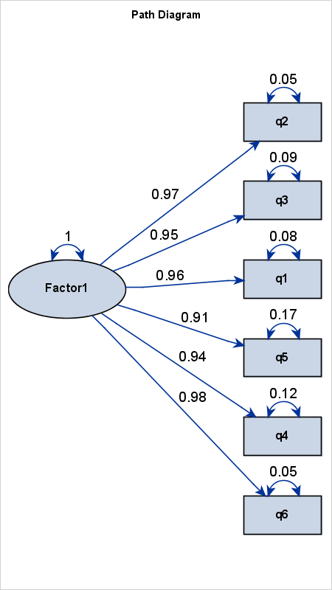
Confirmatory Factor Analysis (Polychoric* Correlations)
Dressing
Eating
Bathing
Walking
Chairs
Toileting
* Estimated correlation between two
underlying normally distributed
continuous variables
Residual correlations <= 0.04

Slide 15
Reliability
Degree to which the same score is obtained when the target or thing being measured (person, plant or whatever) has not changed.
Internal consistency (items)
Need 2 or more items
Test-retest (administrations) correlations
Need 2 or more time points

Slide 16
Reliability
Model
Reliability
Intraclass Correlation
Two-way random
Two-way mixed
One-way
BMS = Between Ratee Mean Square N = n of ratees
WMS = Within Mean Square k = n of items or raters
JMS = Item or Rater Mean Square
EMS = Ratee x Item (Rater) Mean Square
Notes:
16

Slide 17
Reliability Formulas
Model
Reliability
Intraclass Correlation
Two-way random
Two-way mixed
One-way
BMS = Between Ratee Mean Square N = n of ratees
WMS = Within Mean Square k = n of items or raters
JMS = Item or Rater Mean Square
EMS = Ratee x Item (Rater) Mean Square
Notes:
17

Slide 18
Internal Consistency Reliability (Coefficient Alpha)
Coefficient alpha = 0.92
(MS_{bms} – MS_{ems})/MS_{bms}
Ordinal alpha = 0.98
http://support.sas.com/resources/papers/proceedings14/2042-2014.pdf

Slide 19
Item-scale correlation matrix
(“Multi-trait Scaling”)
19
Notes:
19

Slide 20
Item-scale correlation matrix
20
Notes:
20

Slide 21
Item Response Theory (IRT)
IRT models the relationship between a person’s response Y_{i} to the question (i) and his or her level of the latent construct (θ) being measured by positing
b_{ik} estimates how difficult it is to have a score of k or more on item (i).
a_{i} estimates the discriminatory power of the item.

Slide 22
Normal Curve (bell-shaped)
z = -1 to 1 (68.2%); z = -2 to 2 (95.4%); z = -3 to 3 (99.6%)

Slide 26
Threshold #1 Parameter (Graded Response Model)
Physical Functioning | 1st Threshold Unable to do (lowest 2%)
Walking | -1.86
Chairs | -1.91
Bathing | -1.72
Dressing | -1.78
Toileting | -1.87
Eating | -1.98

Slide 27
Threshold #2 Parameter (Graded Response Model)
Physical Functioning |  | 2nd Threshold Unable to do or have difficulty
Walking |  | -0.55 (lowest 32%)
Chairs |  | -0.81
Bathing |  | -1.02
Dressing |  | -1.10
Toileting |  | -1.27
Eating |  | -1.53 (lowest 9%)

Slide 28
Item Parameters (Graded Response Model)
Physical Functioning | 1st Threshold Unable to do | 2nd Threshold Have difficulty | Slope (Discrimination)
Walking | -1.86 | -0.55 | 4.63
Chairs | -1.91 | -0.81 | 5.65
Bathing | -1.72 | -1.02 | 6.34
Dressing | -1.78 | -1.10 | 8.23
Toileting | -1.87 | -1.27 | 7.23
Eating | -1.98 | -1.53 | 4.87

Slide 31
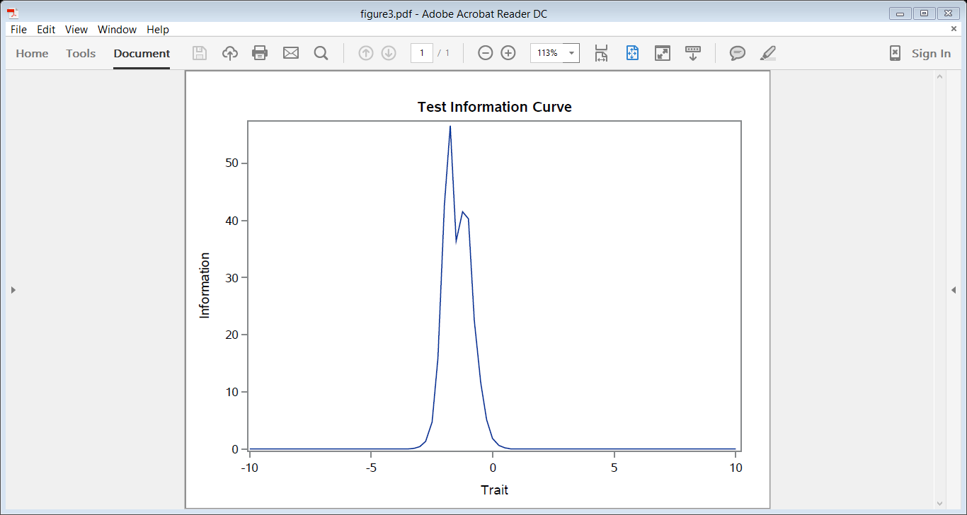
Reliability = (Info – 1) / Info
Reliability = 0.95
Reliability = 0.90

Slide 32
Validity
Content validity: Does measure “appear” to reflect what it is intended to (expert judges or patient judgments)?
Do items operationalize concept?
Do items cover all aspects of concept?
Does scale name represent item content?
Construct validity
Are the associations of the measure with other variables consistent with hypotheses?

Slide 33
Physical Function Scale Correlations
r = 0.39 (self-rated general health)
r = -0.23 (number of chronic conditions)
Cohen's rule of thumb for correlations that correspond to effect size rules of 0.20 SD, 0.50 SD and 0.80 SD are as follows: 0.100 is small correlation 0.243 is medium correlation 0.371 is large correlation
(r's of 0.10, 0.30 and 0.50 are often cited as small, medium and large, respectively).

Slide 34
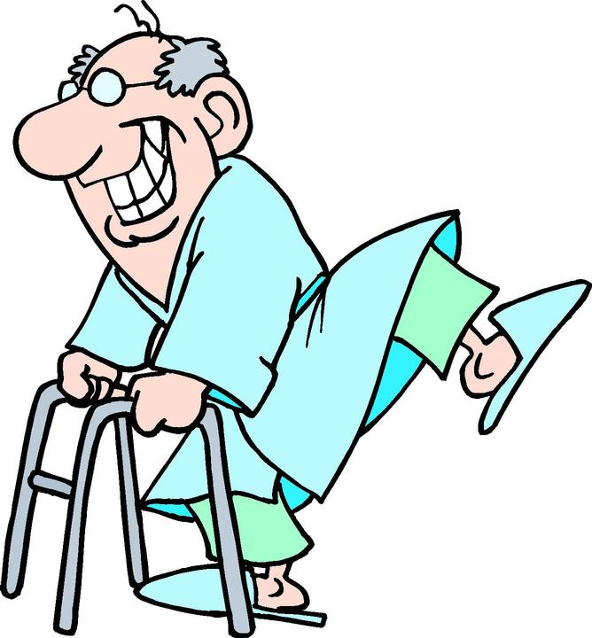
Summary
The 6 physical functioning items target relatively easy activities
Items representing higher levels of physical functioning are needed for the majority of Medicare beneficiaries.
Lifting or carrying groceries
Doing chores like vacuuming or yard work
Running a short distance

Slide 35
Differential Item Functioning (DIF)
Probability of choosing each response category should be the same for those who have the same estimated scale score, regardless of other characteristics
Evaluation of DIF by subgroups

Slide 36
DIF (2-parameter model)
Men
Women
White
Slope DIF
Location DIF
AA
I cry when upset
I get sad for no reason
Higher Score = More Depressive Symptoms
Notes:
36

Slide 37
Item Responses and Trait Levels
Person 1
Person 2
Person 3
Trait
Continuum
Item 1
Item 2
Item 3
www.nihpromis.org

Slide 38
Computer Adaptive Testing (CAT)
Notes:
Early research on CAT was funded by the U.S. military to enhance mental measurement.
NASD = National Association of Security Dealers. In 1978 they began developing CAT for regulatory exam to assess knowledge of securities and securities future products among licensed brokers.
The National Council of State Boards of Nursing starting using CAT in 1994.

Slide 39
Reliability Target for Use of Measures with Individuals
Reliability ranges from 0-1
0.90 or above is goal
SE = SD (1- reliability)^{1/2}
Reliability = 1 – (SE/10)²
Reliability = 0.90 when SE = 3.2
95% CI = true score +/- 1.96 x SE
Notes:
T = z*10 + 50

Slide 40
In the past 7 days …
I was grouchy [1st question]
Never [39]
Rarely [48]
Sometimes [56]
Often [64]
Always [72]
Estimated Anger = 56.1
SE = 5.7 (rel. = 0.68)
Notes:
Never: 39
Rarely: 48
Sometimes = 56
Often = 64
Always = 72

Slide 41
In the past 7 days …
I felt like I was ready to explode
[2nd question]
Never
Rarely
Sometimes
Often
Always
Estimated Anger = 51.9
SE = 4.8 (rel. = 0.77)

Slide 42
In the past 7 days …
I felt angry [3rd question]
Never
Rarely
Sometimes
Often
Always
Estimated Anger = 50.5
SE = 3.9 (rel. = 0.85)

Slide 43
In the past 7 days …
I felt angrier than I thought I should [4th question]
- Never
Rarely
Sometimes
Often
Always
Estimated Anger = 48.8
SE = 3.6 (rel. = 0.87)

Slide 44
In the past 7 days …
I felt annoyed [5th question]
Never
Rarely
Sometimes
Often
Always
Estimated Anger = 50.1
SE = 3.2 (rel. = 0.90)

Slide 45
In the past 7 days …
I made myself angry about something just by thinking about it. [6th question]
Never
Rarely
Sometimes
Often
Always
Estimated Anger = 50.2
SE = 2.8 (rel = 0.92) (95% CI: 44.7-55.7)

Slide 46
Recommended Reading
Cappelleri, J. C., Lundy, J.J., & Hays, R. D. (2014). Overview of classical test theory and item response theory for quantitative assessment of items in developing patient-reported outcome measures. Clinical Therapeutics, 36 (5), 648-662

Slide 47
drhays@ucla.edu (310-794-2294). http://gim.med.ucla.edu/FacultyPages/Hays/
Notes:
47

