Slide 1

Use of Health-Related Quality of Life Measures to Assess Individual Patients
July 24, 2014 (1:00 – 2:00 PDT)
Kaiser Permanente Methods Webinar Series
Ron D.Hays, Ph.D. drhays@ucla.edu

Slide 2
Physical Functioning and Emotional Well-Being at Baseline for 54 Patients at UCLA-Center for East West Medicine
EWB
Physical
MS = multiple sclerosis; ESRD = end-stage renal disease; GERD = gastroesophageal reflux disease.
2

Slide 3
Significant Improvement in all but 1 of SF-36 Scales (Change is in T-score metric)
Change
t-test
prob.
PF-10
1.7
2.38
.0208
RP-4
4.1
3.81
.0004
BP-2
3.6
2.59
.0125
GH-5
2.4
2.86
.0061
EN-4
5.1
4.33
.0001
SF-2
4.7
3.51
.0009
RE-3
1.5
0.96
.3400
EWB-5
4.3
3.20
.0023
PCS
2.8
3.23
.0021
MCS
3.9
2.82
.0067

Slide 4
Effect Size
(Follow-up – Baseline)/ SD_{baseline}
_{Cohen’s Rule of Thumb:}
_{ES = 0.20 Small}
_{ES = 0.50 Medium}
_{ES = 0.80 Large}

Slide 5
Effect Sizes for Changes in SF-36 Scores
Effect Size
0.13
0.35
0.35
0.21
0.53
0.36
0.11
0.41
0.24
0.30
PFI = Physical Functioning; Role-P = Role-Physical; Pain = Bodily Pain; Gen H=General Health; Energy = Energy/Fatigue; Social = Social Functioning; Role-E = Role-Emotional; EWB = Emotional Well-being; PCS = Physical Component Summary; MCS =Mental Component Summary.
0.11 0.13 0.21 0.24 0.30 0.35 0.35 0.36 0.41 0.53

Slide 6
Defining a Responder: Reliable Change Index (RCI)
Note: SD_{bl} = standard deviation at baseline
r_{xx} = reliability

Slide 7
Significant Change
> = 1.96

Slide 8
Amount of Change in Observed Score Needed To be Statistically Significant
Note: SD_{bl} = standard deviation at baseline and r_{xx} = reliability

Slide 9
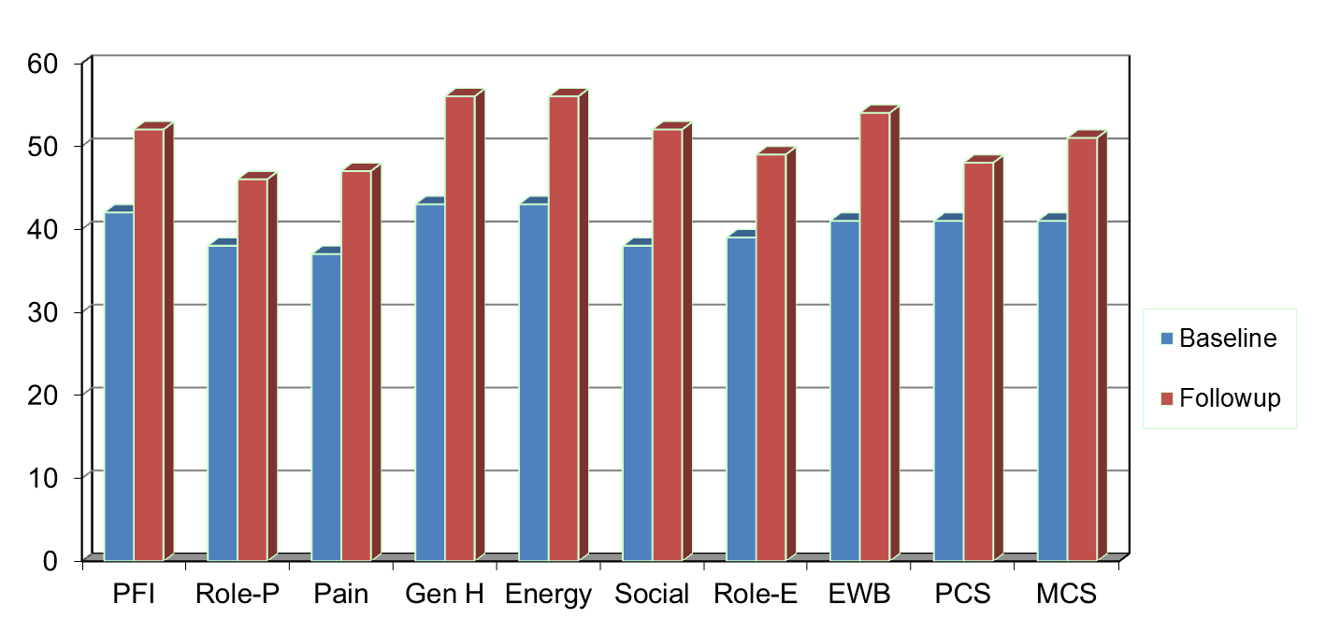
Amount of Change Needed for Significant Individual Change
Effect Size
0.67
0.72
1.01
1.13
1.33
1.07
0.71
1.26
0.62
0.73
PFI = Physical Functioning; Role-P = Role-Physical; Pain = Bodily Pain; Gen H=General Health; Energy = Energy/Fatigue; Social = Social Functioning;
Role-E = Role-Emotional; EWB = Emotional Well-being; PCS = Physical Component Summary; MCS =Mental Component Summary.

Slide 10
7-31% Improve Significantly
% Improving
% Declining
Difference
PF-10
13%
2%
+ 11%
RP-4
31%
2%
+ 29%
BP-2
22%
7%
+ 15%
GH-5
7%
0%
+ 7%
EN-4
9%
2%
+ 7%
SF-2
17%
4%
+ 13%
RE-3
15%
15%
0%
EWB-5
19%
4%
+ 15%
PCS
24%
7%
+ 17%
MCS
22%
11%
+ 11%

Slide 11
Item Responses and
Trait Levels
Person 1
Person 2
Person 3
Trait
Continuum
Item 1
Item 2
Item 3

Slide 12




Computer Adaptive Testing (CAT)

Slide 13
PROMIS Measures
Adult Health Measures
  More than 1,000 individual items (questions)
  51 distinct item banks or scales
  20 languages
Pediatric Health Measures
  More than 150 items (questions)
  18 distinct banks or scales
  8 languages
www.nihpromis.org

Slide 14
The PROMIS Metric
T Score
  Mean = 50
  SD = 10
  Referenced to US General Pop.
  T = 50 + (z * 10)
www.nihpromis.org

Slide 15
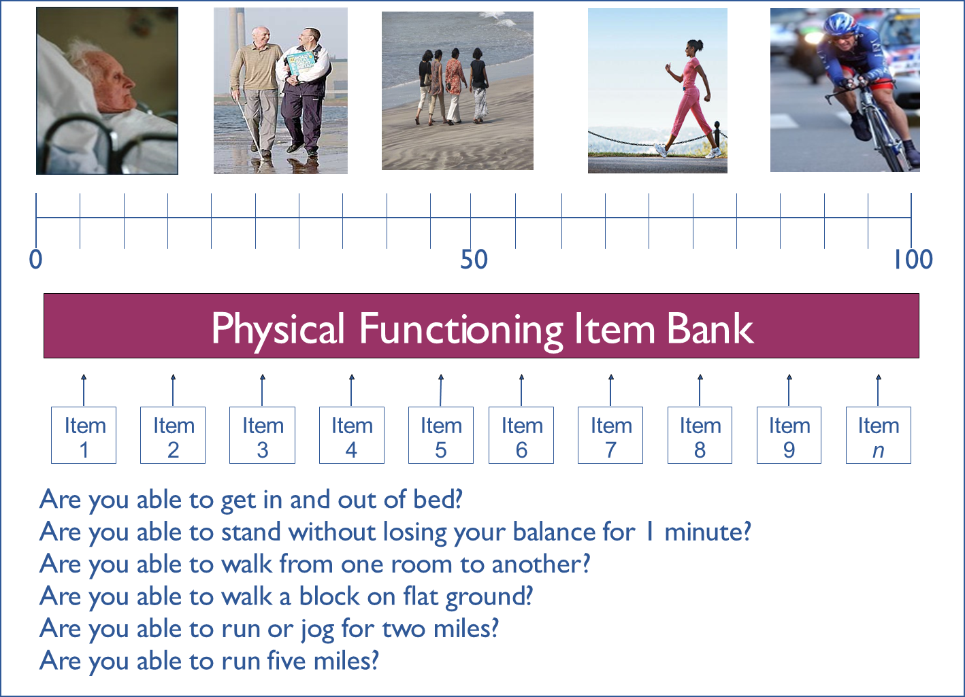

Slide 16

Normal Distribution
Within 1 SD = 68.2%, 2 SDs =95.4%; 3 SDs = 99.6%

Slide 17
Reliability Target for Use of Measures with Individuals
Reliability ranges from 0-1
  0.90 or above is goal
  SE = SD (1- reliability)^{1/2}
  Reliability = 1 – (SE/10)²
  Reliability = 0.90 when SE = 3.2
  95% CI = true score +/- 1.96 x SE
Notes:
T = z*10 + 50

Slide 18
In the past 7 days …
I was grouchy [1st question]
  Never [39]
  Rarely [48]
  Sometimes [56]
  Often [64]
  Always [72]
Estimated Anger = 56.1
SE = 5.7 (rel. = 0.68)

Slide 19
In the past 7 days …
I felt like I was ready to explode
[2nd question]
  Never
  Rarely
  Sometimes
  Often
  Always
Estimated Anger = 51.9
SE = 4.8 (rel. = 0.77)

Slide 20
In the past 7 days …
I felt angry [3rd question]
  Never
  Rarely
  Sometimes
  Often
  Always
Estimated Anger = 50.5
SE = 3.9 (rel. = 0.85)

Slide 21
In the past 7 days …
I felt angrier than I thought I should [4th question]
- Never
  Rarely
  Sometimes
  Often
  Always
Estimated Anger = 48.8
SE = 3.6 (rel. = 0.87)

Slide 22
In the past 7 days …
I felt annoyed [5th question]
  Never
  Rarely
  Sometimes
  Often
  Always
Estimated Anger = 50.1
SE = 3.2 (rel. = 0.90)

Slide 23
In the past 7 days …
I made myself angry about something just by thinking about it. [6th question]
  Never
  Rarely
  Sometimes
  Often
  Always
Estimated Anger = 50.2
SE = 2.8 (rel = 0.92)

Slide 24
PROMIS Physical Functioning vs. “Legacy” Measures
10 20 30 40 50 60 70

Slide 25
Person Fit
Large negative Z_{L} values indicate misfit.
  one person who responded to 14 of the PROMIS physical functioning items had a Z_{L} = -3.13
  For 13 items the person could do the activity (including running 5 miles) without any difficulty.
    But this person reported a little difficulty being out of bed for most of the day.

Slide 26
Person Fit
Item misfit significantly related to:
  Longer response time
  More chronic conditions
  Younger age

Slide 28
PROMIS CAT Report

Slide 30
“Implementing patient-reported outcomes assessment in clinical practice: a review of the options and considerations”
Snyder, C.F., Aaronson, N. K., et al. Quality of Life Research, 21, 1305-1314, 2012.
  HRQOL has rarely been collected in a standardized fashion in routine clinical practice.
  Increased interest in using PROs for individual patient management.
  Research shows that use of PROs:
    Improves patient-clinician communication
    May improve outcomes

Slide 31
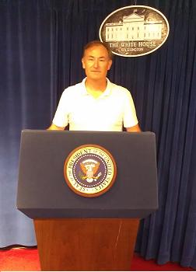
Thank you
drhays@ucla.edu (310-794-2294)
Powerpoint file available for downloading at: http://gim.med.ucla.edu/FacultyPages/Hays/
Notes:
31

Slide 32
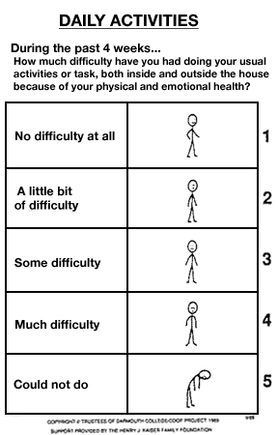
Appendix:
Dartmouth
COOP
Charts

