Slide 1


Estimating Individual Change
RCMAR Methods Seminar
November 18, 2019 (3-4pm)
1100 Glendon Ave (Suite 850, Room 852
https://drhays.dgsom.ucla.edu/pages/presentations

Slide 2
PROMIS® 4-item Physical Function Scale
T-score metric
  Mean of 50 and SD of 10 in U.S. general population
Items in the scale
Group-level change
Minimally important difference
Individual Change (Responder)
  Reliable Change Index

Slide 3
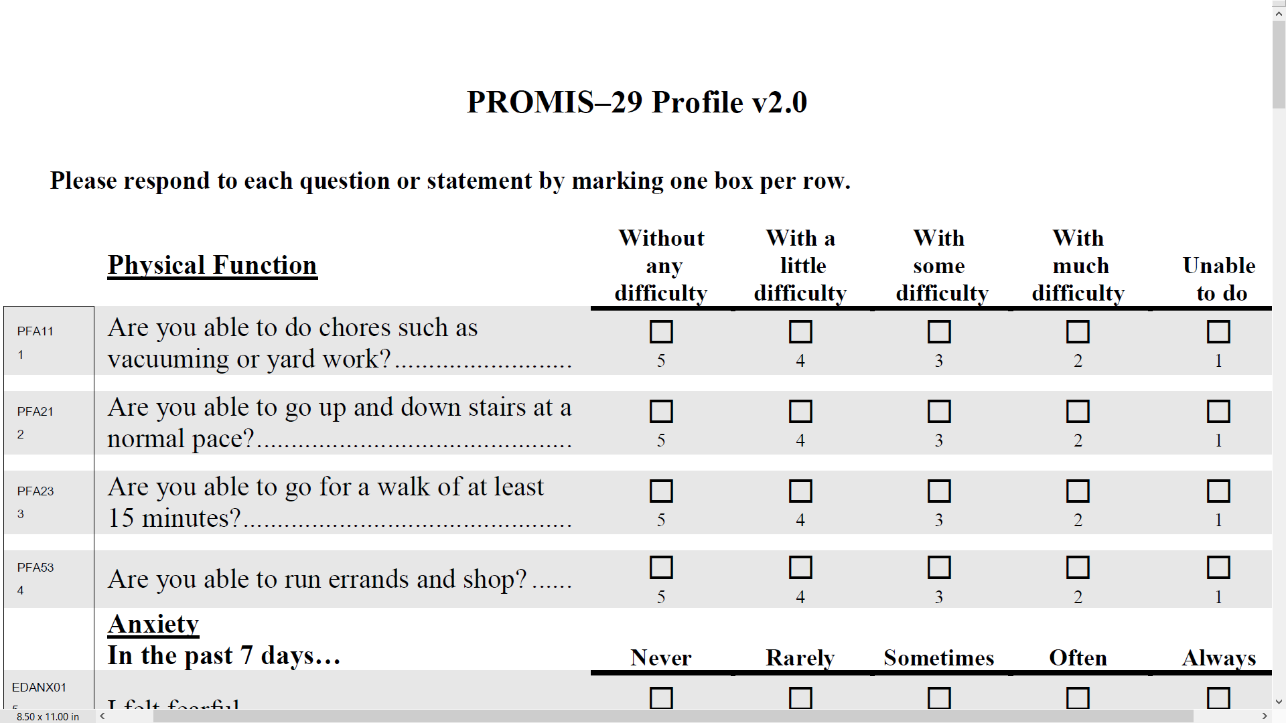

Slide 4
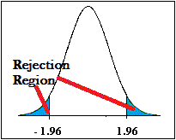

Group-Level Change in Physical Functioning from Baseline (46) to 3 months Later (47)
--
--
$$\frac{X_{2}−X_{1}}{ (SDd/\sqrt{n}}$$
>= 1.96
Within group t-test = 4.15
Effect size = Numerator/SD_{b} = 0.08

Slide 5
Minimally Important Difference (MID) Retrospective Rating of Change Anchor Item
We would like know about any changes in how you are feeling now compared to how you were feeling 6 months ago.
How has your ability to carry out your everyday physical activities such as walking, climbing stairs, carrying groceries, or moving a chair changed?
  Got a lot better
  Got a little better
  Stayed the same
  Got a little worse
  Got a lot worse

Slide 6
Raw Score Change on PROMIS
Physical Functioning (T-score) by Change on Anchor
 | Lot Better | Little Better | Same | Little Worse | Lot Worse
 | (n = 21) | (n = 35) | (n = 252) | (n = 113) | (n = 30)
Change | 1.94ª | 1.63^{a,b} | 0.27^{b} | -1.68^{c} | -3.20^{d}
Hays, R.D., Spritzer, K. L., Fries, J. F., & Krishnan, E. (2015). Responsiveness and minimally important
difference for the Patient-Reported Outcomes Measurement and Information System (PROMIS) 20-Item
Physical Functioning Short-Form in a Prospective Observational study of Rheumatoid Arthritis. Annals of
the Rheumatic Diseases. 74(1):104-7.

Slide 7
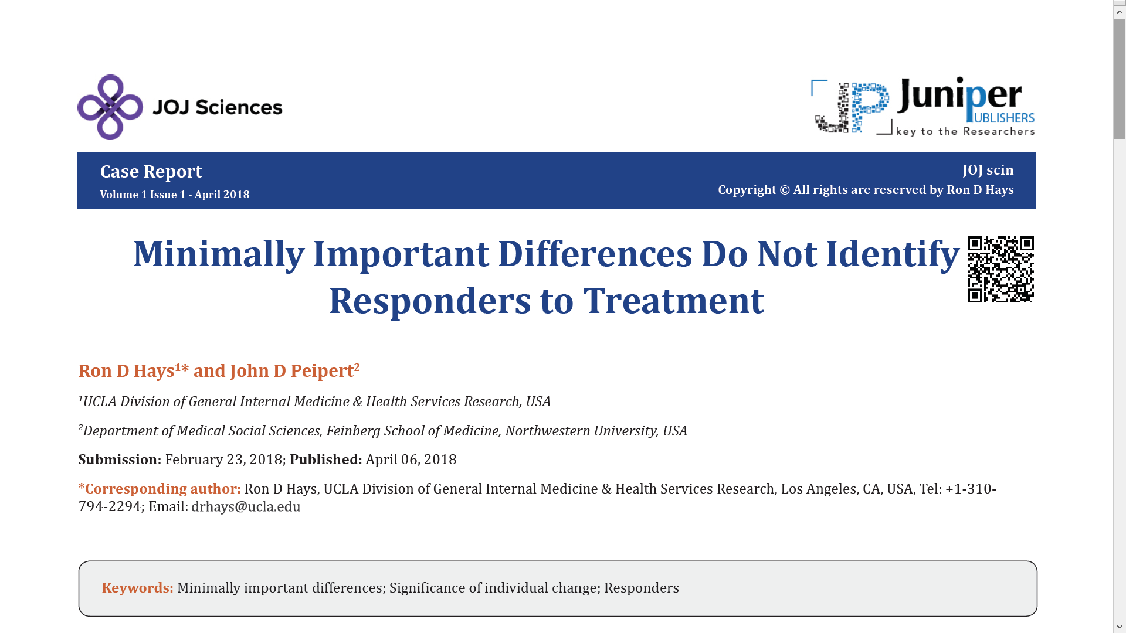

Slide 8
Reliable Change Index (RCI)
>= 1.96
SEM = standard error of measurement
SD_{bl} = standard deviation at baseline
r_{xx} = reliability

Slide 9
Amount of Change in Observed Score Needed To be Statistically Significant
= 2.77 *
SD
∗
1
−
r
xx
“Coefficient of repeatability” or “minimal detectable change” given measurement error of instrument
Note: SD = standard deviation and r_{xx} = reliability

Slide 10
Reliable Change Index (RCI)
>= 1.96
13% Got Better (Responders)
9% Got Worse
78% Stayed the Same

Slide 11
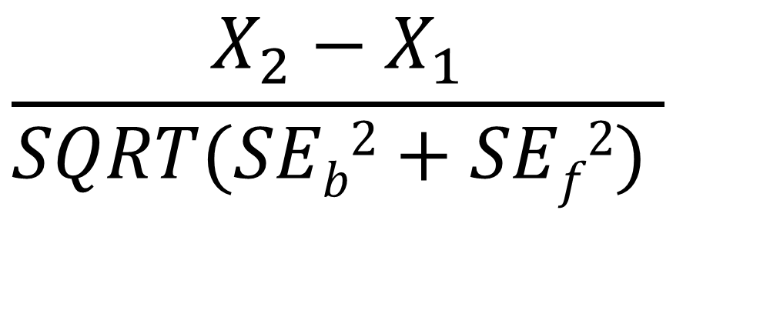
Reliable Change in IRT
$$\frac{X_{2}−X_{1}}{SQRT(SEb2+SEf2) }$$
Jabrayilov et al. (2016). Comparison of classical test theory
and item response theory in individual change assessment.
Appled Psychological Measurement, 40(8), 559-572.
Notes:
Standard errors are obtained using the information function. We use Expected A Posterior (EAP) estimates of physical function and associated standard errors.

Slide 12
Notes:
The standard error of measurement in the classical reliable change index is the same for everyone: in the sample.
SEM = SD * SQRT (1-reliability)
We used the average of the SEM at baseline and follow-up.
With item response theory the standard error depends on the responses to the items in the scale and where the person is on the underlying concept. We used expected a-posterior SDs to estimate standard errors for comparison to the CTT results. (SD of the posterior distribution).
78% of the patients stayed the same according to the CTT estimates versus 91% based on IRT.
Of the 1425 that were classified as the same according to CTT, 99% were also classified as the same by IRT.
However, only 27% of the 173 people that were worse according to CTT were classified as such by IRT. Similarly, only 38% of the 236 people classified as better by CTT were also deemed better by IRT.
The Spearman rank—order correlation between CTT and IRT categories of change was 0.54 (p = 0.0228).

Slide 13
78%
91%

Slide 14
27%
99%
38%
Spearman rank-order correlation = 0.54
*Δ = -13.7
SEM = 2.6, RCI_{CTT} = 3.7 versus SE = 7.1, RCI_{IRT} = 1.93

Slide 15
Physical Function Simulation
R mirt library
Simulated 10k response patterns for change in true “thetas”
-3.0, -2.0, -1.0, 0.0, 1.0, 2.0, 3.0
-3 to -2, -3 to -1, -3 to 0, -3 to 1, -3 to 2, -3 to 2, -3 to 3
-2 to -1, -2 to 0, -2 to 1, -2 to 2, -2 to 3
-1 to 0, -1 to 1, -1 to 2, -1 to 3
0 to 1, 0 to 2, 0 to 3
1 to 2, 1 to 3
2 to 3

Slide 16
0%
100%
33%

Slide 17
100%
100%
99.9%

Slide 18
100%
100%
100%

Slide 19
0%
100%
88%

Slide 20
100%
100%
100%

Slide 21
0%
100%
75%

Slide 22
100%
100%
89%

Slide 23
100%
100%
89%

Slide 24
100%
100%
89%

Slide 25
100%
100%
1%

Slide 26
0%
100%
1%

Slide 27
100%
100%
0%

Slide 28
0%
100%
0%

Slide 29
100%
100%
0%

Slide 30
100%
100%
0%

Slide 31

Thank you.
  Cella, D., Choi S. W. Condon, D. M., et al. (2019). PROMIS® adult health profiles: Efficient short-form measures of seven health domains. Value in Health, 22(5), 537-544.
  Hays, R. D., Spritzer, K. L., Sherbourne, C. D., Ryan, G. W., & Coulter, I. D. (2019). Group and individual-level change on health-related quality of life in chiropractic patients with chronic low back or neck pain. Spine, 44(9), 647-651.
  Hays, R. D., Spritzer, K. L., Schalet, B.D. , & Cella, D. (2018). PROMIS®-29 v2.0 profile physical and mental health summary scores. Quality of Life Research, 27, 1885-1891.
Notes:
Jabrayilov et al. did a simulation and concluded that IRT is superior to CTT in detection of individual change when a scale has 20 or more items, but CTT was superior for shorter scales.
The simulation used the Fisher information function to estimate IRT standard errors. We used expected a-posterior SDs here.
31

Slide 32
31%
100%
32%
Spearman rank-order correlation = 0.56

Slide 33
Physical Function Simulation
R mirt library
Simulated 10k response patterns for each of the following true thetas
-3.0, -2.5, -2.0, -1.5, -1.0, -0.5, 0.0, 0.5, 1.0, 1.5, 2.0, 2.5, 3.0
130,000 observations for baseline
130,000 observations for follow-up
Randomly linked baseline to follow-up simulated response patterns

Slide 34
51%
46%

Slide 35
98%
89%
98%
Spearman rank-order correlation = 0.94

